Slide 1
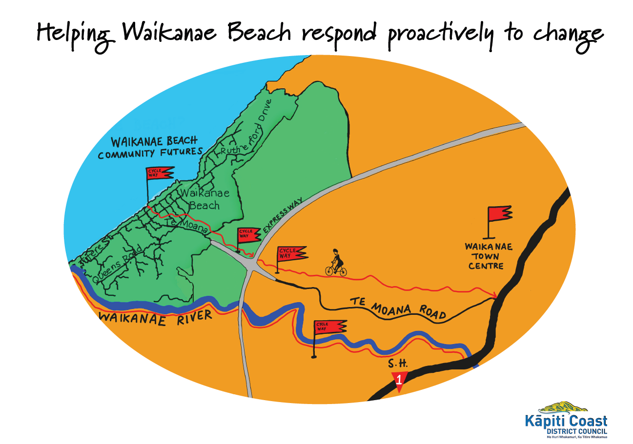
Community Futures Waikanae Beach -10 July 2016

Slide 4
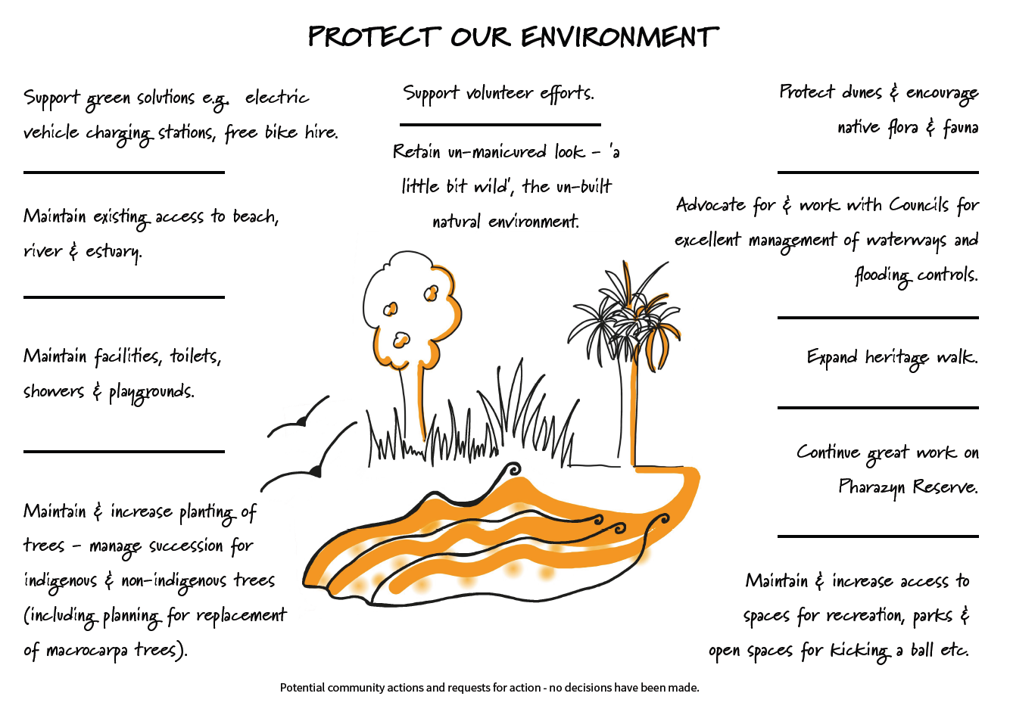

Slide 7
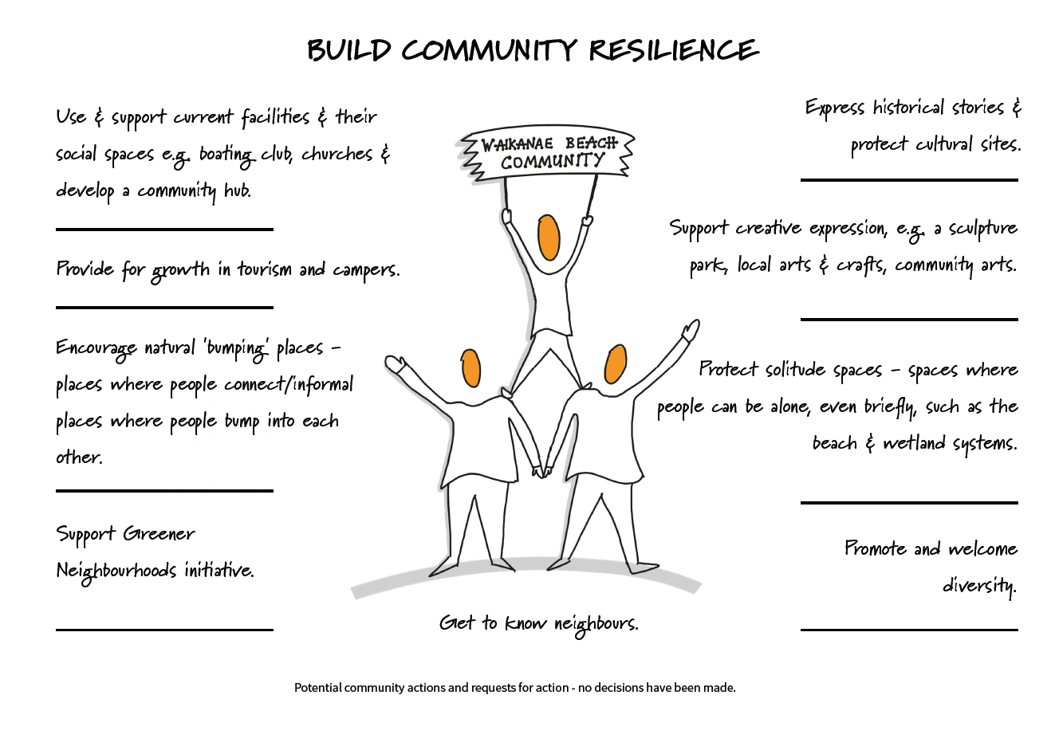

Slide 9
