Slide 1
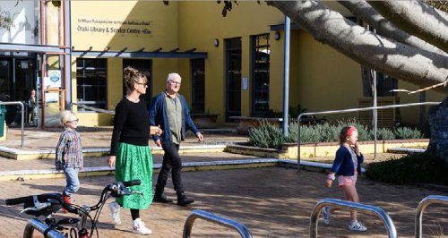
KCDC Speed Management Plan (Part B: Implementation 2024-27)
13/02/2025

Slide 2
Briefing purpose
Confirm process for implementing Part B (SMP) – Schools
Confirm the effect on individual schools following October 2024 Briefing
(Reflects Land Transport Rule: Setting of Speed Limits 2024)
(the ‘Rule’ - operable 10/24)

Slide 3
2023 SMP RECAP
October 2023
Speed Management Plan approved
June 2024 – SMP Implementation Plan, Part A (Completed)
13 schools – New 30km/h Variable Speed Limit (VSL) signs
7 roads – New permanent speed limits
New speed limits - enforceable
2024 to 27 - SMP Implementation Plan, Part B (To be completed)
Implement 30km/h speed limits
schools
towns/ villages

Slide 4
2024 Briefing summary (Oct. 24)
Part B: Implementation (Option 5)
Targets risk (schools)
Deferred until 2027-30 NLTP
Paekakariki speed humps (Wellington Rd) excl. RSP outside school
Waikanae Beach Village speed humps
Te Horo beach speed humps
Pedestrian crossing points (Te Moana, Tutere, Mazengarb)
Mill Road 30km/h permanent speed limit extension
Withdrawn – 2 sites (not permitted under the ‘Rule’)
Waikanae Town Centre (Marae Lane, Ngaio Street)
Raumati South (Poplar Ave)
Includes construction of Te Moana Pedestrian Refuge - east of Nimmo Street West

Slide 5
2024 Speed Limits Rule – Key messages
Roads fronting schools
30km/h Variable speed limits (not 30km/h permanent)
Consultation required
Speed Management Plans
Consultation NOT required
30km/h VSL fronting schools
Funding assistance
NTLP Dec’ 24 – now possible (application submitted)
NZTA Certification, either,
Speed Management Plan
Alternative Method

Slide 6
Confirm process
Submit Alternative Method (Not SMP) for remaining schools:
Via Excel template
NZTA certify – KCDC can then implement
Speed humps/ Raised pedestrian zebra crossings etc
8 schools
30km/h Variable speed limits
11 schools
Consultation
No consultation required as per ‘Rule’
Schools invited comment proposals prior to Xmas 2024
Consultation adjacent residents re signs/ speed humps*

Slide 7
Effects (Changes from Oct. 2024 briefing)
Paekākāriki –
2 x Speed humps deferred to 2027 – 30
Wellington Road raised pedestrian zebra crossing RETAINED
Te Ra Waldorf
Pedestrian platform REPLACED with temporary speed hump
Raumati Beach School
Raised pedestrian zebra crossing REMOVED (does not qualify)
30km/h variable SL REPLACES 30km/h permanent
Kapakapanui School
Proposed 30km/h VSL EXTENDED
Te kura-ā-iwi Whakatupuranga Rua Mano
Raised threshold REPLACED with Speed hump
30km/h variable SL REPLACES 30km/h permanent
Te Kura Kaupapa Māori o te Rito
30km/h variable SL REPLACES 30km/h permanent

Slide 8
Next Steps
February – KCDC submit alternative Method to NZTA*
March/ April - NZTA Certify Alternative Method
1st half 2025
Targeted consultation
Package 1 - 30km/h VSL signs
Package 2 - RSP’s/ speed humps/ speed cushions
Design commences
Package 1
Package 2
Construction of Te Moana Road Pedestrian Refuge
Late 2025/ early 2026 – Package 1 (Install)
1st half 2026 – Package 2 (Construct)

Slide 9
Ron Minnema
Transport Safety Lead
Te kaitaataki Waka Whakaruru
Ron.minnema@kapiticoast.govt.nz

Slide 10
APPENDIX: MAPS

Slide 11
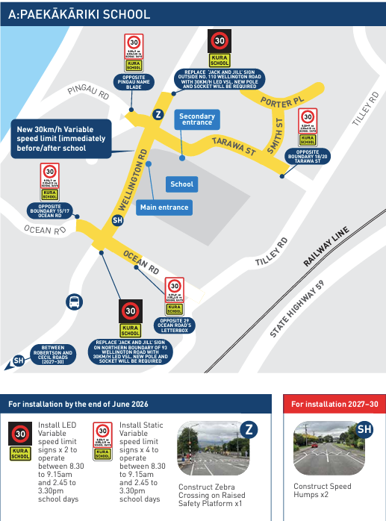

Slide 12
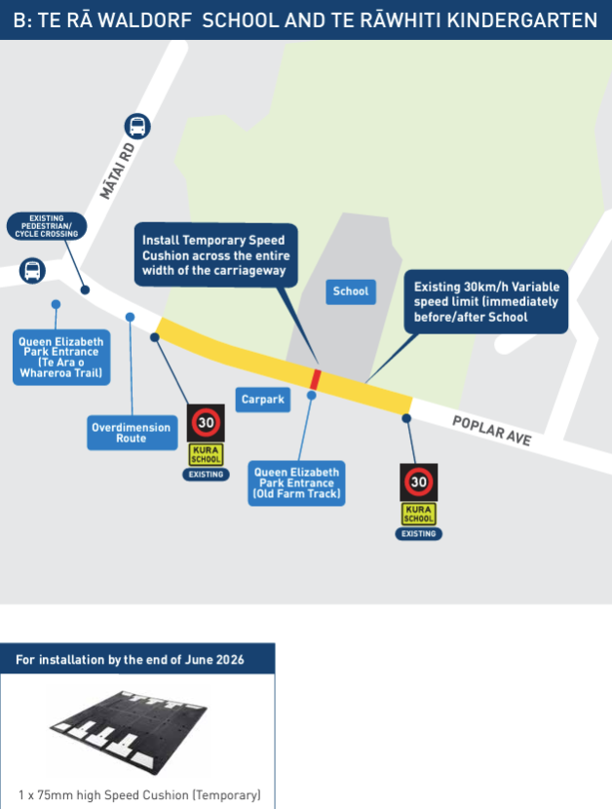

Slide 13
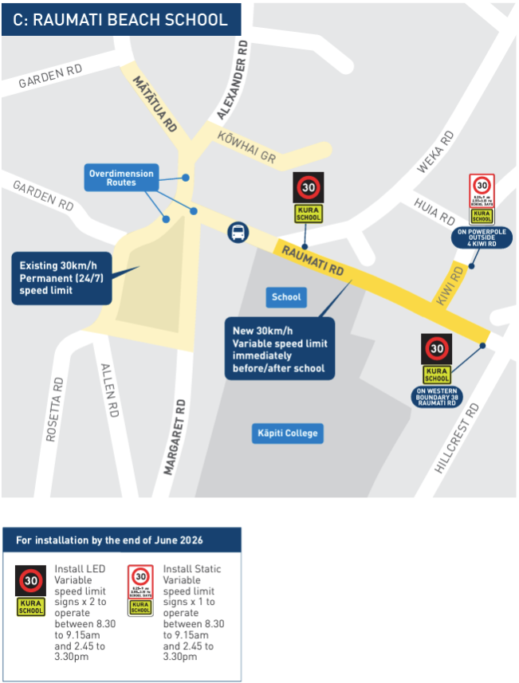

Slide 14
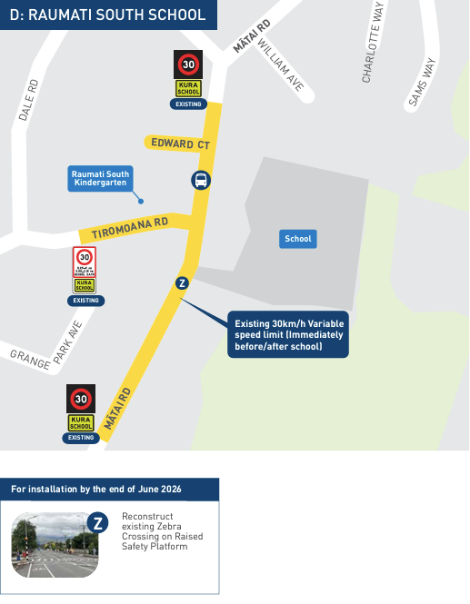

Slide 15
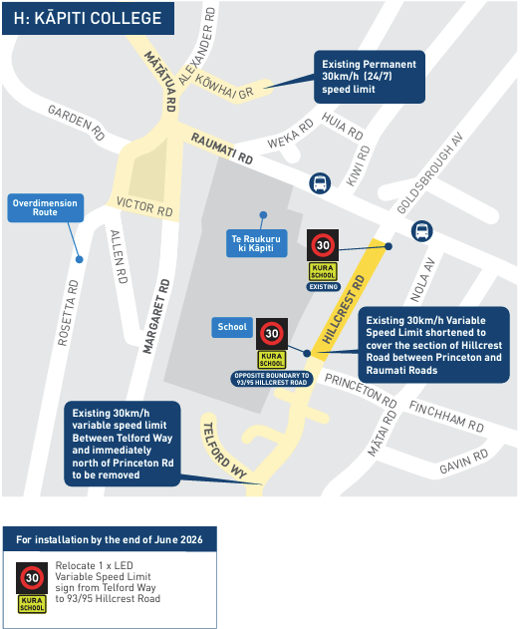

Slide 16
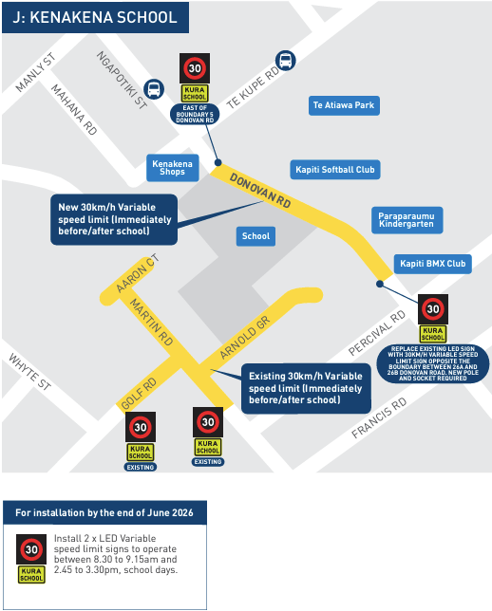

Slide 17
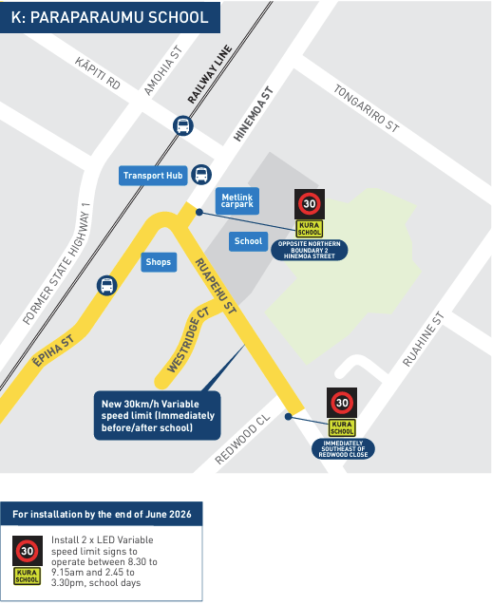

Slide 18
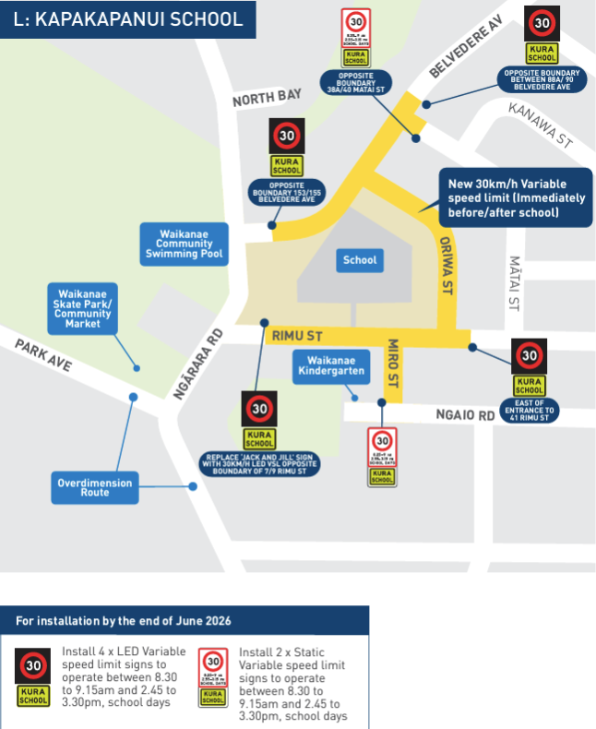

Slide 19
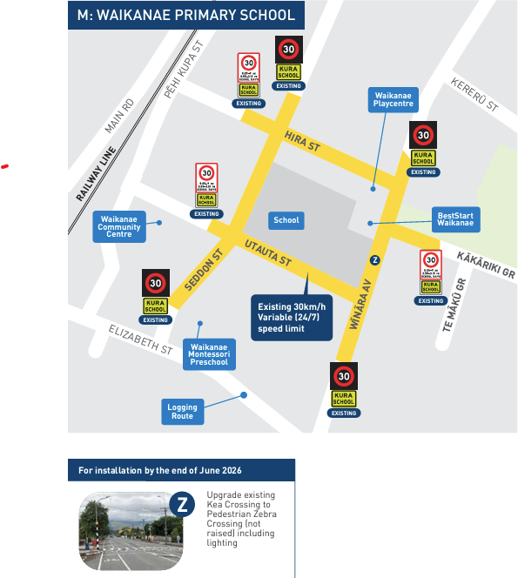

Slide 20
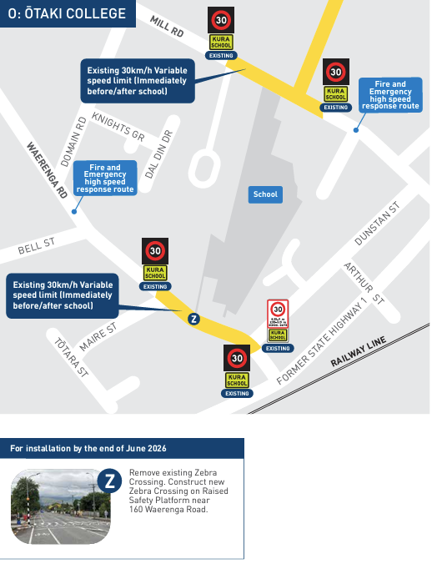

Slide 21
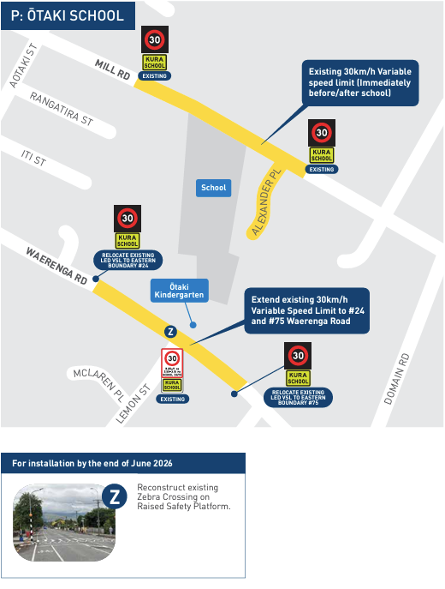

Slide 22
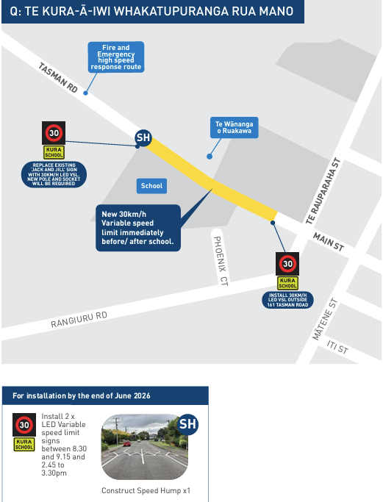

Slide 23
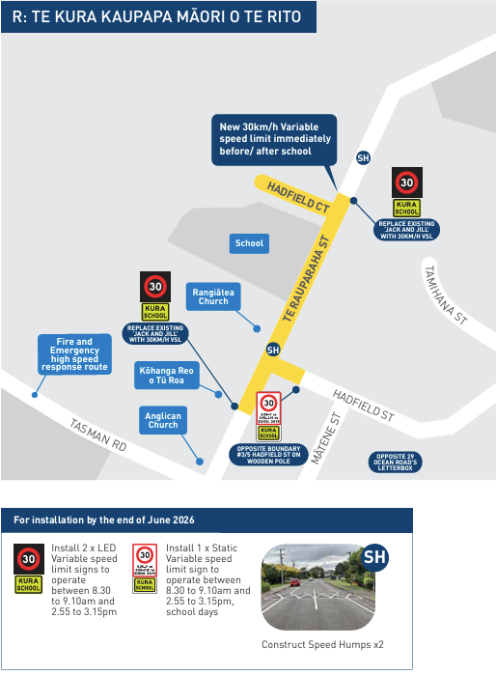

Slide 24
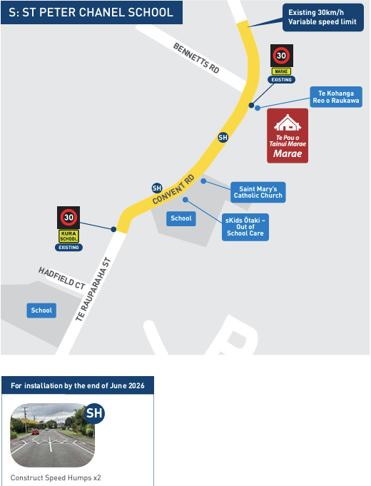

Slide 25
