Slide 1
Flood Hazard Mapping
Update

Slide 2
Outline
History / Background
New Model Build
Project Overview
Engagement Strategy
GW Major River Flooding Project

Slide 3
Flood Model History
RMA 1992 required Flood Hazards to be identified.
1998 flooding in Kapiti led to development of first hydraulic models (MIKE model).
Incorporated into the District Plan through Plan Change 51.
Included KCDC and GWRC hazard layers.
Updated mid 2010s

Slide 4
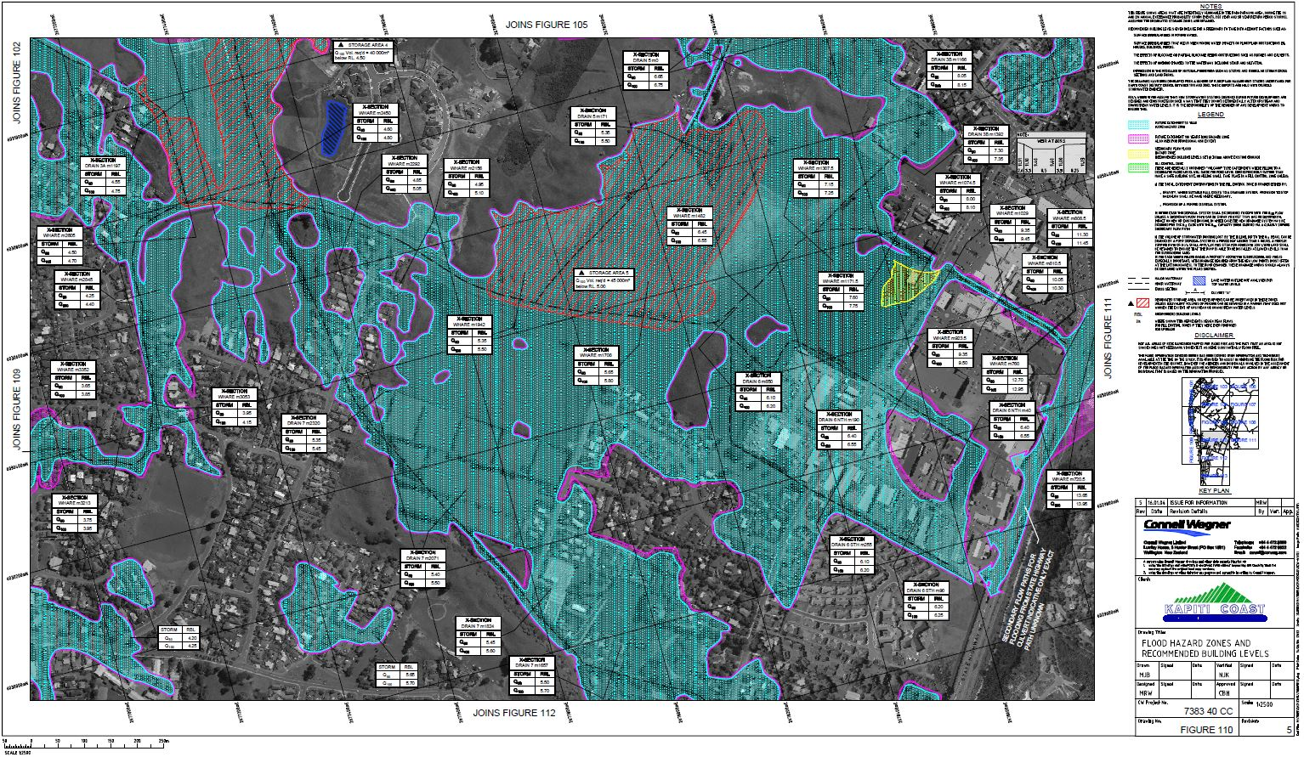

Slide 5
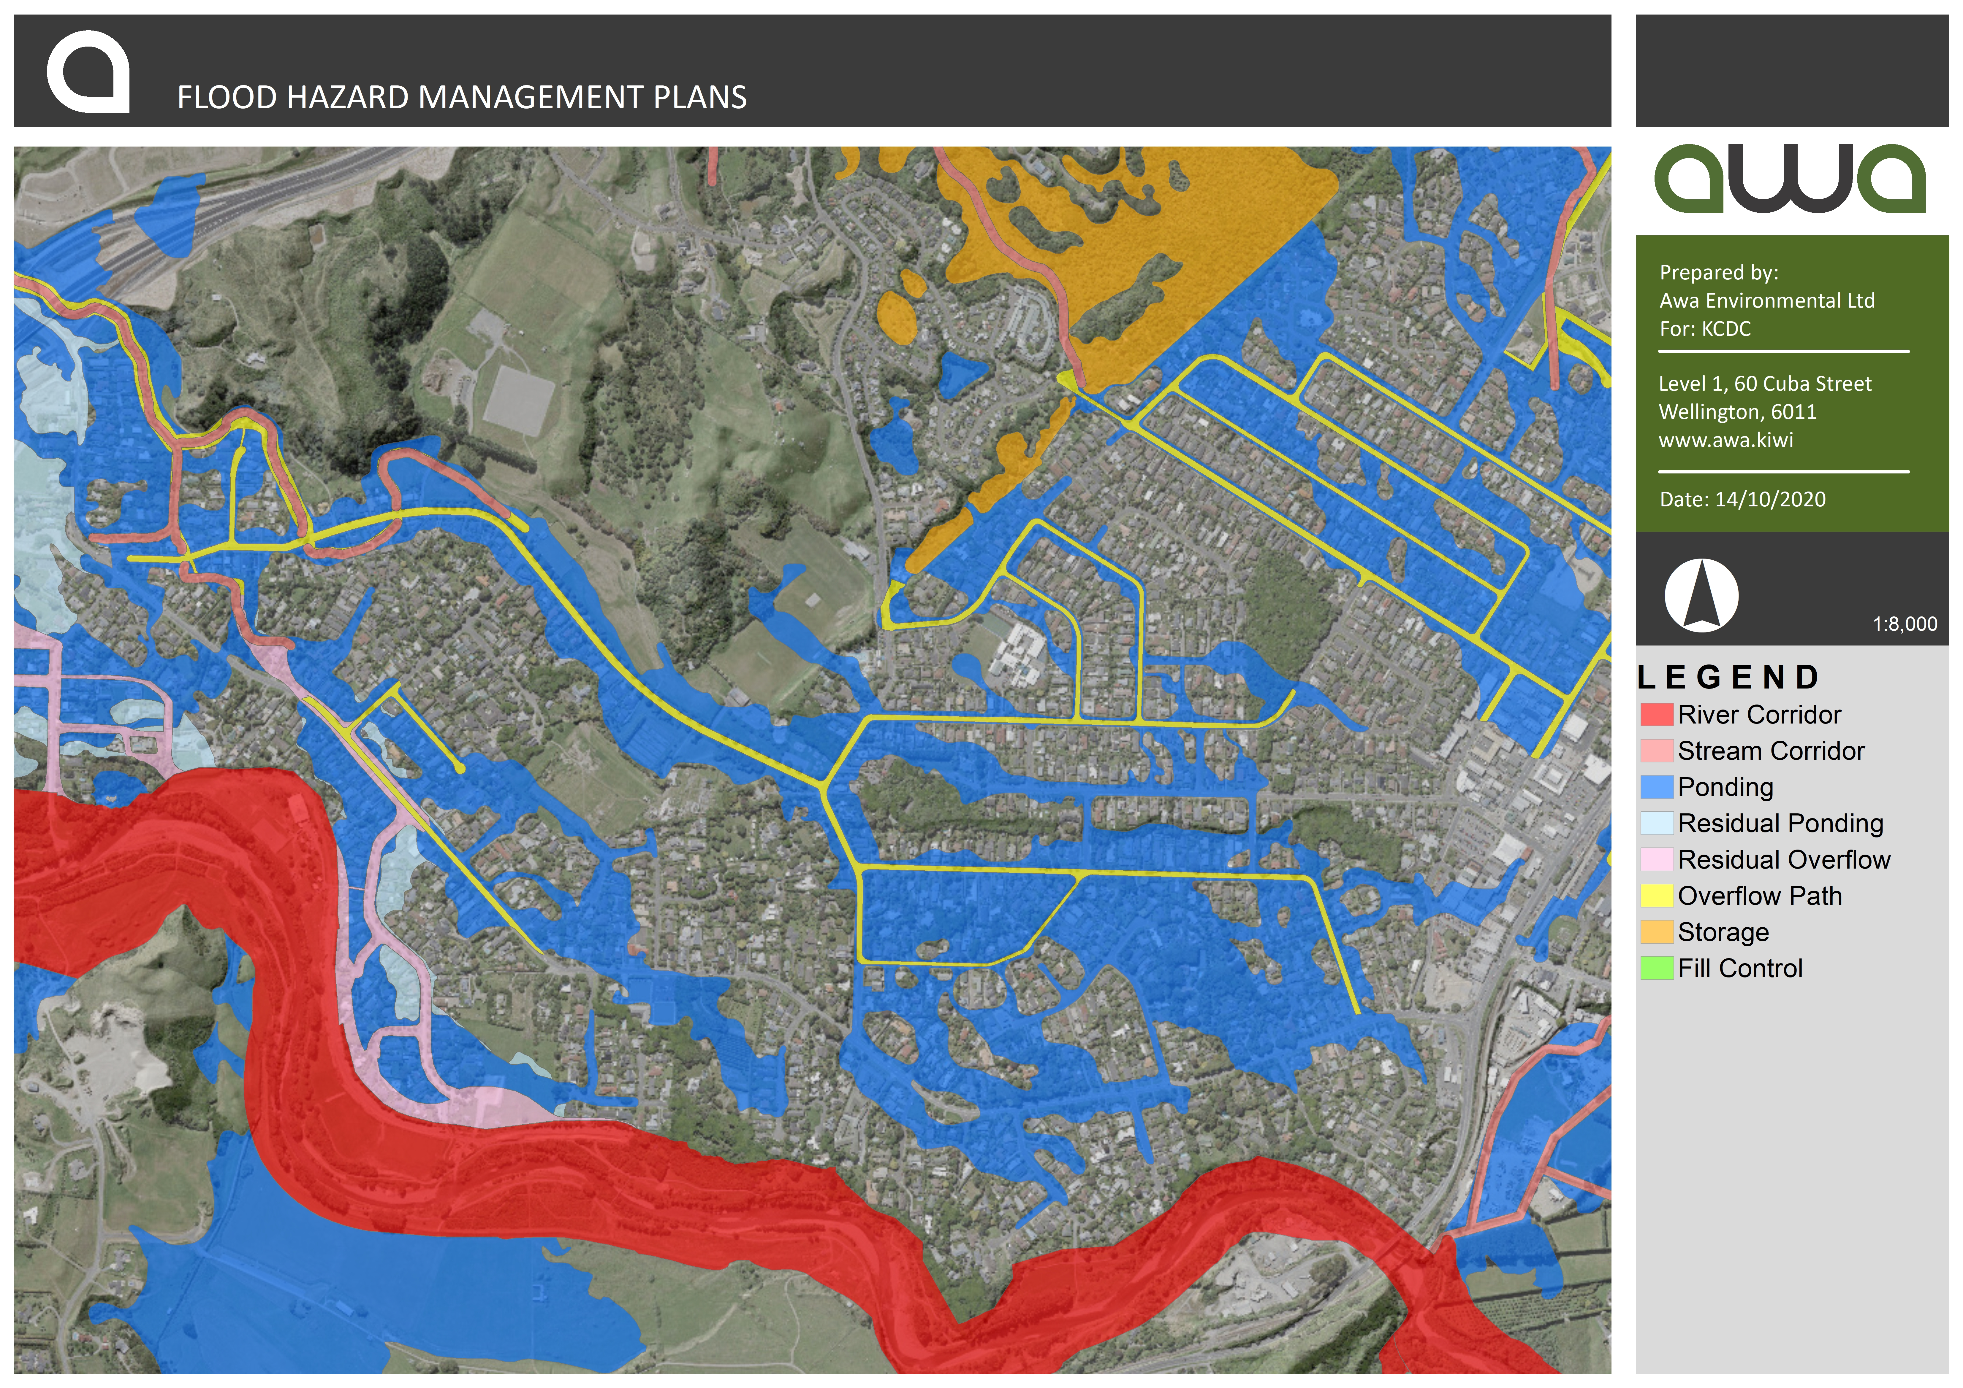
District Plan Maps

Slide 6
Background
Current Maps:
Based on outdated 2010 LiDAR data and 2007 climate change predictions.
Do not account for recent developments (expressways, private developments).
Lack adequate representation of significant groundwater effects.
Updated Models:
Developed by Awa Environmental using advanced TUFLOW software.
Incorporates latest climate change projections and groundwater modelling.
Incorporates new developments and infrastructure
Provides more accurate predictions for range of flood events.

Slide 7
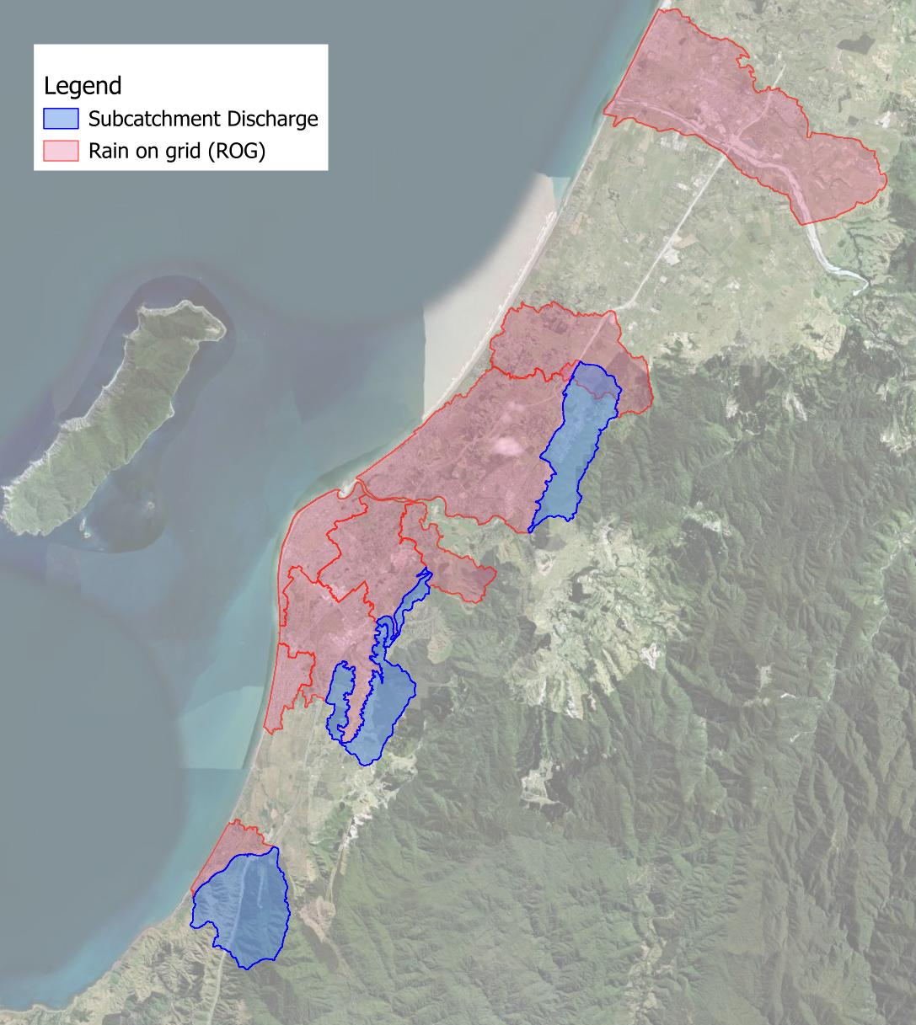
New Model Build – Software / Method
Built on TUFLOW modelling software (rain-on-grid).
More accurate results.
Improved model run times.
Easier to update (e.g. new LiDAR, network upgrades)
Integrated modules (e.g. water quality for ICM)

Slide 8
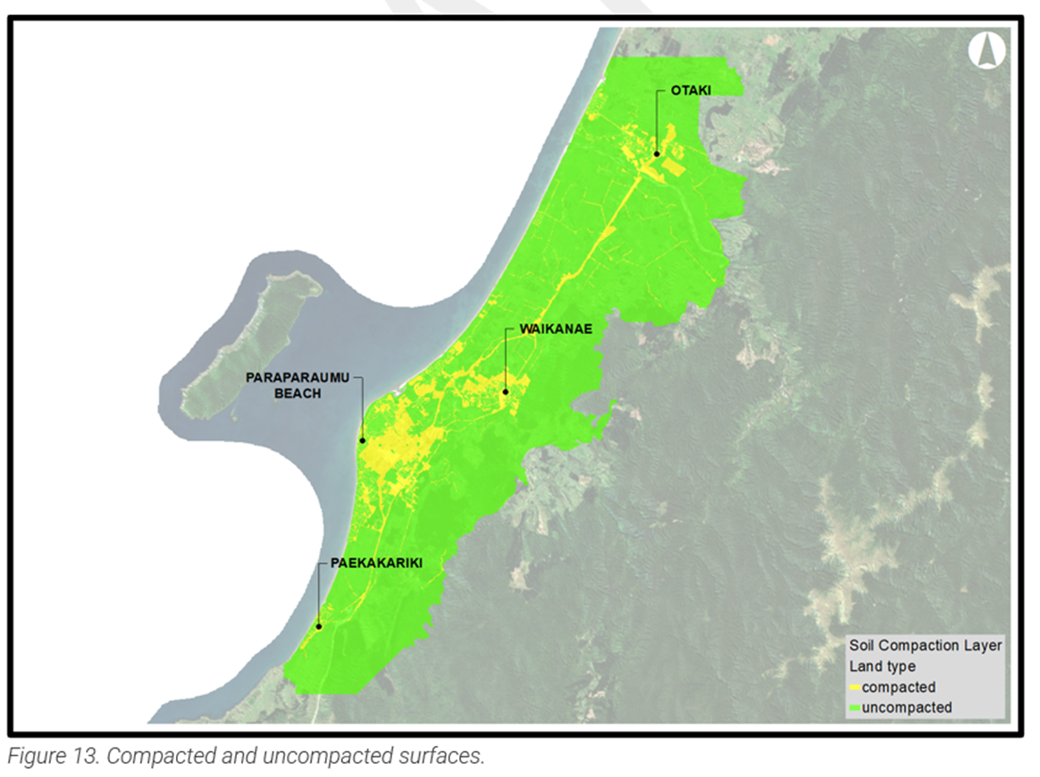
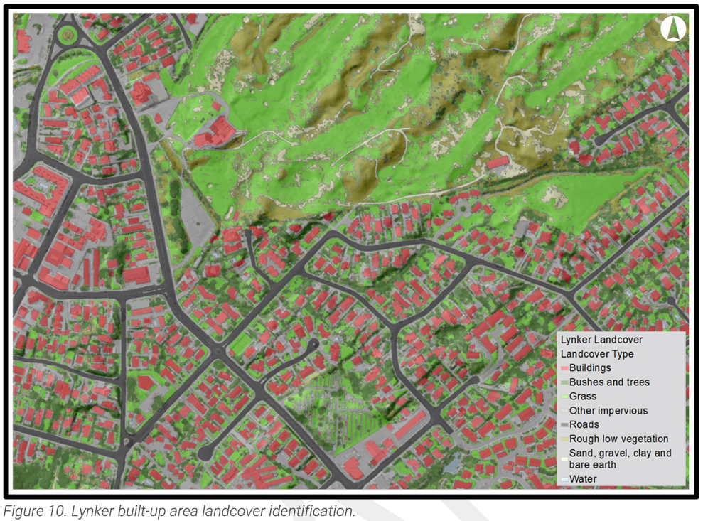
New Model Build – Inputs / Data
DEM Lidar
Soils (infiltration rates)
Landuse
Hydrology
Rainfall
Groundwater
Climate change
Stormwater network (as-builts)
Building footprints
Includes joint probability analysis of combined conditions (rainfall, groundwater, storm-surge)

Slide 9
Wider Context
Regional Context:
Greater Wellington Regional Council (GWRC) revising their flood models for major rivers.
Potential overlaps with KCDC mapping requiring coordinated communication.
National Context:
NIWA undertaking Central Government funded national flood hazard mapping project – products due June/July 2025
Other TAs updating their flood hazard mapping – highlighting issues with insurers.

Slide 10
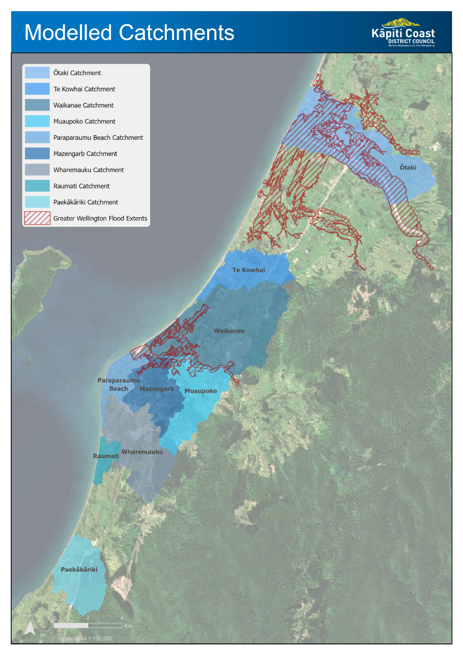

Slide 11
Project Overview
Purpose: Socialise updated flood hazard models utilising advanced software, updated LiDAR data, groundwater effects and climate change scenarios.
Outcomes:
  Improved awareness of current and future flood risks.
  Kāpiti Coast community engaged for feedback and validation of new flood model.
  Key stakeholders engaged including Mana whenua, developers, insurers, other agencies.
  More accurate flood hazard model available to inform flood mitigation, infrastructure planning and policy development.
  Set up third-party access to model for scenario testing and map update process to reflect changes on the ground.

Slide 12
Project Staging
Phase 2: Flood Awareness Campaign – Dec 2024
Launch public awareness initiatives.
Educate on ‘living with more water’, flood risks and flood preparedness.
Phase 3: Community Engagement – Mar/Apr 2025
Release draft flood maps for public comment.
Host consultation events and provide online feedback tools.
Phase 4: Feedback and Refinement – May 2025
Analyse community feedback.
Refine models and update maps accordingly.
Phase 5: Reporting and Integration – Jun/Jul 2025
Report back to Elected Members.
Update systems and documentation.
Communicate outcomes to the public.

Slide 13
Engagement Strategy
Community Stakeholders
Flood Awareness Campaign (Phase 2 – Dec 2024)
  Educational materials on flood risks and preparedness – “Living with more water”.
  Clarify roles of KCDC and GWRC.
  Update LIMs – online landing page (general)

Slide 14
Engagement Strategy
Community Stakeholders
Flood Map Consultation (Phase 3 – Mar/Apr 2025)
  Release draft maps, via online portal.
  Direct communication to newly affected property owners (minor property vs building footprint).
  Mana whenua engagement – TWOK, Marae briefings/drop-ins.
  Targeted sessions with developers and insurance sector.
  Host public drop-in sessions and information events.
  Social media channels.

Slide 15
Engagement Strategy
Online Portal (Phase 3 – Mar/Apr 2025)
Interactive “story map”
Outline model build & inputs
Draft Flood Maps
  Existing flood extents (KCDC & GW)
  New flood extents & depth (heatmap)
  1 in 100 yr scenarios (current climate, 2070, 2130)
  Building footprints
  Searchable by property address
Model build reports (technical reports)
Have your say page & feedback form

Slide 16
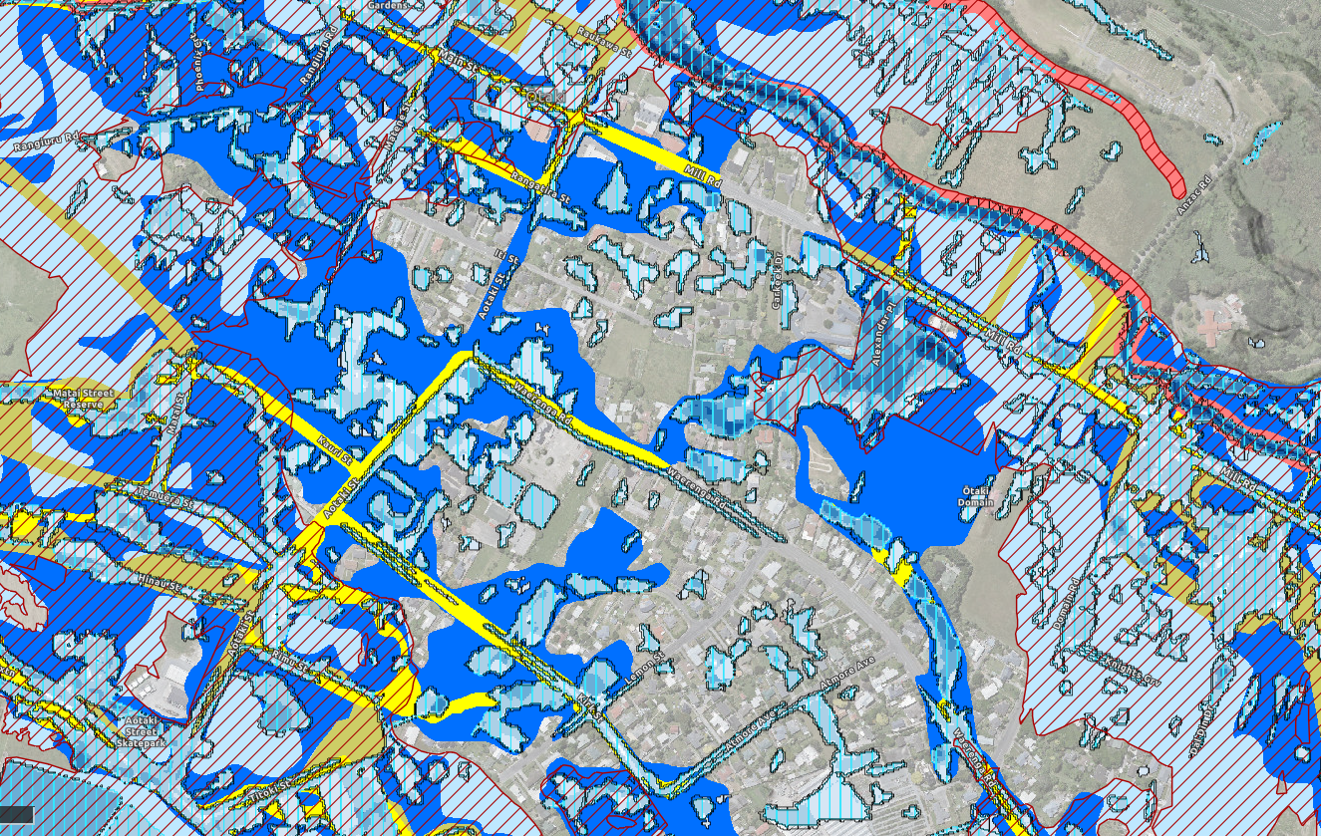

Slide 17
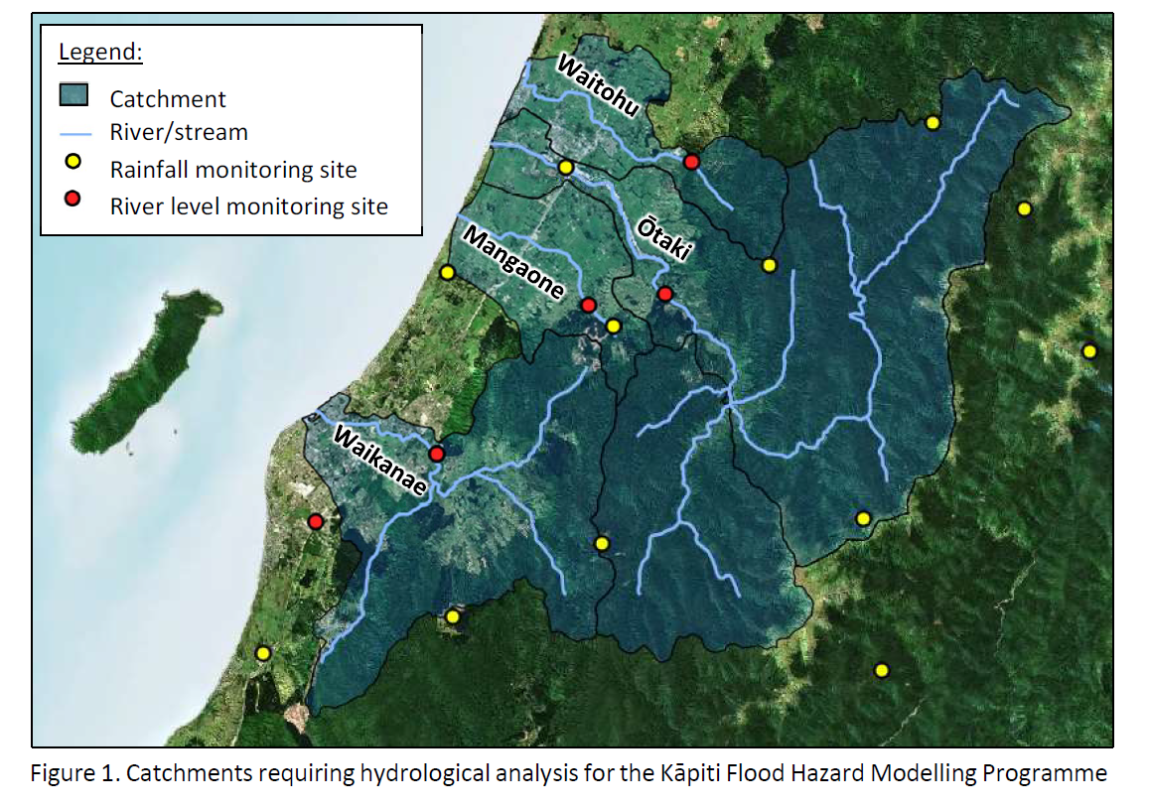
What GW is doing
GW is updating the flood hazard maps for the Kāpiti area in the following major river and stream areas:
Ōtaki River, including the Waitohu Stream and Mangapouri Stream
Waikanae River
Mangaone Stream

Slide 18
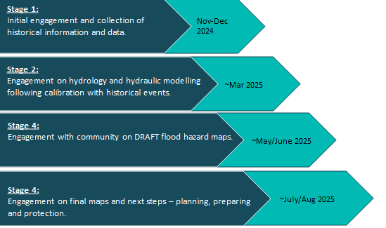
GW’s engagement plan

Slide 19
Next Steps
Finalise Engagement Materials: Prepare for public awareness campaign and consultation phase.
Coordinate with GW: Align messaging and engagement.
Plan Community Engagement Events: Schedule sessions and encourage participation.
Model Sharing Arrangements: Set up training and model management for third parties.
EM Briefing Prior to Consultation Phase: Engagement package, portal & activities.

Slide 20
Questions?

