Slide 2
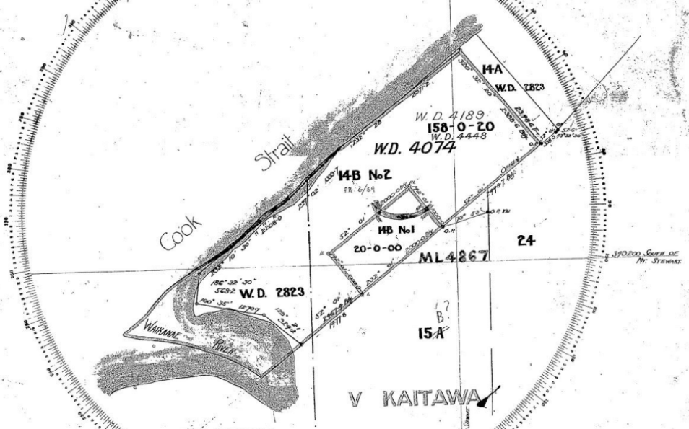
Notes:
1920, pg 16 of Baker, CIA

Slide 3
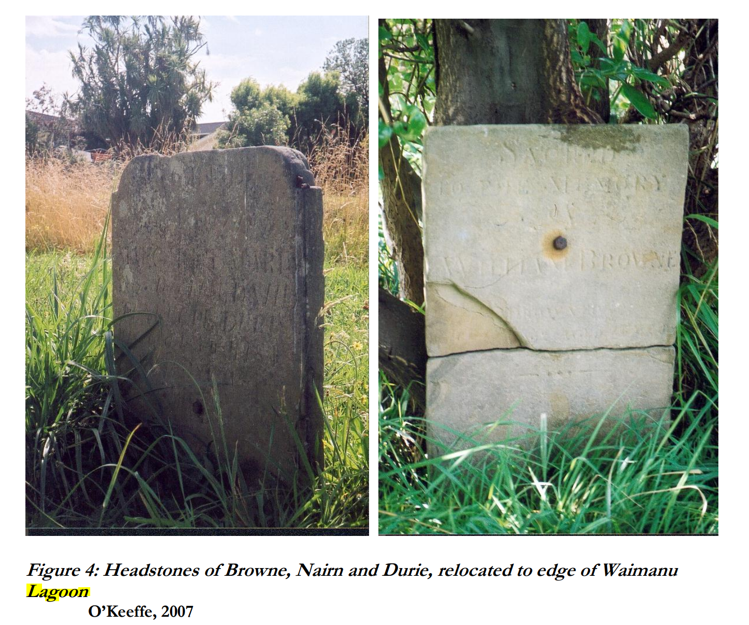
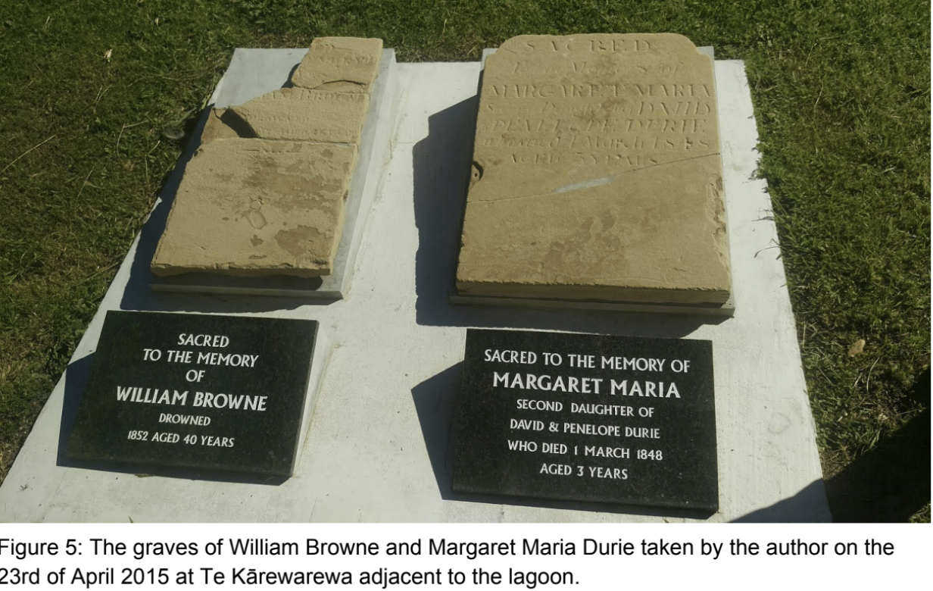
Notes:
Image on right from CIA

Slide 4
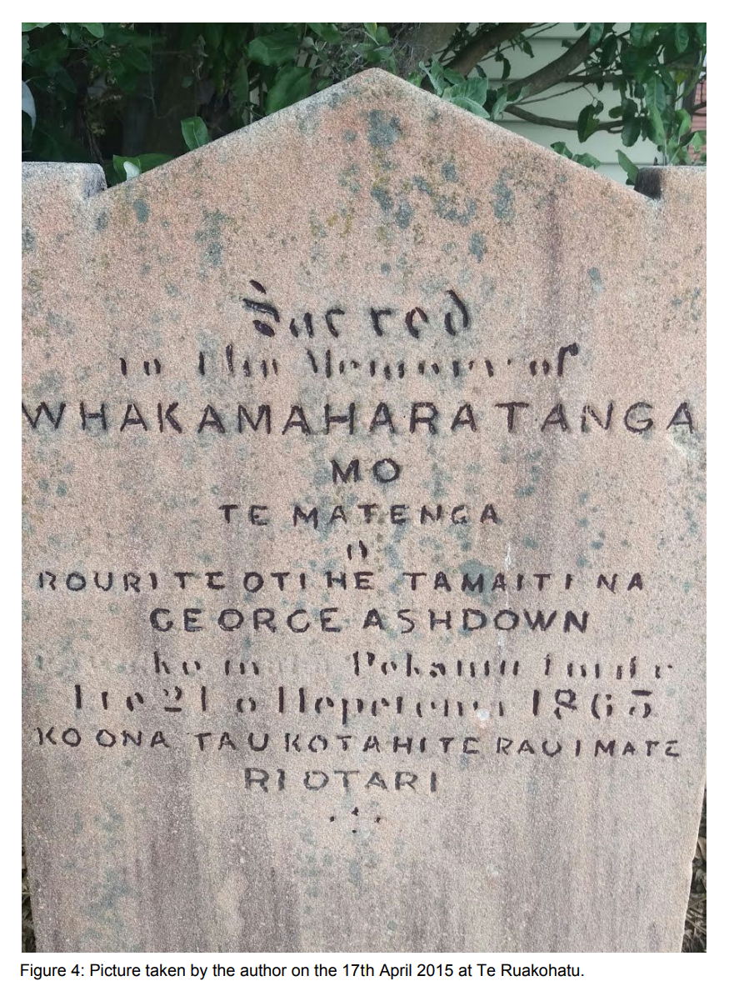
Notes:
Image from CIA

Slide 5
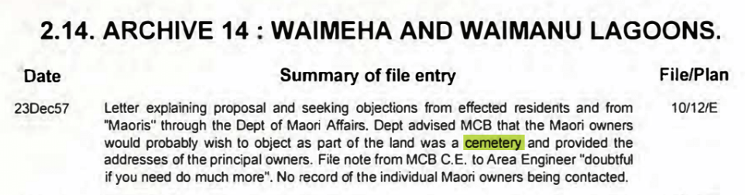
John Easther, 1991. Waikanae River Archive, in Kāpiti Coast Floodplain Management Plans

Slide 6
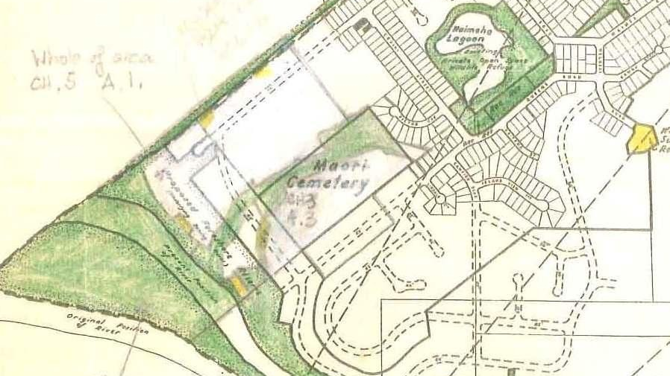
Notes:
Waikanae District Scheme 1968, As referenced in KCDC commissioned WAAHI TAPU PROJECT–CONFIDENTIAL FOR KCDC /ĀTI AWA USE ONLY1WAAHI TAPU PROJECTWTS0319ASite Report for:TAMATI PLACE URUPĀ

Slide 7
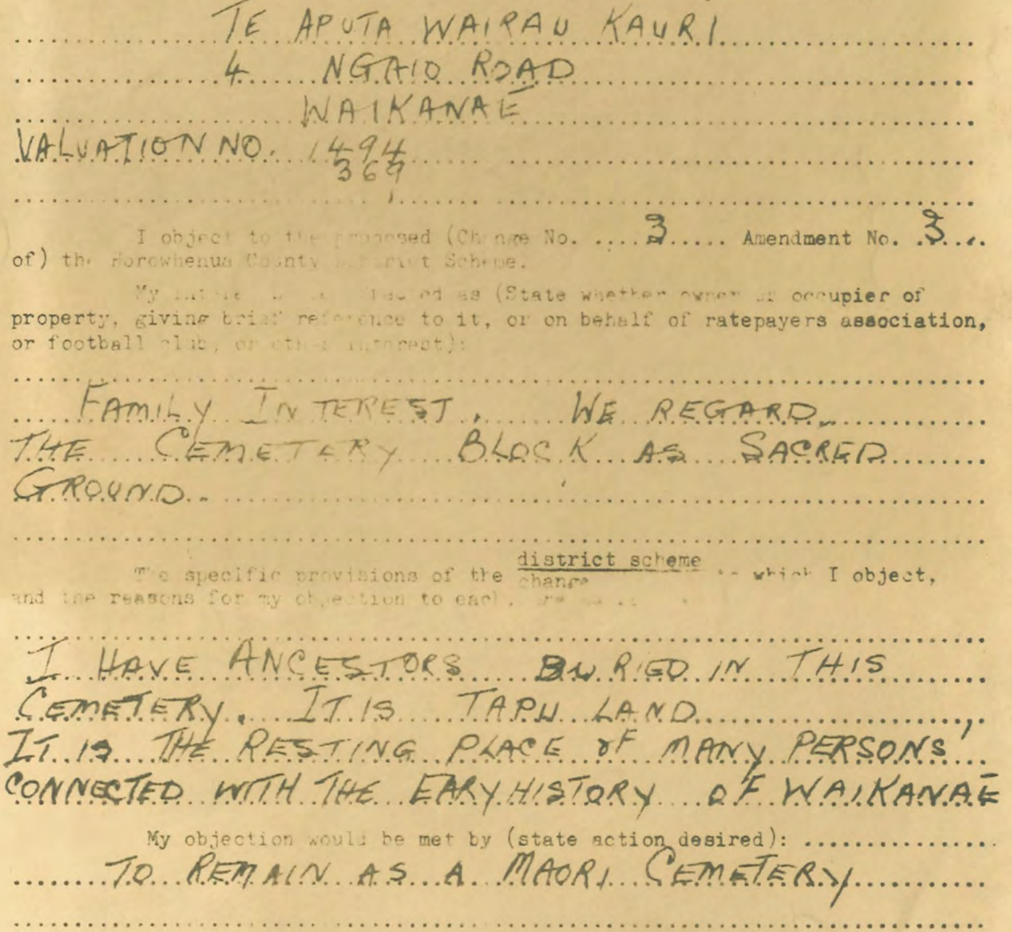
Notes:
Submission by Te Aputa Wairau Kauri in opposition of lifting cemetery designation in Horowhenua County Council Hearing Minutes 25 May 1970

Slide 8
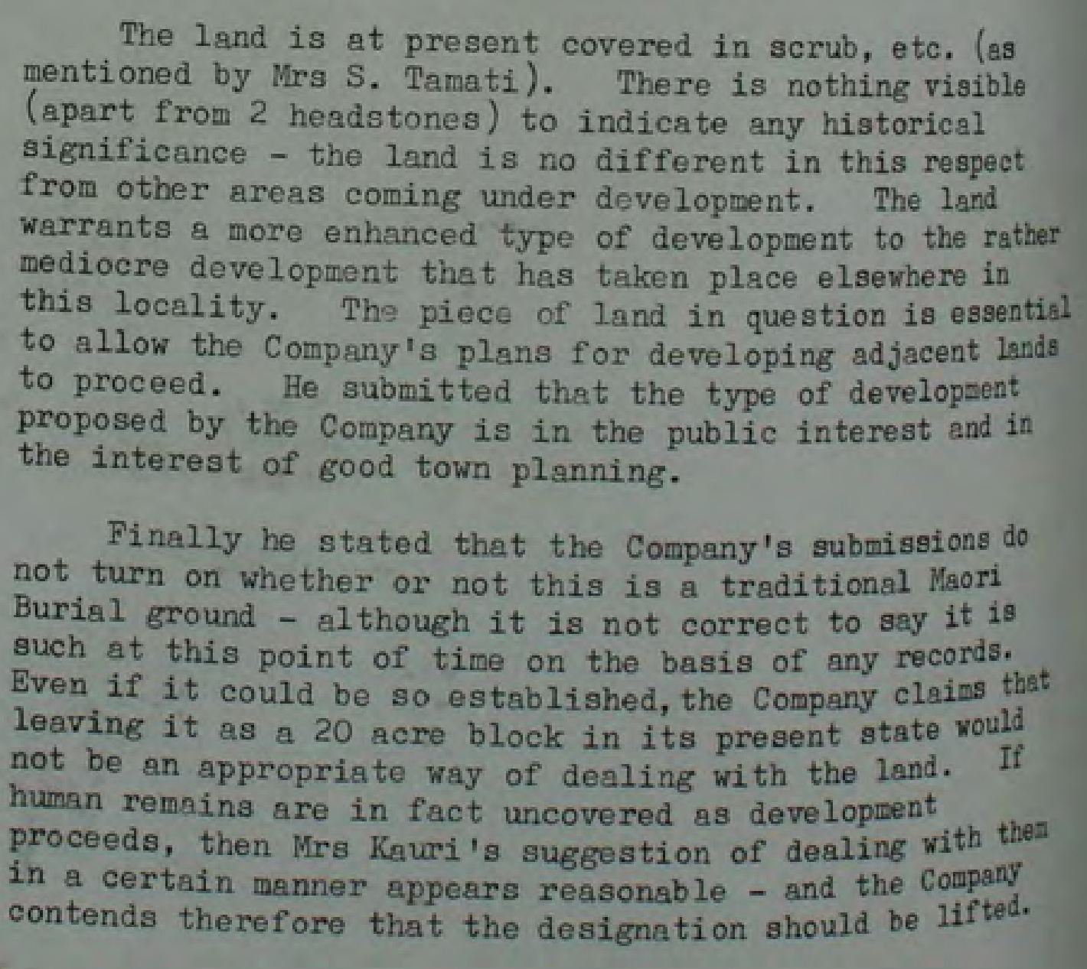
Notes:
Minutes of the Horowhenua County Council 8 July 1970

Slide 9
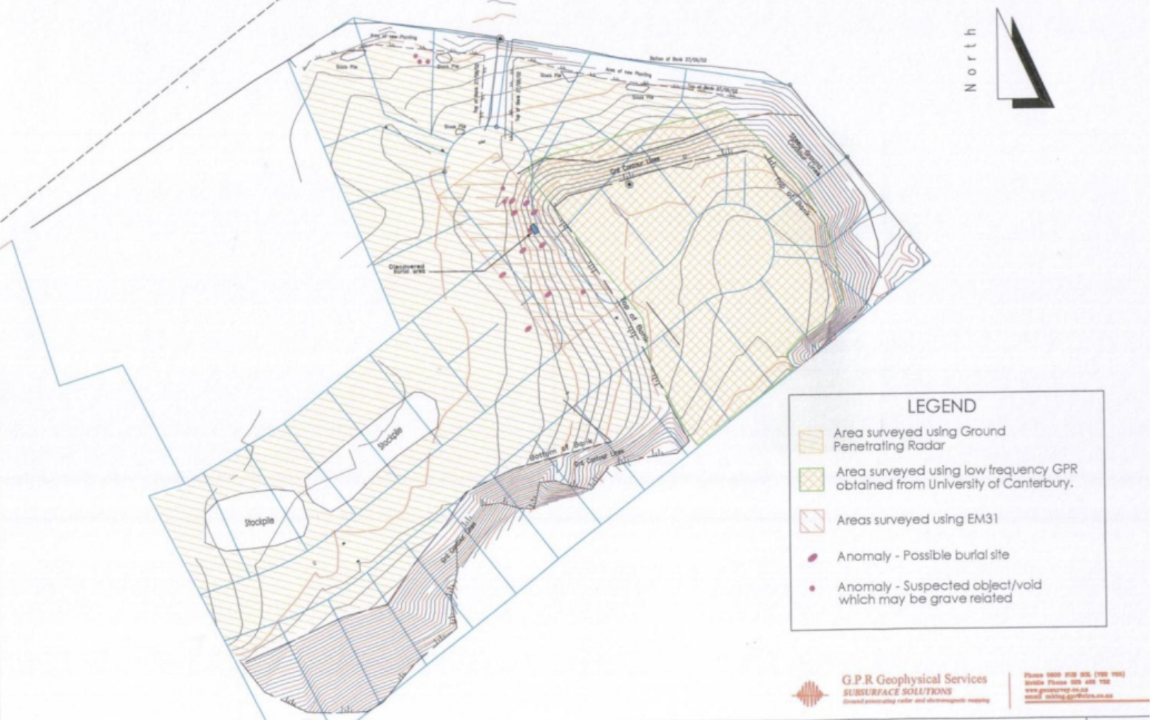
Notes:
GPR Survey in O’Keeffe 2012 Archaeological assessment

Slide 10
