Slide 1
Elected Member Briefing
Local Water Done Well update
15 May 2025

Slide 2
Purpose of this briefing
Provide an overview of the Consultation results
Summary of the consultation
Options and priorities results
Feedback themes
Overview of Mana Whenua views
Summary conclusions
Next steps
Future implementation timeline

Slide 3
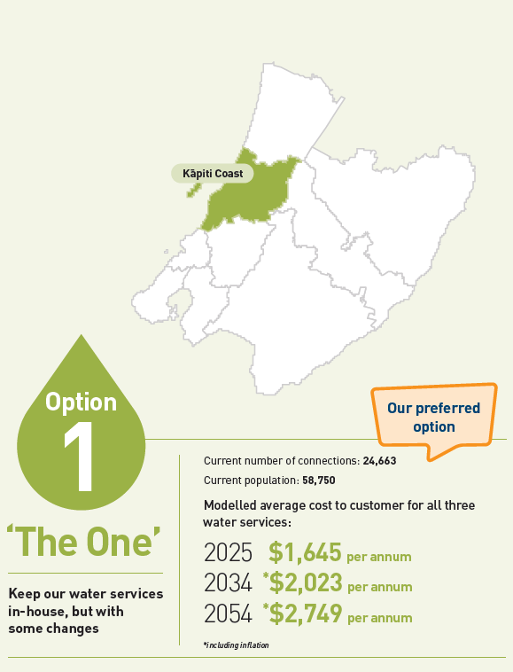
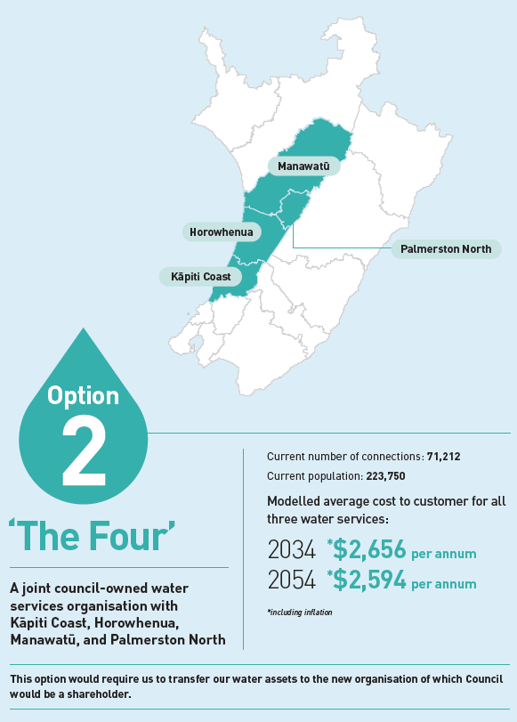
Summary of consultation
Notes:
Consulted on two options as per legislative requirement to have at least two options
Discounted options
A Wellington regional model – Average costs more than double - Discounted in Nov 2024
A KC only WSO – Higher setup and operating costs
Consumer trust – not access LGFA
A two Council option with Horowhenua – higher costs without sufficient benefits of scale
Option 1 the In house Business unit, was identified as the preferred option.

Slide 4
Summary of consultation
Local pop ups x 5
Ōtaki / Paraparaumu / Waikanae / Raumati Paekākāriki
Live webinar
Council digital channels
Rates notice and ratepayer email
521 submissions in total

Slide 5
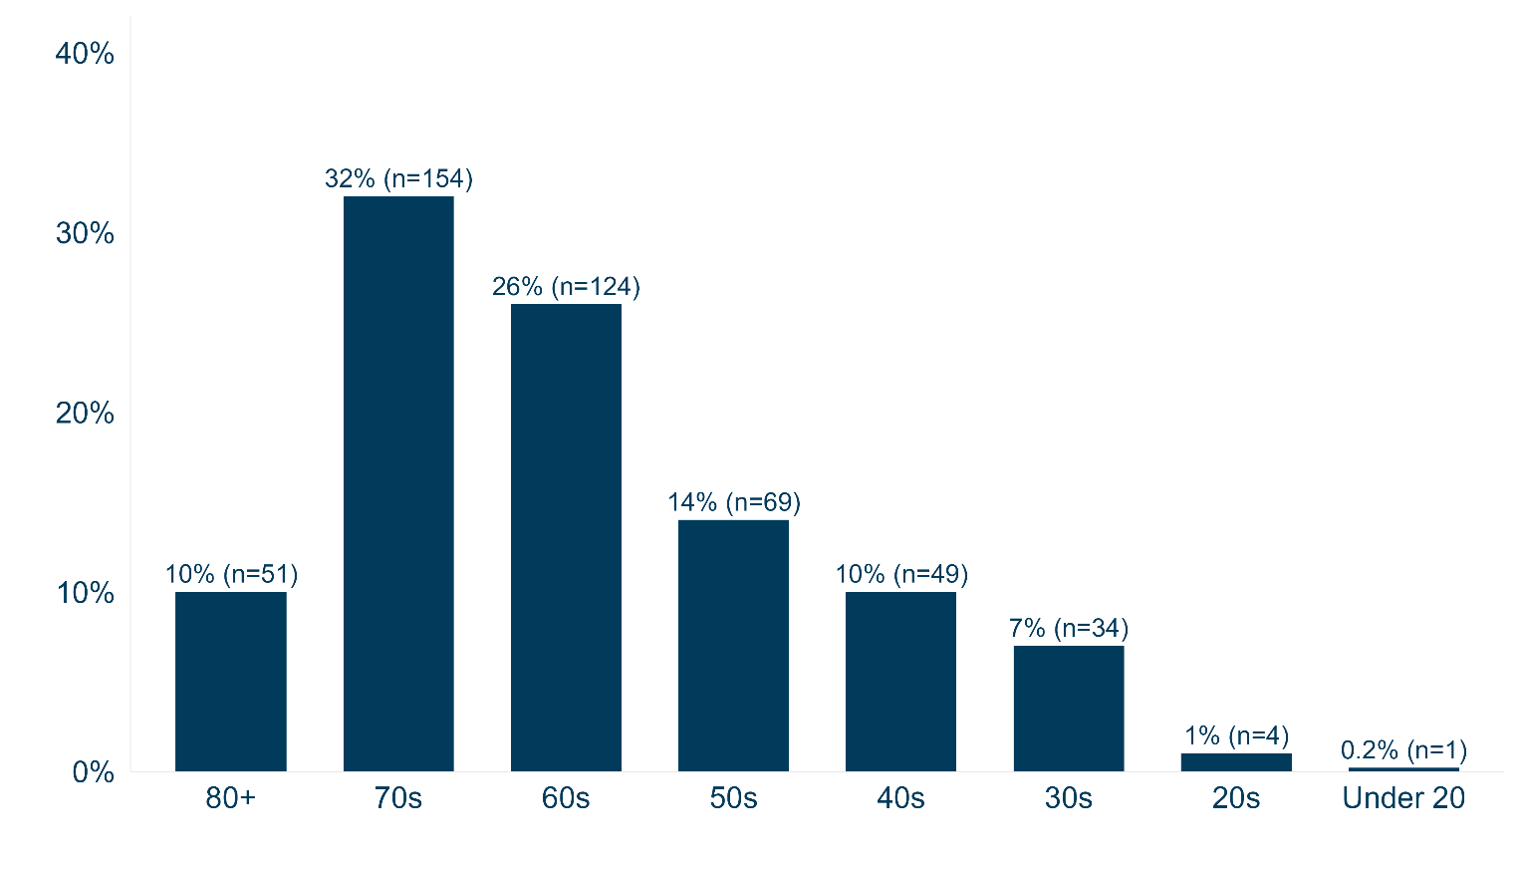
Age distribution

Slide 6
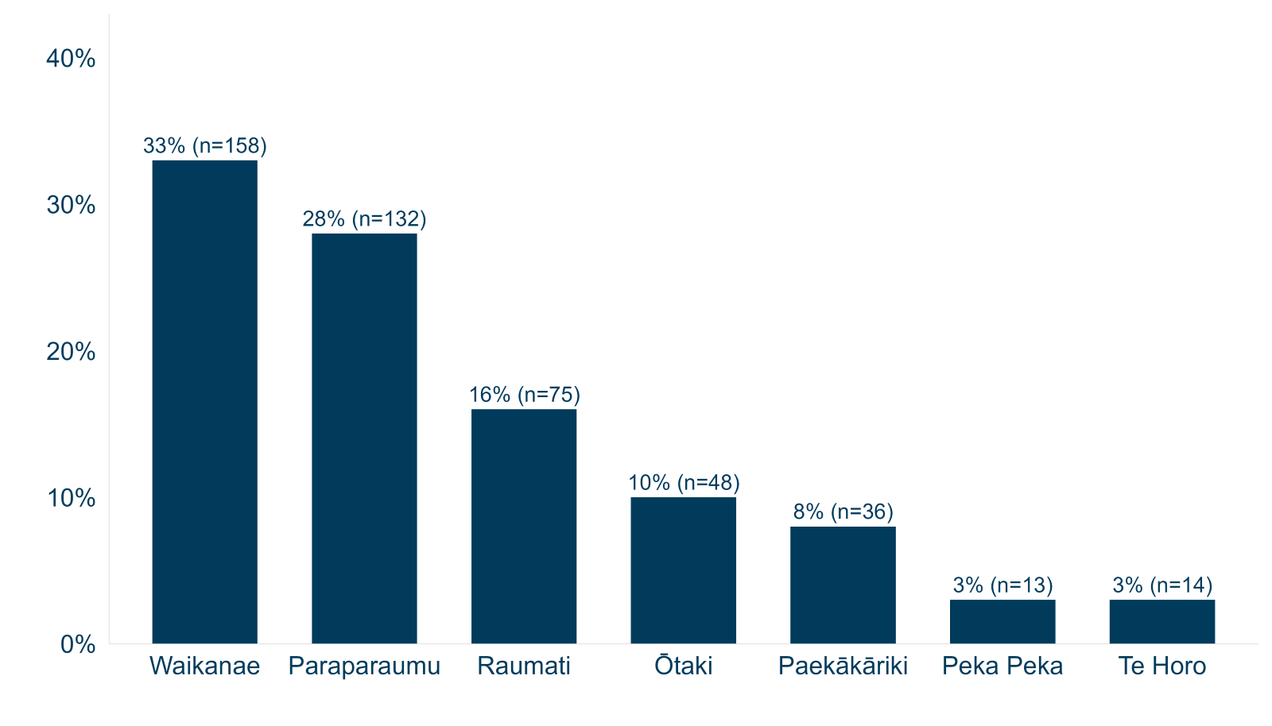
Respondent Location

Slide 7
Option preference
94%
6%

Slide 8
Option preferences
Age
Response | 30 and under n = 39 | 40s n = 49 | 50s n = 69 | 60s n = 124 | 70s n = 152 | 80+ n = 48
Option 1: The One | 95% 37 | 94% 46 | 93% 64 | 94% 116 | 95% 145 | 94% 45
Option 2: The Four | 5% 2 | 6% 3 | 7% 5 | 6% 8 | 5% 7 | 6% 3
Location
Response | Paekākāriki-Raumati n = 109 | Paraparaumu n = 131 | Waikanae n = 155 | Ōtaki n = 47 | Other n = 68
Option 1: The One | 97% 106 | 95% 125 | 93% 144 | 87% 41 | 94% 64
Option 2: The Four | 3% 3 | 5% 6 | 7% 11 | 13% 6 | 6% 4
Ratepayer
Response | No (Not Ratepayer) n = 12 | Yes (Ratepayer) n = 474
Option 1: The One | 92% 11 | 94% 447
Option 2: The Four | 8% 1 | 6% 27

Slide 9
Community priorities
 | % of maximum ranked score | “One” Council internal Business Unit | “Four” Council COO KCDC, HDC, MDC & PNCC
Safe and reliable services | 89%
Public Ownership | 81%
Financially sound | 69%
Resilience | 61%
Local priorities | 52%
Mana whenua aspirations | 40%

Slide 10
Feedback analysis process
An independent expert public consultation company analysed all responses.
The analysis process:
Reviewed every submission multiple times
Identified key points and grouped them into themes and subthemes
Sub themes mentioned more than 5 times were included in the analysis
Reviewed the theming and comments and refined further for relevance and clarity.

Slide 11
Feedback on option 1
Theme | Subtheme | Frequency
OPTION 1 STRENGTHS |  | 182
 | Support: Direct local control of water priorities | 55
 | Support: Continuity of existing systems/expertise | 53
 | Support: Recognition of past Kāpiti investments | 39
 | Support: General support for option 1 | 14
 | Support: Not fixing what is not broken | 11
 | Support: Affordability is key | 5
 | Support: Lower costs for ratepayers until 2047 | 4
 | Support: Avoiding complex transition disruptions | 1
OPTION 1 WEAKNESSES |  | 5
 | Concern: Limited long-term economies of scale | 3
 | Concern: Managing unexpected large investments | 2

Slide 12
Feedback on option 2
Theme | Subtheme | Frequency
OPTION 2 STRENGTHS |  | 16
 | Support: Enhanced system resilience & resources | 5
 | Support: Cost efficiencies through scale post-2047 | 4
 | Support: Coordinated planning across catchments | 3
 | Support: General support for option 2 | 2
 | Support: Better access to technical specialists | 1
 | Support: Greater borrowing capacity (500% cap) | 1
OPTION 2 WEAKNESSES |  | 125
 | Concern: Kāpiti subsidising other districts' needs | 32
 | Concern: Higher establishment & operating costs | 29
 | Concern: Kāpiti priorities outweighed by others | 25
 | Concern: Replicating Wellington Water problems | 19
 | Concern: Reduced local influence over decisions | 13
 | Concern: Horowhenua water infrastructure | 6
 | "Suggest: Must include all 4" | 1

Slide 13
Mana Whenua
Wai holds significant cultural and spiritual value, and Mana Whenua have a responsibility for managing and protecting our water resources.
Iwi representatives of Te Whakaminenga o Kapiti formally express their support for maintaining the existing in-house model for water management in our hāpori.

Slide 14
Conclusions
The community consultation indicates:
Strong support for option 1, an in-house business unit delivery model with many perceived strengths and few weaknesses.
Low support for option 2, ”The Four” Council organisation. Many perceived concerns and few strengths.
The relative importance of the priorities
Further areas of community interest in water services
Transparent governance and management accountability
good future planning and investment
Inclusive and clear cultural partnership role
Prudent fiscal management
Environmental stewardship
Consumer
Mana Whenua have expressed support for an in-house business unit delivery model

Slide 15
Next steps
27 May Council decision on the Water Services Model
Decision Communications
Staff update
Public announcement
Provide feedback to submitters
Water Services Delivery Plan
CE Certification
Council adoption by the end of August.
Must be lodged with DIA by 3 September 2025

Slide 16
Future Implementation Timeline
2025/26 – Setting up systems
Establish ringfencing provisions
Review and refine ringfencing arrangements and policies
Establish stand-alone financial statements
Review information disclosures readiness
2026/27 – Transition to new arrangements
Annual reports require stand-alone water activity financial statements
Prepare information disclosures under the new regulations
Water Services Strategy Development for 1 July 2027
Revenue thresholds and Price / Quality regulation available to the Commerce Commission
2027/28 Information disclosures and full water services reporting regime
Ringfencing
Stand-alone financials
Water Services Strategy operational
Information disclosures
Revenue thresholds and Price / Quality regulation available

Slide 17
Discussion and questions

