Slide 1
Te Whakaminenga o Kāpiti Hui
Local Water Done Well Legislation
Kapiti Coast Water Services
18 February 2025

Slide 2
Purpose of this briefing
Delivery model options and overview
Joint water services organisation arrangements
The cost of services
Next steps

Slide 3
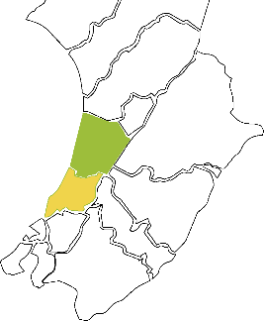
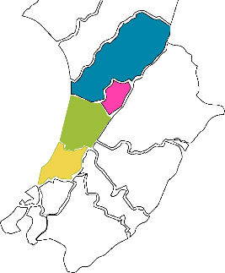
Water Delivery Model Options
 | “One” Council IBU New KCDC IBU |  | “Two” Council CCO KCDC / HDC |  | “Four” Council CCO KCDC, HDC, MDC & PNCC
Population | 58,750 |  | 96,450 |  | 223,750
Connections | 24,500 |  | 34,825 |  | 71,212

Slide 4
Delivery Model Options
“One” Council In-house Business Unit
  Utilises existing Council Iwi relationship arrangements
  Establish a fully ringfenced and resourced Internal Business Unit
    Debt to be managed within Council limits (revenue x 280%, LGFA Board have the discretion to approve up to 350% for high growth councils)
    Consideration of referendum, as per standing orders, not required
“Four” Council Water Services CCO (or variance thereof)
  Iwi representation and engagement must be considered and agreed by shareholders and iwi partners
  Kapiti Coast / Horowhenua / Manawatu / Palmerston North City shareholder Councils
    Limited liability company owned by shareholder councils
    Independent board and CE. Board cannot comprise elected members or any staff
    Asset-owning full-service CCO
    Access to increased debt limits for water services (revenue x 500%)
    Consideration of a referendum as per standing orders

Slide 5
What is important to Kapiti
Public Ownership
Our water assets remain in public ownership.
Safe and reliable services
Our community continues to receive safe, reliable, efficient and effective water services
Mana whenua
Mana whenua aspirations and concepts have a meaningful influence in managing our water
Financial sustainability
Our water service is financially sustainable and maintains fair and transparent charging for customers.
Local priorities
Our water services organisation recognises local priorities in planning for the future and catering for growth
Resilience
Our water organisation is resilient – it remains strong and functional in all circumstances

Slide 6
Options overview
 | “One” Council internal Business Unit | “Four” Council COO KCDC, HDC, MDC & PNCC
Public Ownership
Safe and reliable services
Mana whenua
Financial
Local priorities
Resilience

Slide 7
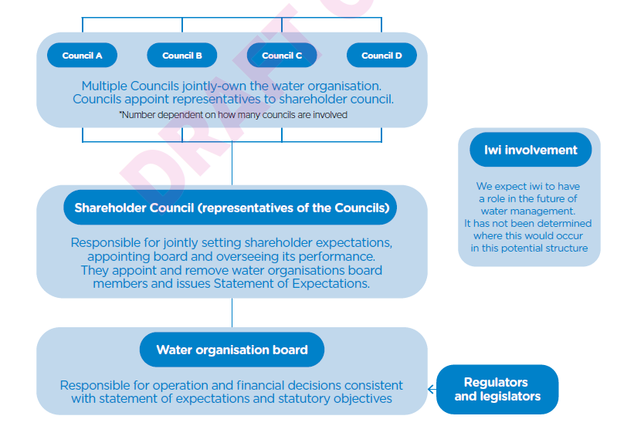
What a Joint Water Services Organisation could look like

Slide 8
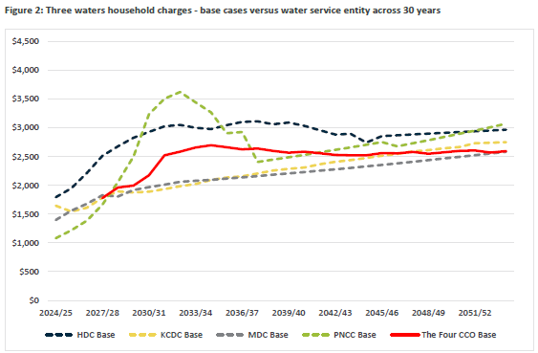
The average household costs over 30 years
New entity starts
Kapiti in house base case

Slide 9
Next steps
6 March Council approve Consultation Document and associated matters.
Consultation Process
  Consultation period early March to early April 2025
  Feedback analysis
  Hearings in late April 2025
Further Council briefings through the consultation period on the detailed development of the Four Council option.
Decision on the Water Services Model – Mid May
CE Certification and adoption of the Water Services Delivery Plan and Implementation Plan End of June
The Water Services Delivery Plan must be lodged with DIA by 3 September 2025

Slide 10
Discussion and questions

