Slide 1
Population demographics and forecasts
2023 Update
Hamish McGillivray
Research and Policy Manager

Slide 2
Introducing our
‘People and Places’ data tool
Accessing population, demographic and
Census data
People+Places (peopleandplaces.nz)

Slide 3
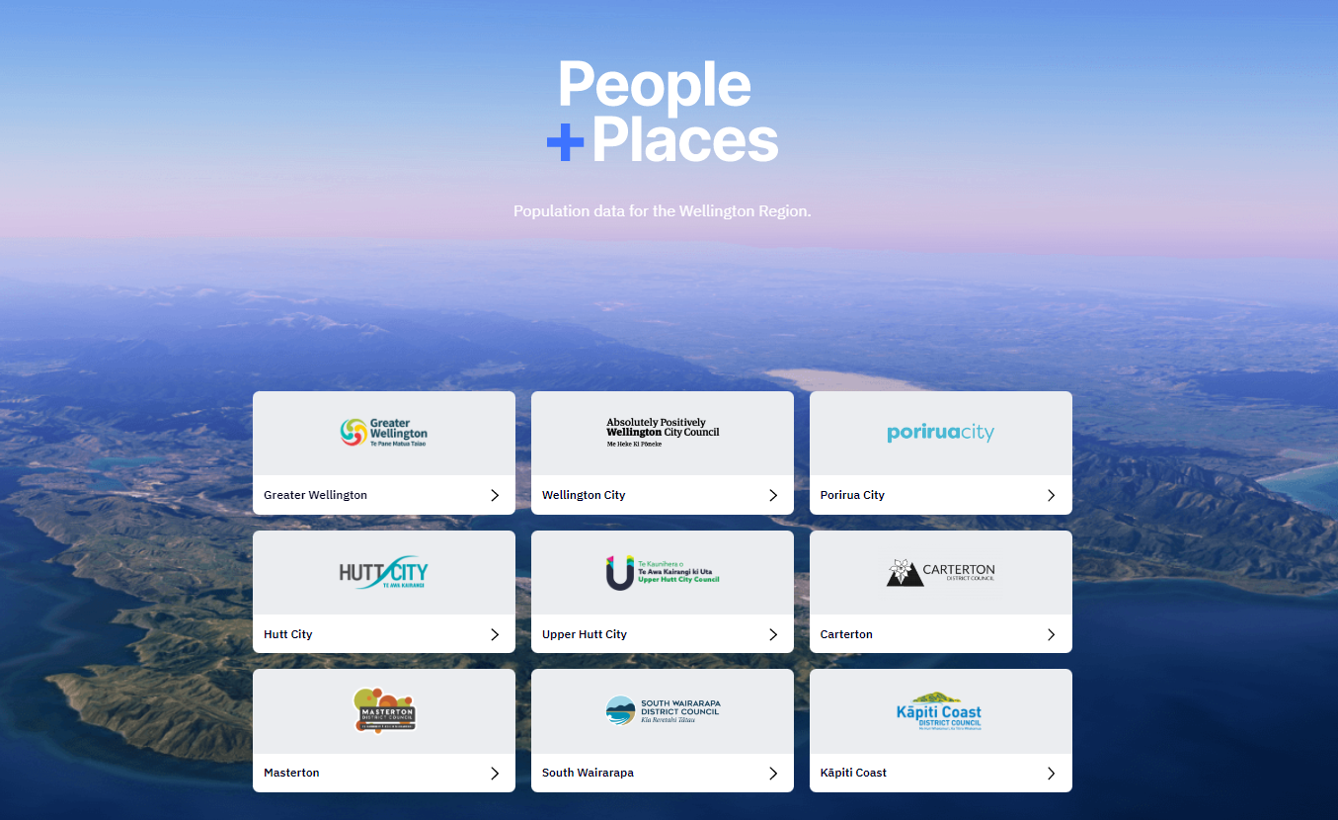
Cenus data & demographics

Slide 4
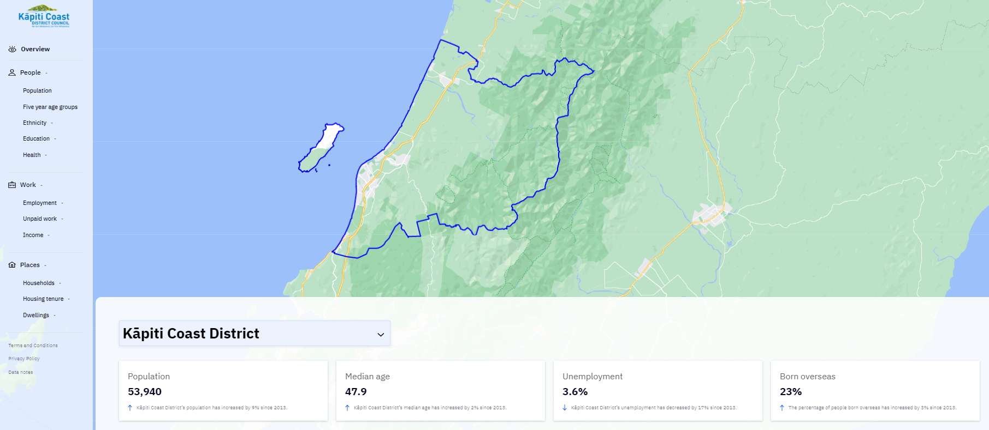
District overview

Slide 5
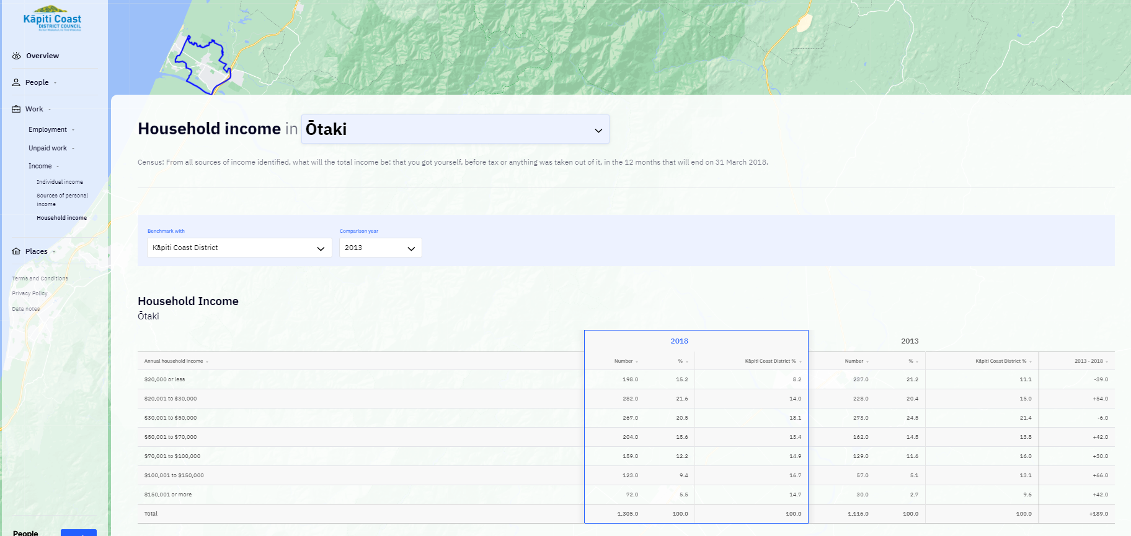
SA2 (suburb) information

Slide 6
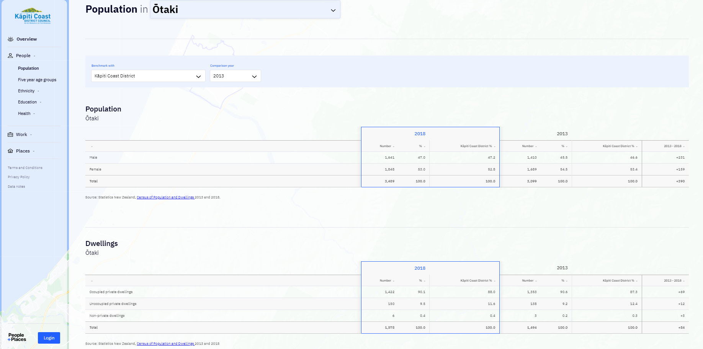
Benchmark and changes

Slide 7
Population forecasts
Greater Wellington Region Population Forecasts

Slide 8

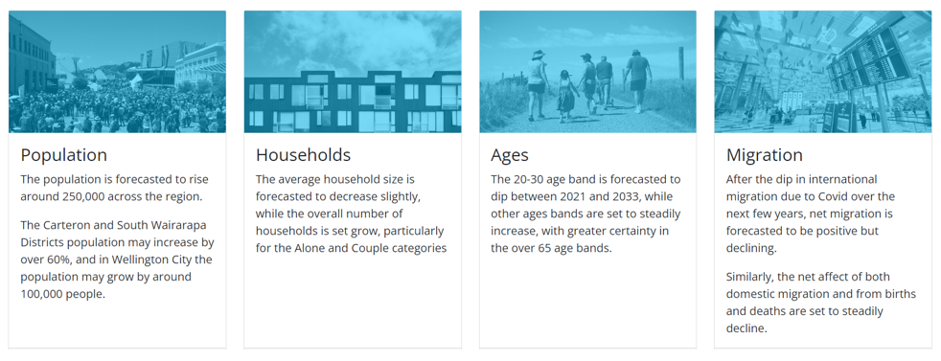
Horowhenua and Wellington region population forecasts

Slide 9
Who are Sense Partners?
“Sense Partners is a boutique consultancy that provide expertise on regulatory economics, cost benefit analysis, economic modelling, energy, climate change policy, and housing and urban development.”
Provide projections services for all Councils in the Wellington and now also Horowhenua region.
Selected from a robust market process in 2020 – first projection completed in 2021.
This is the second annual update – ahead of Census results being available.
Provides consistency of projections and support.

Slide 10
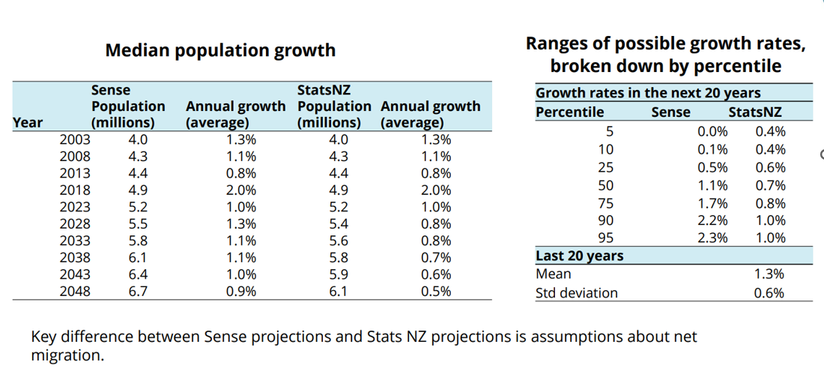
Different to StatsNZ projections

Slide 11
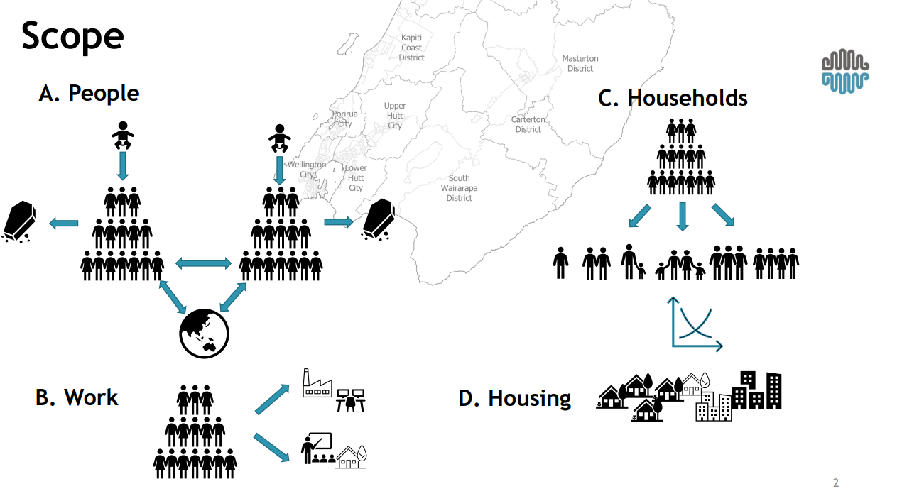
Approach to forecasting

Slide 12
Population forecasts – percentiles
110,175
92,020
80,924
68,876
60,210

Slide 13
Comparison with 2021
2021 50th Percentile – Population of 90,069 by 2051 (+31,814)
110,175
92,020
80,924
68,876
60,210

Slide 14
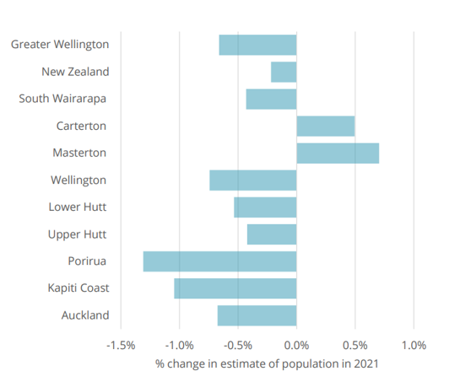
Impact of Covid-19 on forecasts
Most districts have seen a downward revision to population growth.
This is primarily due to:
Lower rates of domestic net migration.
Lower rates of international net migration.
This has reduced the population across the projection horizon.

Slide 15
A growing and aging population

Slide 16
Household make-up
Household size
2.5 2.3 2.2
Household type (percentage)
 | One parent | Two parent | Multi-family | Couple | Multi-person | Alone
 | With dependants (children) |  |  | Without dependants (children)
2018 | 10.0 | 21.9 | 1.9 | 34.1 | 2.2 | 29.9
2054 | 8.7 | 19.6 | 1.8 | 35.3 | 2.0 | 32.6
Population by household type (percentage)
2018 | 11.4 | 37.7 | 4.2 | 30.1 | 2.1 | 13.0
2054 | 10.0 | 33.7 | 4.0 | 33.1 | 2.1 | 15.1
2018 | 53.3 |  |  | 45.2
2054 | 47.7 |  |  | 50.2

Slide 17
A growing workforce
Working age population
 | 5th percentile | 25th percentile | 50th percentile | 75th percentile | 95th percentile
2003 | 26,042 | 26,042 | 26,042 | 26,042 | 26,042
2008 | 28,123 | 28,123 | 28,123 | 28,123 | 28,123
2013 | 28,647 | 28,647 | 28,647 | 28,647 | 28,647
2018 | 31,449 | 31,449 | 31,449 | 31,449 | 31,449
2023 | 32,396 | 32,953 | 33,276 | 33,594 | 34,006
2028 | 32,434 | 33,804 | 34,800 | 35,789 | 37,109
2033 | 31,912 | 34,011 | 35,817 | 37,837 | 40,150
2038 | 31,039 | 33,950 | 36,711 | 40,100 | 43,846
2043 | 30,879 | 34,625 | 38,757 | 43,533 | 49,264
2048 | 30,491 | 34,994 | 40,763 | 46,681 | 54,851
Working age population - share of population
 | 5th percentile | 25th percentile | 50th percentile | 75th percentile | 95th percentile
2003 | 57.7% | 57.7% | 57.7% | 57.7% | 57.7%
2008 | 57.9% | 57.9% | 57.9% | 57.9% | 57.9%
2013 | 56.6% | 56.6% | 56.6% | 56.6% | 56.6%
2018 | 57.0% | 57.0% | 57.0% | 57.0% | 57.0%
2023 | 56.0% | 56.8% | 57.3% | 57.8% | 58.3%
2028 | 54.4% | 55.4% | 56.2% | 56.7% | 57.8%
2033 | 52.2% | 53.5% | 54.4% | 54.9% | 56.2%
2038 | 50.2% | 51.7% | 52.8% | 53.8% | 54.8%
2043 | 49.9% | 51.5% | 52.8% | 54.0% | 55.6%
2048 | 49.7% | 51.5% | 53.1% | 54.5% | 55.9%
Population aged 70 years or older - share of population
 | 5th percentile | 25th percentile | 50th percentile | 75th percentile | 95th percentile
2003 | 16.6% | 16.6% | 16.6% | 16.6% | 16.6%
2008 | 17.3% | 17.3% | 17.3% | 17.3% | 17.3%
2013 | 18.1% | 18.1% | 18.1% | 18.1% | 18.1%
2018 | 19.2% | 19.2% | 19.2% | 19.2% | 19.2%
2023 | 19.9% | 20.2% | 20.3% | 20.4% | 20.5%
2028 | 20.9% | 21.0% | 21.0% | 21.0% | 21.1%
2033 | 23.2% | 23.1% | 22.8% | 22.3% | 22.1%
2038 | 25.5% | 24.9% | 24.1% | 23.1% | 22.3%
2043 | 27.4% | 26.4% | 25.0% | 23.6% | 22.4%
2048 | 28.1% | 26.8% | 24.7% | 23.2% | 21.5%
While the working age population is forecast to increase (+ 14,721) – the share of total population is forecast to decrease (- 4.6%)
But there are oppportunities in this space

Slide 18
Additional dwellings

Slide 19
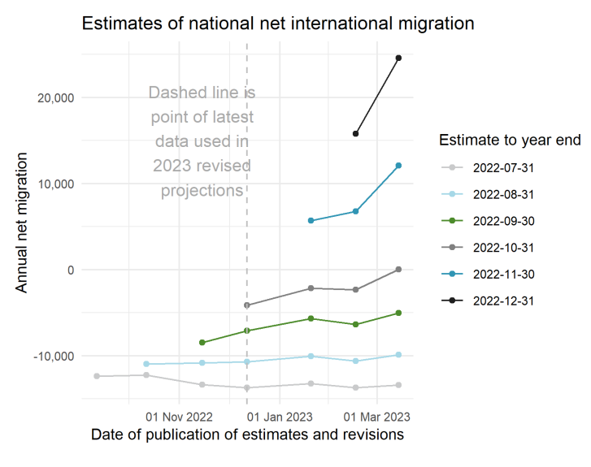
Warning - already signs of change
Net migration has recently shifted from negative to positive.
Immigration data released in March showed:
  a big jump in estimated net international migration of +33,000 for the year to January
  a substantial upward revision to estimated net immigration in the last quarter of 2022 and since the borders reopened in July 2022.
Important that we continue to take a medium to long-term view to inform planning and investment over short-term cyclical changes and shocks.

Slide 20
Next Steps
Adding the lastest forecast data on Council’s website.
Use information to inform planning and investment work – including LTP 2024.
Upcoming briefing on the demand and supply of development capacity for housing and business.
Prepare for the availability of Census 2023 data.
Further work to develop data and reporting tools.
Population and demographics - Kāpiti Coast District Council (kapiticoast.govt.nz)

