Slide 1

Reviewing the Advisory Groups
Disability Advisory Group
Youth Council
Older Persons’ Council

Slide 2
Wider Review
This work is part of a broader Advisory Group Review focused on operational aspects to enable consistency
and strengthen accountability across existing Advisory Groups

Slide 3
Community based advisory groups
Their expertise is their experience, knowledge and connection to people in the communities they represent
Not technical experts
Not sector representatives

Slide 4
Our Advisory Groups
Focus on:
  Providing feedback and ideas related to the communities they represent
  Acting as a conduit between the broader community and the Council
  Advocating for their communities

Slide 5
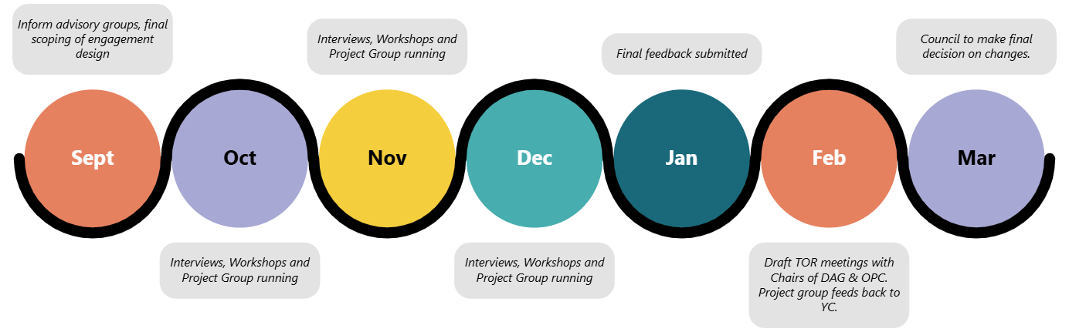
Work we have undertaken

Slide 6
What does this mean?
All three groups have co-designed with Council staff and agreed to a new and improved Terms of Reference – tailored to accommodate the specific needs of each group.
The three advisory groups are now aligned and can run in a more cohesive and efficient manner.

Slide 7
The Top Three Priorities
From our workshops and project groups we have determined three top priorities moving forward:
  Greater diversity and representation
  Robust selection process
  Improving how we work with our advisory groups

Slide 8
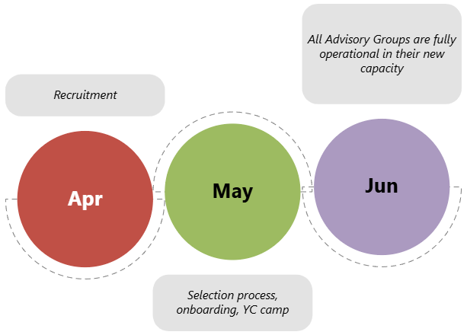
What's next?

