Slide 1
Submissions S160, S160.FS.3 & S221.FS.1
Tīhei mauri ora,
Ka mihi au ki ngā mana whenua o tēnei rohe
Ko Tararua ngā pae maunga e rū nei taku ngākau
Ko Waikanae te awa e mahea nei aku māharahara
Ka mihi ki ngā tohu o nehe rā, o Paraparaumu e noho nei au
Nō Amerika ki te Tonga ōku tīpuna
Ko Nancy Gomez ahau
Nō reira, tēnā koutou, tēnā koutou, tēnā tātou katoa
Our submission is in opposition to some proposed building heights, walkable catchments and KCDC application of Policy 3 of the National Policy Statement on Urban Development.
The Sec42A Councils officer report (Appendix B) stated that the Council does not accept any of the points raised in submission S160. However, we will focus on points S160.01 & S160.02 requesting the reduction of walkable catchments and reduction of building heights proposed by PC2.

Slide 2
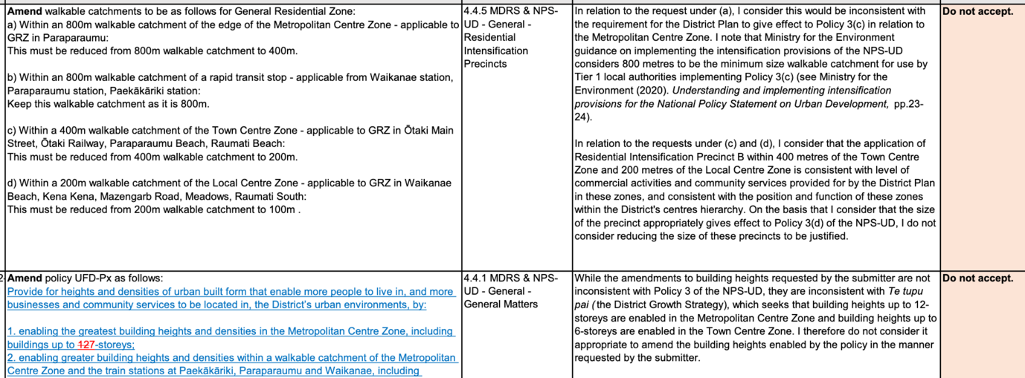

Slide 3
And our response to the Councils officer report is that we do not agree with their statement of not accepting points S160.01 & S160.02 because:
It is up to each local authority to determine the size of walkable catchments appropriate for local circumstances.
The MfE NPS-UD guidance document is not intended to be a step-by-step guide to
preparing plan changes to give effect to the NPS-UD intensification provisions. Plan changes and outcomes depend on the local context and local authorities will need to give effect to the intensification provisions in their local context (pp6).
For metropolitan zones edge, the 800-metre catchment mentioned in the guidance document was determined by assuming most people would be happy to walk 10 minutes to access services and amenities.
While the 800-metre catchment may be a good starting point, the draw of certain amenities will influence how far people are willing to walk to access them, and is likely to influence the size of a walkable catchment. While walkable catchments of 400 to 800 metres will be suitable for most tier 1 urban environments, it may be appropriate for larger tier 1 urban environments to consider greater distances in some situations. (pp23).
Therefore, reducing the walkable catchment from the edge of the metropolitan zone from 800m to 400m is in line with the guidance and is consistent with the requirement for the District Plan to give effect to Policy 3(c).

Slide 4
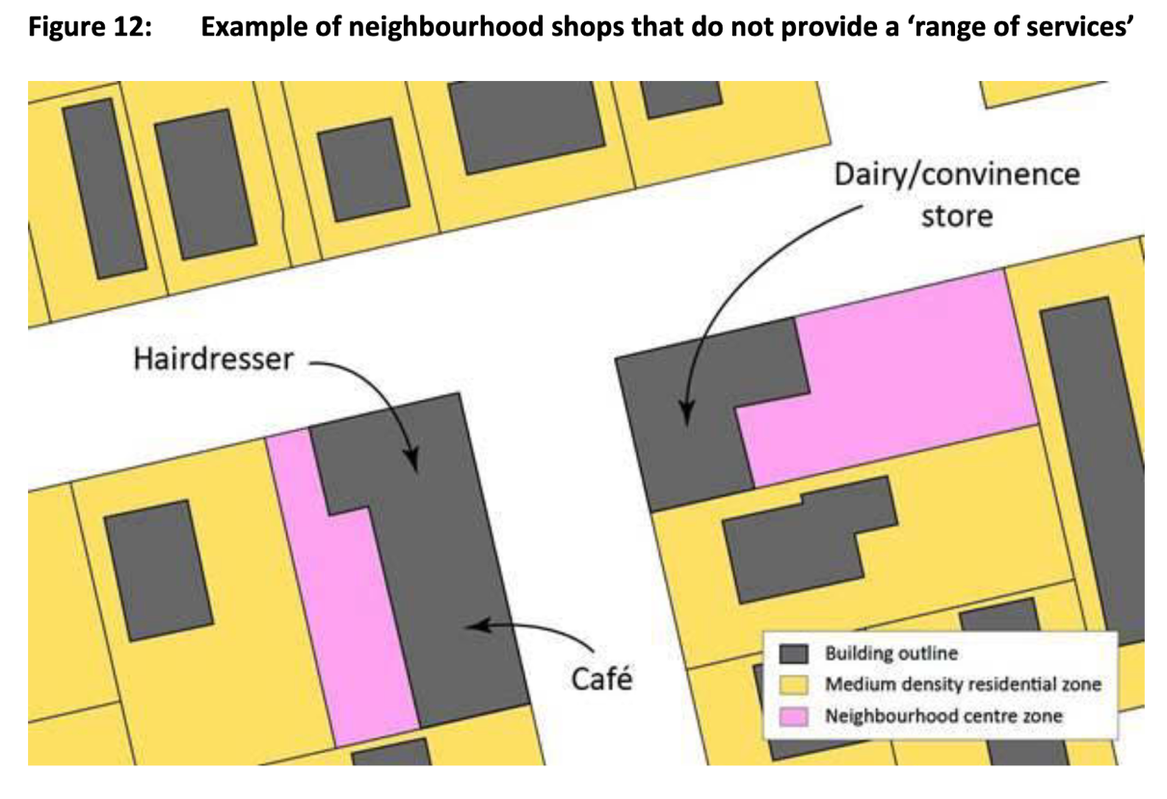
c) & d) The MfE NPS-UD guidance document advise local authorities to think of a variety of commercial and community services that serve the needs of the catchment when implementing Policy 3(d) for town centres and local centre. The guidance document on pp36 provides an example of neighbourhood shops that do not provide a variety of commercial and community services.
https://environment.govt.nz/assets/Publications/Files/Understanding-and-implementing-intensification-provisions-for-NPS-UD.pdf
As stated in submission S160, the level of commercial activities in some centres zones (such as Mazengarb, Meadows & Waikanae Beach) is too low to justify a 4-storey buildings within a 400m walkable catchment for Town centre and 200m walkable catchment for Local centre.
Given the existing urban built form of the District, and that the range of services is very limited in some centre zones, the reduction of the walkable catchment to 200m within the town centre and to 0m within local centre is guaranteed. However, if a walkable catchment must be had for local centre areas, then 100m walkable catchment could more be appropriate.

Slide 5
In relation to S160.02 requesting lower building heights to 7-storeys in the Metropolitan centre and 5-storeys in the Town centre, the Sec42A Councils officer report (Appendix B) states that “While the amendments to building heights requested by the submitter are not inconsistent with Policy 3 of the NPS-UD, they are inconsistent with Te tupu pai (the District Growth Strategy), which seeks that building heights up to 12- storeys are enabled in the Metropolitan Centre Zone and building heights up to 6-storeys are enabled in the Town Centre Zone”.
Having read the Te tupu pai (the District Growth Strategy) document, we are not clear how the proposed heights were derived. It would be good to see KCDC survey results and/or consultation feedback evidence that informed the proposed heights in Te tupu pai and subsequently in PC2. Regardless, the requested amended heights as set out in S160.02 are reasonable given the existing urban built form of the District and to give effect to Policy 3(b).

Slide 6
I would like to bring to the Panel’s attention a few points for consideration:
it is important that any proposed height is sensitive to its surrounding environment and that integrates well into the existing built form of the District being low density and predominately one storey dwellings . The character of the existing built form in areas of Kapiti is documented in the Urban Perspectives/Boffa Miskell Character Assessment updates dated June 2022.
https://www.kapiticoast.govt.nz/media/jnupdttn/pc2_s32_appendixi_characterassessmentwaikanaebeach.pdf https://www.kapiticoast.govt.nz/media/ox2jcsx5/pc2_s32_appendixh_characterassessmentraumatibeach.pdfhttps://www.kapiticoast.govt.nz/media/ovmj4oap/pc2_s32_appendixj_characterassessmentotakibeach.pdf
there is no explanation in the Sec32 report or Te tupu pai (the District Growth Strategy) about the choice of building heights in some areas of the District.
appropriate investigations of the level of commercial activity and community services in the centre zones must be undertaken by KCDC to establish whether the proposed building heights are commensurate with the level of commercial activity and community services in the centre zones of the District.

Slide 7
the very low level of commercial and community activities in local centres do not justify up to 4 storey buildings within a 200m walkable catchment and higher intensification of residential zone (GRZ) around the local centre zones should be removed. Alternatively, the reduction of the walkable catchment from 200m to 100m, and this walkable catchment applicable only to Kenakena and Raumati South local centres.
height up to 5-storeys within town centre zones and height of up to 4 storeys within a 200m walkable catchment from edge of the town centre, seems more appropriate to achieve efficient integration with the existing urban built form and sense of place of the surrounding residential area whilst given effect to policy 3(d).
Taking into consideration the existing urban built form of the District and that policy 3(b) requires building heights of at least 6 storeys, proposing up to 12 storeys high buildings within the Metropolitan Centre zone (i.e. Paraparaumu centre) doesn’t seem to be justifiable. Heights up to 7 storeys again is more appropriate to achieve efficient integration with the existing urban form and sense of place, whilst given effect to policy 3(b).

Slide 8
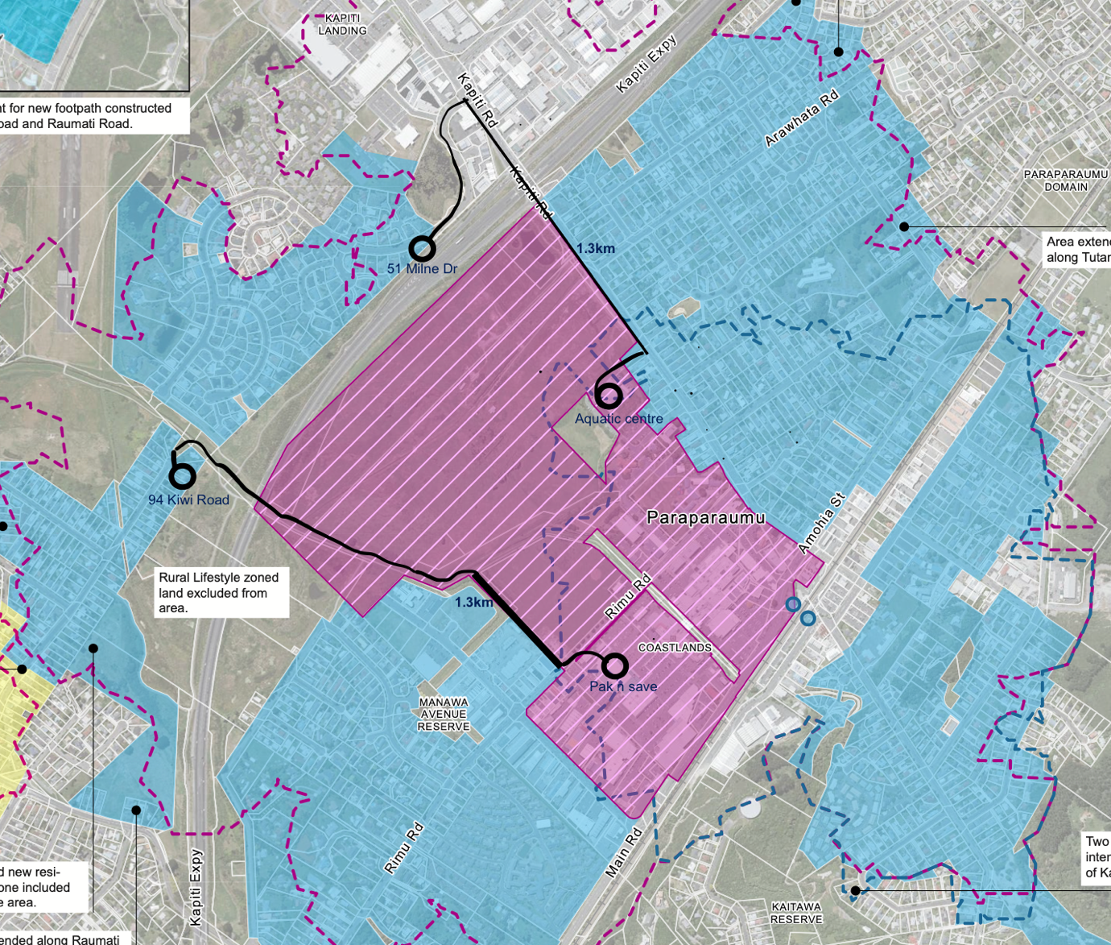
it is best to concentrate up to 6 storey high buildings closer to the Metropolitan zone and to avoid isolated high-rise developments on the other side of Kapiti Expressway that are not compatible and/or complementary with the existing urban built form around Milne Drive and around Kiwi Road. This concentration could be achieved by the reduction of the walkable catchment to 400m.

Slide 9
We would like to see a revised application of policy 3, the amendment of walkable catchments and building heights proposed by PC2 to the ones shown in the table, and such further or other consequential amendment as required to give effect to the table shown.
We oppose to all parts of Kainga Ora submission that attempts to go beyond the level of intensification proposed by PC2, and those parts of submission S122 should be rejected as recommended by the Sec42A Councils officer report (Appendix B).
Happy to provide any clarification or answer any questions by the Panel.

