Slide 1
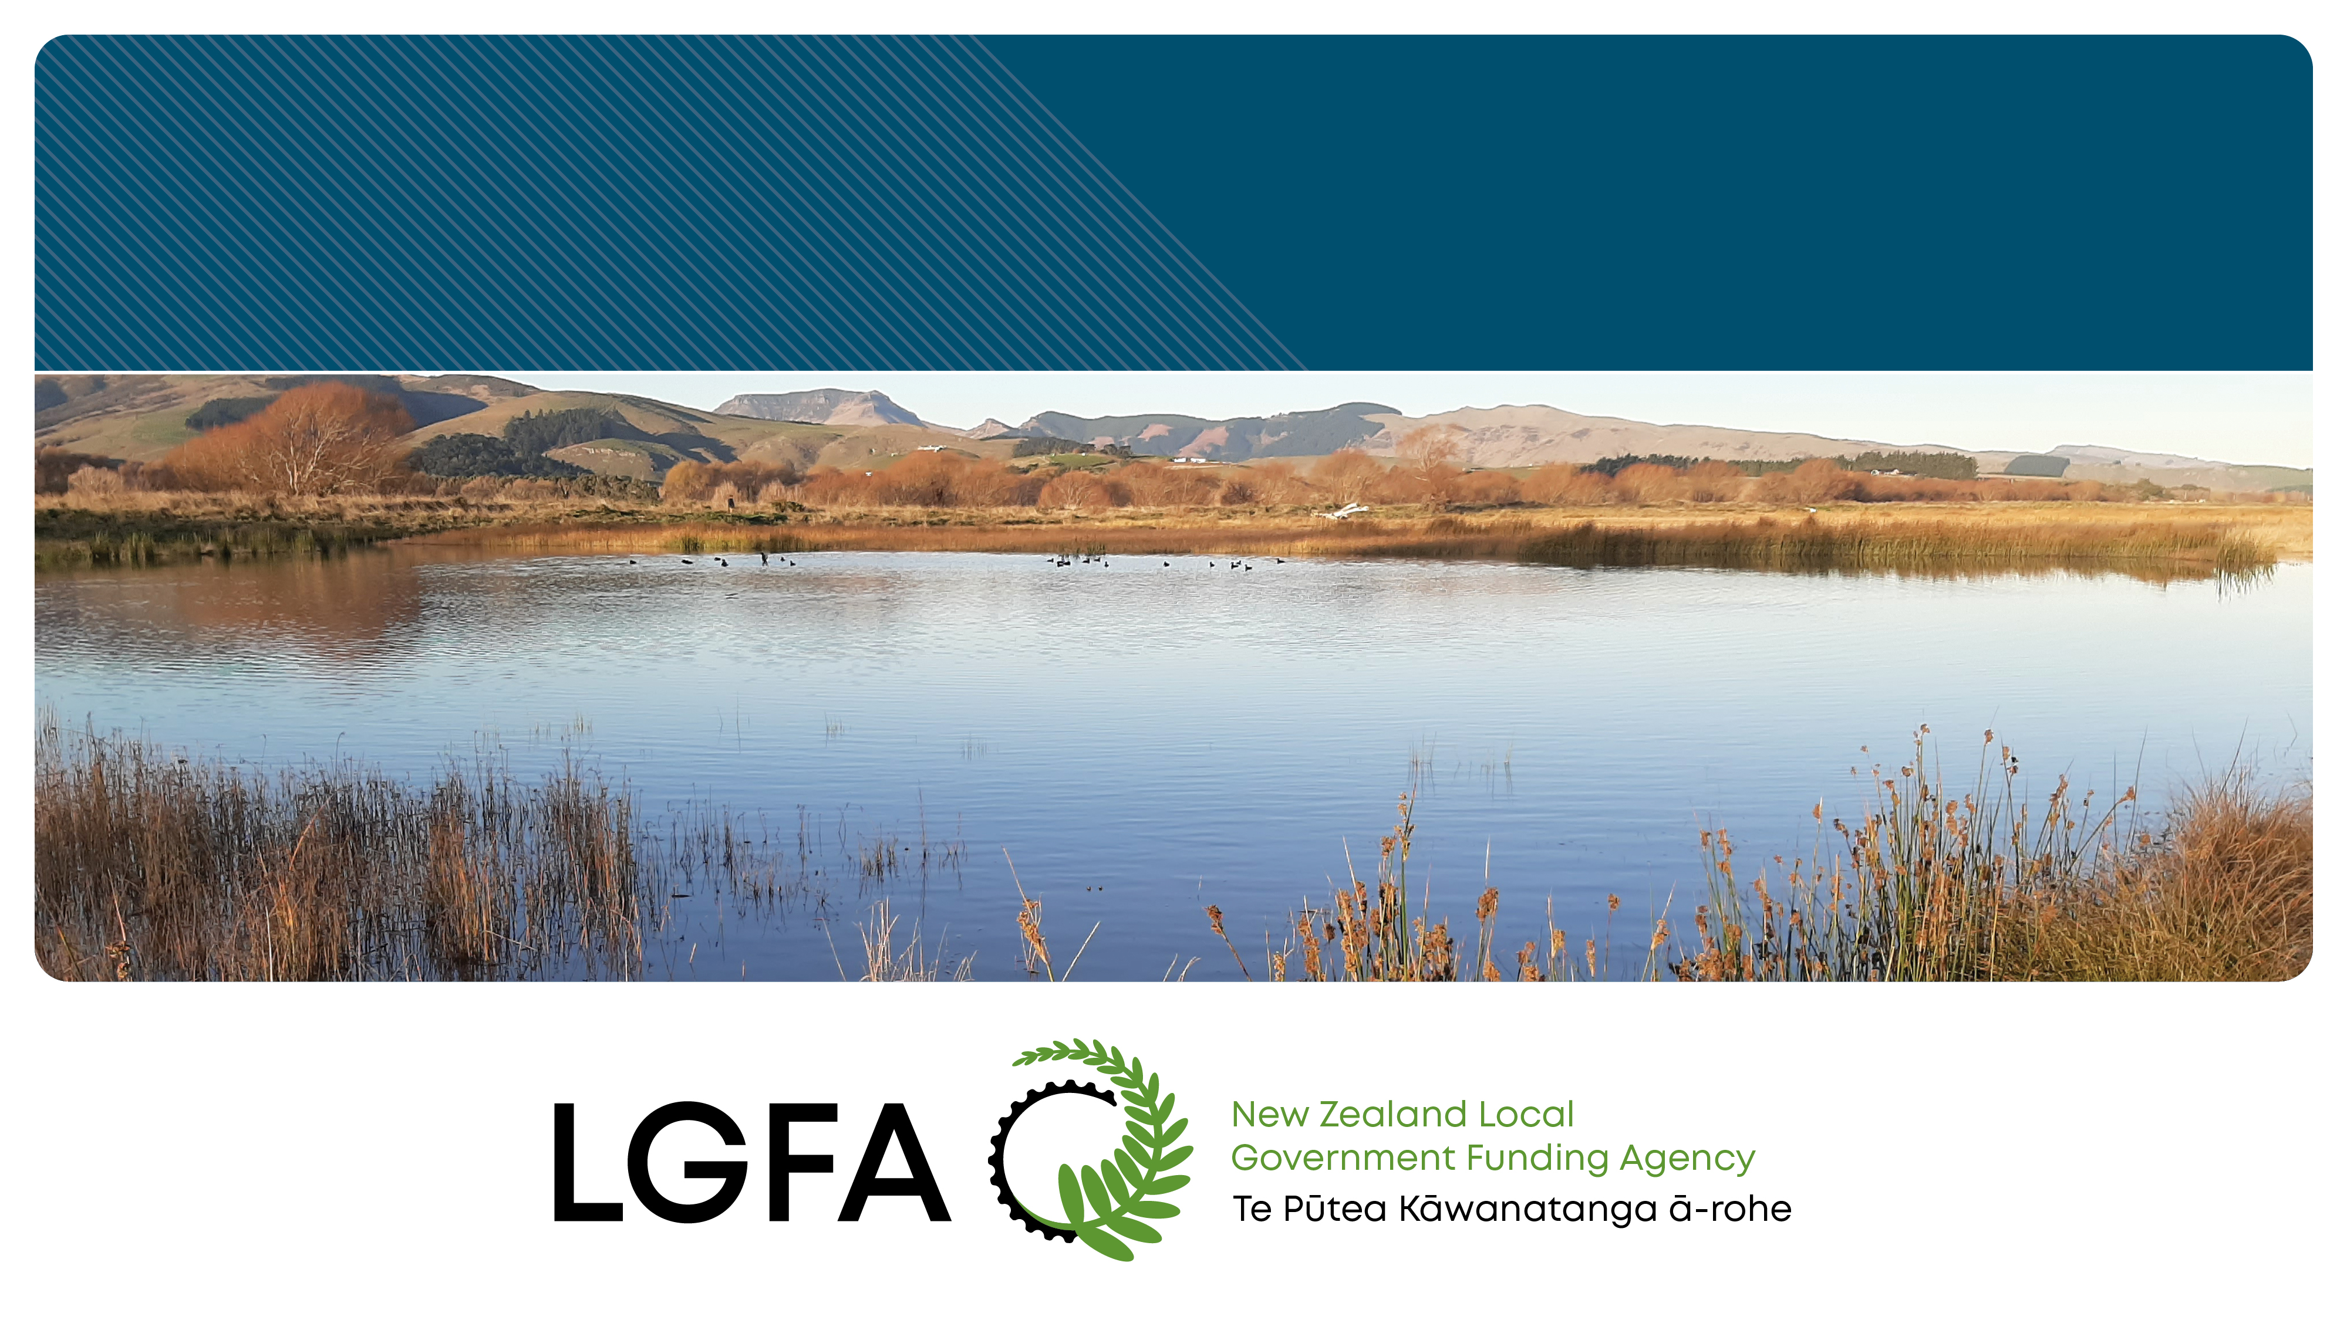
Kapiti District Council Update
14 November 2024

Slide 2

LGFA OVERVIEW
SHAREHOLDERS
NZ Government largest shareholder at 20%
30 councils hold 80% shareholding
Can only sell shares to NZ Government or councils
GUARANTORS
72 guarantors of LGFA
Guarantors comprise:
  All shareholders except the NZ Government
  Any non-shareholder who may borrow more than NZ$20 million
  Any council shareholder of a Council-Controlled Organisation (CCO) that is approved for borrowing by LGFA
Security granted by each of the guarantors is over their rates revenue
Guarantors cannot exit guarantee until
  Repaid all their, and any of its CCO’s, borrowings and
  After the longest outstanding LGFA bond to mature (currently 2037)
BORROWERS
77 member councils
6 CCOs³
Approximately 90% market share
Councils’ borrowing secured against rates revenue
Must meet LGFA financial covenants
GOVERNANCE
Board comprising 5 Independent and 1 Non-Independent Directors
NZD Bonds listed on NZX
Independent Trustee for NZD Bonds
Issue of securities under the Financial Markets Conduct Act 2013
Audited by Audit NZ
CAPITAL STRUCTURE
NZ$25 million paid in capital
NZ$20 million uncalled capital
NZ$89 million retained earnings
NZ$548 million Borrower Notes that can be converted to equity
Current capital ratio of 2.60% with policy of 2% minimum and target of 3%
LIQUIDITY
Up to NZ$1.5 billion liquidity facility from NZ Government¹
NZ$2.89 billion liquid assets portfolio²
NZ$945 million of Treasury Stock currently available for repo
As at 30 September 2024
¹ Maximum amount under the facility available for liquidity purposes. The actual amount available will be the amount of commitment set by LGFA up to NZ$1.5 billion.
² Excludes liquid assets held to support council standby facilities
³ Far North Holdings Limited acceded on 9 September bringing the number of CCOs to 6.
Source: LGFA

Slide 3

LGFA FINANCIAL PERFOMANCE – HISTORICAL AND FORECAST
Note: Based upon nominal values Source: LGFA Annual Reports and SOI
Forecast performance based upon assumptions outlined in LGFA SOI 2024-27 available at www.lgfa.co.nz/investors/annual-reports-and-statement-intent

Slide 4
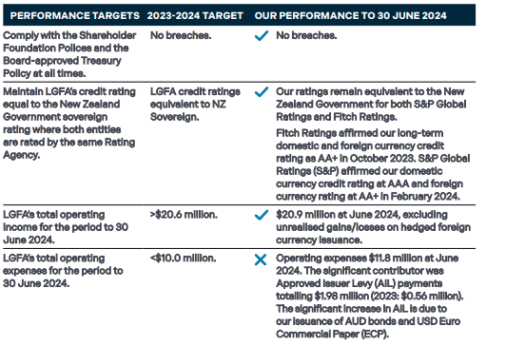
LGFA PERFORMANCE: 12 MONTHS TO JUNE 2024
Source: LGFA’s Annual Report to June 2024

Slide 5
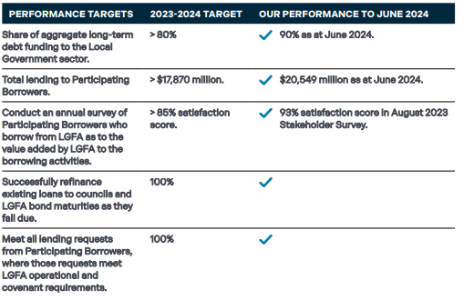
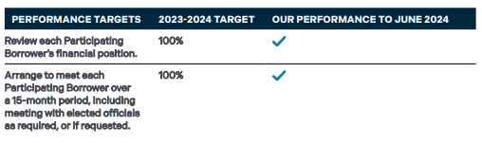
LGFA PERFORMANCE: 12 MONTHS TO JUNE 2024
Source: LGFA’s Annual Report to June 2024

Slide 6
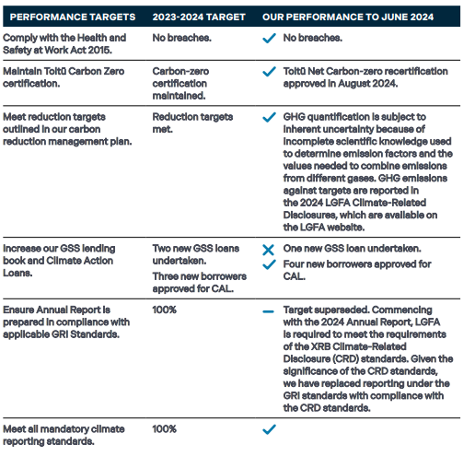
LGFA PERFORMANCE: 12 MONTHS TO JUNE 2024
Source: LGFA’s Annual Report to June 2024

Slide 7
LOCAL AUTHORITY GROSS DEBT
Council Gross debt (at parent level and Auckland Council at group level. Source: LGFA calculation from council annual reports.

Slide 8
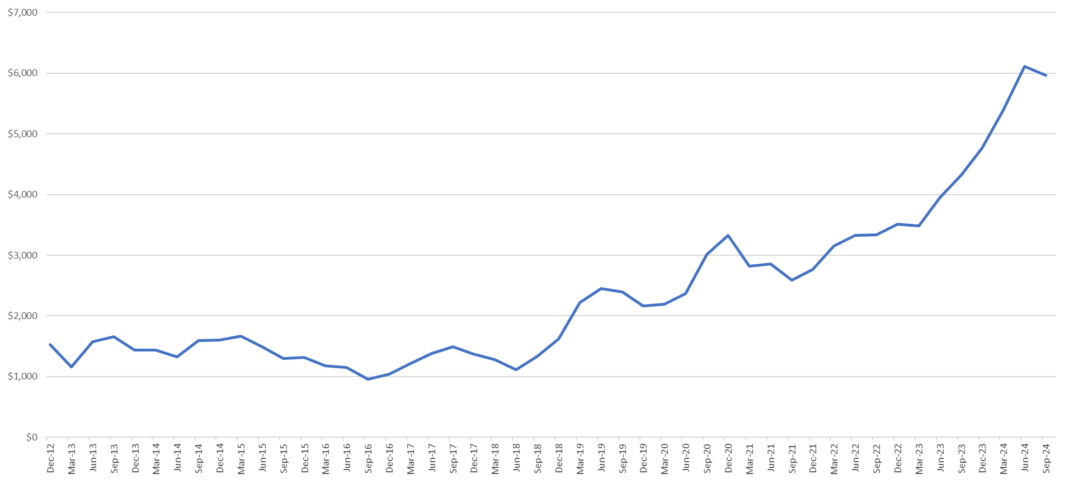
COUNCIL AND CCO BORROWING FROM LGFA INCREASING -
12 MONTH ROLLING BORROWING (NZ$ million)
Note: Includes new borrowing and refinancing

Slide 9
NEW ZEALAND COUNCILS EXTERNAL CREDIT RATINGS
39 councils in New Zealand have credit ratings and they all are members of LGFA.
Over the past year:
On 21 February 2024, S&P Global Ratings lowered the outlook on fifteen councils and two CCOs from stable to negative.
Six councils were already on negative outlook from S&P Global Ratings (Bay of Plenty Regional Council, Hamilton City Council, Hutt City Council, Kapiti Coast District Council, Marlborough District Council and Wellington City Council).
Far North District Council, Hawke’s Bay Regional Council, Clutha District Council, Hauraki District Council and Whakatane District Council received inaugural credit ratings from Fitch Ratings in 2024.
Since June 2024, Bay of Plenty Regional Council, Hamilton City Council, Horowhenua District Council, Hutt City Council, Porirua City Council, Upper Hutt City Council and Wellington City Council had their credit ratings downgraded.
Source: S&P Global Ratings, Fitch Ratings, Moody’s Investor Services, LGFA
As at 30 October 2024

Slide 10
CCO LENDING
LGFA Shareholder approved lending to CCOs and CCTOs at November 2019 AGM
Why?
  Waikato Water and possibility that other Water entities could be CCOs
  Dunedin City Council
  Reduce administration for councils if frequent and large amount of on-lending to CCOs (CCHL)
No additional risk to LGFA
  Shareholders must provide credit support through a guarantee or uncalled capital
  100% equity must be owned by local authorities / Crown
  Council shareholders in CCO must be guaranteeing members of LGFA
  LGFA board approval
  Bespoke financial covenants
  No other lender can have preferred treatment
Parent council approval required
Loan pricing the same as parent council
CCOs can access LGFA product suite
  Short term lending
  Long term lending
  Forward start lending
  Committed standby facilities
  Sustainable lending / Climate Action loans
Current CCO Members
Destination Westland Limited
Dunedin City Treasury Limited
Far North Holdings Limited
Infrastructure Holdings Limited
Invercargill City Holdings Limited
Whanganui District Council Holdings Limited

Slide 11
WATER SECTOR REFORMS – 8 AUGUST ANNOUNCMENT
Minister of Local Government and LGFA announced
  LGFA’s existing CCO lending framework will be extended to new water organisations that are CCOs and financially supported by their parent council or councils.
  Financially supported = guarantee or uncalled capital.
  Lend to both singled owned or multiply-owned water organisations, who are supported by the parent council(s).
  Leverage for water organisations up to a level equivalent to 500 percent of operating revenues, subject to water organisations meeting prudent credit criteria.
  Borrowing by water organisations will be treated as separate from borrowing by parent council or councils.
  Water organisations will have access to existing suite of financial products that are currently made available to councils and CCOs. These include green and sustainable loans and climate action loans, short and long-term loans and standby facilities.
  Councils will also retain the ability to borrow through LGFA should they choose to keep water services ‘in house’ rather than establish a water organisation.
  Financially independent water organisations will not meet the qualifying criteria.
  LGFA will work with Central government to review whether it can lend to water organisations on an unsupported basis.
Average term of council long term loans from LGFA is 3.94 years (April 2028) at 31 May 2024.
Council borrowing forecast and LGFA bond issuance forecast outlined in LGFA’s Statement of Intent published on 25 June 2024 based upon councils Long Term Plans but assumes no lending to Watercare.

Slide 12
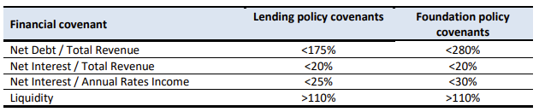
HIGH GROWTH COUNCILS – 8 AUGUST ANNOUNCMENT
LGFA to seek shareholder approval to change Foundation Policy covenants at November 2024 AGM
  Allow the LGFA Board to approve an increase Net Debt limit for a high growth council beyond the current ceiling of 280 percent of Total Revenue to a maximum level of 350%.
  Applied on a council-by-council basis and only apply to a small number of councils.
No changes contemplated to other covenants.
Likely to be available for Tier 1 and Tier 2 councils (for investment in growth infrastructure) as defined in the National Policy Statement on Urban Development
Any council approved for a bespoke limit would be placed on the Council Borrower Watch List.

