Slide 1
Council Workshop
Freedom Camping Policy 2012 Review
Focusing on:
Site analysis
Implementation
Tourism links

Slide 2
The need for a Bylaw
Benefits
Can be made under the FCA but must meet tests:
restrict or prohibit freedom camping at sites based on protection;
must be most appropriate/proportionate way of addressing problem; and
not inconsistent with the NZ Bill of Rights.
Must be reviewed initially after five years (then every 10 years) or in response to any Government changes to the FCA.
Council must have the capacity to resource compliance with the bylaw.
Impacts:
Can restrict or prohibit where freedom camping may occur in certified self-contained vehicles and permit not self-contained freedom camping.
Can specify the restrictions/conditions that relate to restricted, prohibited or permitted areas.
Opens up a wide range of offences to enforce.
Infringement offences specific to breach of bylaw.
Results in safe and practical sites that are not over-subscribed with minimal impact to local environment as compliance officers are empowered to manage.

Slide 3
Today’s workshop focuses on the site assessment and implementation/tourism links (3 tables – 10 minutes each)
TABLE - CAMPING RESTRICTIONS
Restricted sites & conditions
Roadside restrictions
Not self-contained camping
Tenting
TABLE - CAMPING PROHIBITIONS
Prohibited sites
Town centre prohibitions
TABLE - IMPLEMENTATION
MEASURES & TOURISM LINKS
Implementation tools and costs
Priorities for linking to tourism
Policy vs Bylaw –
our proposed approach is to proceed with a Bylaw only
1
Minimising through implementation –
further discussion today on tools and costs
Compliance & enforcement
2
Freedom camping sites
Impacts
3
Site assessment criteria
and analysis –
today’s focus on camping restrictions, conditions, and prohibitions
Tourism
Opportunities to explore – further discussion today on priorities to link tourism with camping

Slide 4
Site assessment criteria & analysis
Consultants assessed appropriateness of Council land for freedom camping.
Includes council reserves to inform reserve management planning process.
Internal project team has undertaken additional assessment of sites.
Iwi engagement through iwi partnerships team.
Freedom Camping Act “criteria” to restrict/prohibit:
Protect the area
Protect access to area
Protect health & safety
of people visiting area
2) Proximity to amenities, recreational opportunities (CWB), tourist attractions and eateries; visual appeal; natural surroundings etc.
3) Iwi values including proximity to waahi tapu.

Slide 5
Key shifts in the proposed approach to freedom camping
Self-contained freedom camping at any site within 200m
3) Iwi values
Under Policy, freedom camping is not permitted in any public place except for “approved” sites (in self-contained vehicles)
…self-contained freedom camping is permitted anywhere under the Freedom Camping Act 2011
Moving from “approved” sites by Policy (not enforceable) to...
…using a Bylaw to prescribe restrictions and conditions or prohibitions to protect areas (enforceable)
Current nine “designated sites” with 24 allocated spaces to…
…proposed 11 “restricted sites” with 44 allocated spaces (includes tenting only site)
2) Amenity value; proximity to recreational opportunities (CWB), tourist attractions and eateries etc.; visual appeal; natural surroundings/ interplay of flora & fauna etc.
Three of current “approved sites” (in Paraparaumu, Waikanae and Ōtaki) no longer available for camping …
…replaced with five additional “restricted sites” (including one for tenting only) across the district
Current maximum stay of 24 hours at any one site (and unlimited no. of stays across district) to…
…maximum stay of 48 hours at any one site across district in a 4-week period (i.e. can stay 48 hours at each site in that period)

Slide 6
Site restrictions and prohibitions
Freedom camping is proposed to be prohibited across town centres and over 30 other sites.
11 restricted sites are proposed.
8 of these are not in reserves and will form part of proposed bylaw.
PROPOSED RESTRICTIONS
Maximum stay of 48 hours at any one site across district in a 4-week period (i.e. can stay 48 hours at each site in that period)
Most sites restricted to maximum vehicle length of 8m (2 sites have 10m)
3 restricted sites are in reserves that have no Reserve Management Plan (RMP) or would be in contradiction to it.
We will seek a Council resolution to allow camping until the RMP process aligns.
3 of the restricted sites with supporting facilities are proposed to permit not self-contained freedom camping.
1 site on the Te Araroa Trail is proposed for tenting only.
Self-contained or not self-contained vehicles dependent on restrictions specific to site

Slide 7
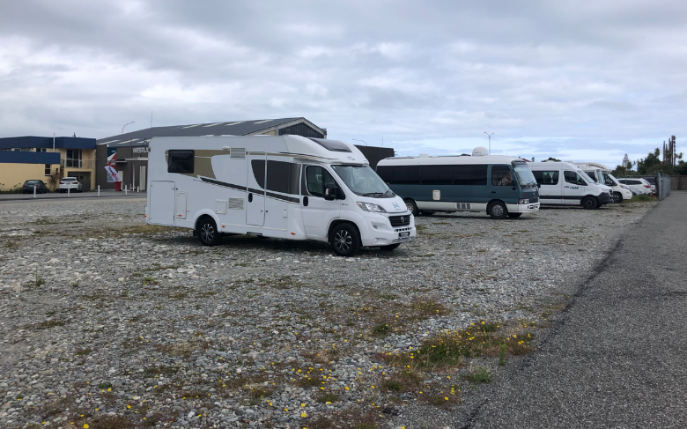
Roadside and town centre restrictions and prohibitions
Under the Freedom Camping Act Self-contained freedom camping is permitted at any location within 200m of a formed road or beach unless restricted or prohibited.
We propose to prohibit freedom camping in “mixed use”, “metropolitan centre”, “town centre” and “local centre” zones under the Operative District Plan.
PROPOSED RESTRICTIONS
Maximum stay of 48 hours at any one site across district in a 4-week period (i.e. can stay 48 hours at each site in that period)
No maximum vehicle length if can park safely
Freedom camping is prohibited on roads where the speed limit is 80km/hour or greater unless you can park safely on the road margin clear of the formed carriageway.
Self-contained freedom camping on residential streets where the speed limit is less than 80km/ hour is permitted if you can park safely.

Slide 8
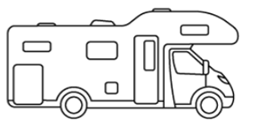
Implementation
Basic implementation tools for safe, practical sites
Appropriately sized marked out vehicle spaces to match motorhome size limits
Adequate turning space for safe vehicle manoeuvrability.
Clear signage on where to park with links to other useful information.
Implementation costs
Based on above basic tools, average cost of $1k-$1.5k per restricted site.
The work of compliance officers is covered by existing regulatory budget.
Campervans & Motorhomes come in a range of lengths from say 4.7m for a van to a maximum permitted length in NZ of 12.6m for a fully integrated vehicle. Our proposed mainly 8m long parking space size restrictions are based on a typical self-contained motorhome like the one below which are 6 - 7.6m long.
Competing uses
No differentiation between freedom camping provisions for
locals vs non-locals so as to enable equal opportunities.
A permit system could be costly / difficult to administer.
Exceptions to restrictions for e.g. overnight fishing.
Other implementation measures
Potential for in-house booking system if pressures remain.
Supporting infrastructure e.g. upgraded dump station.

Slide 9
Tourism link priorities
Align with Kāpiti Destination Management Plan
e.g. through enabling a longer stay per site to encourage visitors to stay.
Paying to camp does not meet the definition of “freedom camping” under the Act but paid options support freedom camping by providing a range of opportunities in the district for camping visitors.
Promotion of sites for camping
e.g. expansion of new Kāpiti tourism website – include freedom camping
site maps and reference other camping opportunities in district i.e.
commercial and DOC campgrounds; update camping apps.
Links to information for campers at site locations
e.g. QR code on sign to link with info on tourist attractions including website and maps showing nearby utilities such as dump stations, public toilets, pools etc.
FUTURE CONSIDERATIONS
NZMCA campground partnership
User pays amenities by 3rd party provider
Seek NZMCA “Motor Home Friendly
Town” status
To encourage NZMCA members to stay in Kāpiti.

Slide 10
Benefits and impacts of new approach
BENEFITS
Self-contained freedom camping at any site within 200m
IMPACTS
3) Iwi values
Ability to enforce compliance with site restrictions/conditions and prohibitions through bylaw
Expectation by community to manage impacts by using compliance and enforcement tools available
Longer stays (48 hours) encourage camping visitors to spend whilst in district on attractions and eateries
Less opportunity for prime beach locations to be used by campers passing through due to extension on 24-hour limit
An increase in sites creating and an overall increase in camping vehicle parks that are safe and practical
2) Amenity value; proximity to recreational opportunities (CWB), tourist attractions and eateries etc.; visual appeal; natural surroundings/ interplay of flora & fauna etc.
Spaces are designed to fit a motorhome size of up to 8m+ meaning standard vehicle car park numbers are reduced
Restricted sites spread right across the district including new locations
Three current designated sites in Paraparaumu, Waikanae and Ōtaki are no longer available for camping

Slide 11
Next steps and timeline
Stage 1:
Early engagement, evidence gathering & analysis; report back on issues
March – August 2024
Stage 2:
Bylaw analysis; developing draft options for consultation
September 2024 – January 2025
Stage 3:
Consultation & hearings
February – March 2025
Stage 4:
Proposed changes for adoption
Mid-2025
Stage 5:
Implementation
2025/2026
Approval to consult scheduled for February 2025

Slide 12
Questions for discussion at tables
Not seeking decision today but proposed sites will form part of draft bylaw, so:
Do you agree with the restricted sites and conditions?
Do you agree with the prohibited sites?
Do you agree with the general provisions around town centre prohibitions and roadside restrictions?
Do you have any comments around proposed implementation?
Do you have any feedback on our priorities for tourism links?

