Slide 1
Renaming of Old State Highway One
Te Whakaminenga o Kāpiti
3 December 2024

Slide 2
Background
2017 MacKays to Peka Peka (M2PP) Expressway opened
Revocation Old SH1 was completed April 2024
Revocation is the formal process of transferring a state highway designation to a local (Council) road designation
Changes to addresses on Old SH1 could not be made until revocation had been completed

Slide 3
Once a state highway has been revoked the name state
highway should not be used for address purposes
In 2015 Old SH1 renaming process commenced, involving extensive discussion and consultation
This included with Councillors, Community Boards, Te Whakaminenga o Kāpiti (TWoK), community and government agencies

Slide 4
Key Timelines and Actions
2016 elected members briefed, including on the seven- section approach and retaining Amohia and Rimutaka Street names
TWoK briefed and asked for a working party, comprising representatives from the district’s three iwi and a local historian, to research names for Old SH1 that represent the district’s cultural and social history
Council confirmed a Council led process, with a seven- section approach, recognising the role of community boards to consult with their communities

Slide 5
Working party reported back with their recommended names
2017 the community boards and TWoK updated
Council invited the community to have their say on names for the seven sections, including names proposed by the working party
2017 the renaming process put on hold
2021 SH1 from Paekākāriki to MacKays Crossing (section one) not revoked by WK and renamed SH59
2022 Peka Peka to Otaki Expressway (PP2O) opened

Slide 6
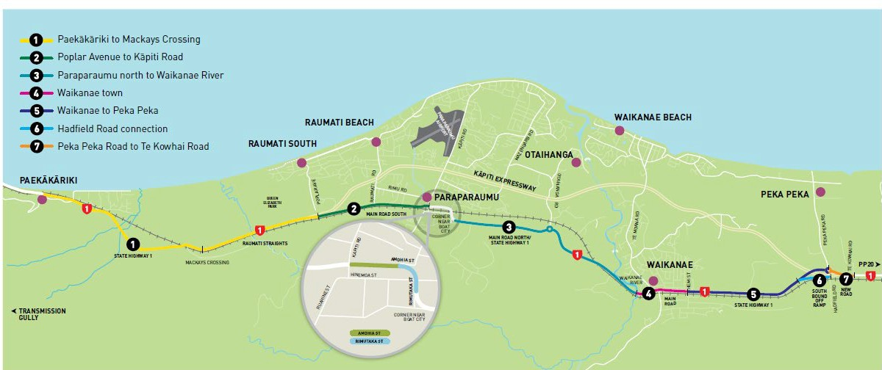
The 2016 Seven Section Renaming Approach Adopted by Council

Slide 7
The Seven Section Approach
The seven sections typically reflect the current demarcations of Old SH1 such as Main Rd South, Main Rd North, Main Rd
Seven sections will largely allow current house numbering to be retained
The renaming process is required to consider guidance from LINZ, NZ/Aus Standards
Giving Old SH1 one continuous name would mean renumbering and renaming over 1,000 properties

Slide 8
PP20 Impacts on Naming Section Seven
Planning for revocation of the PP2O section of Old SH1 is underway
Section seven (Peka Peka Rd to Te Kowhai Rd) is now part of a longer, continuous section of Old SH1 to Otaki. One road name may be appropriate from Peka Peka roundabout to the Otaki River
Propose that renaming section seven is undertaken as part of the future Old SH1 Peka Peka to Otaki renaming process

Slide 9
Working Party Report
The working party agreed on one name for each of the seven sections
Their report provides background about each name’s historical and cultural significance and the relationship with the local area
The names identified are:

Slide 10
Section | Location | Proposed Name
Section One | Paekākāriki to MacKay’s. Now SH59 | Hurumutu
Section Two | Poplar Avenue to Kāpiti Rd | Hokowhitu
Section Three | Paraparaumu North to Waikanae River | Rauoterangi
Section Four | Waikanae Town | Kākākura
Section Five | Waikanae to Peka Peka | Unaiki
Section Six | Hadfield Rd connection | Katu
Section Seven | Peka Peka Rd to Te Kowhai Rd. Proposed to be undertaken as part of the PP20 Old SH1 renaming process | Matene Te Whiwhi

Slide 11
2016 Community Board Recommendations
Community Board | Section | Recommendation
Paekākāriki Community Board | Section 1: Paekākāriki to Mackays, Now SH 59 renaming not required | Hurumutu Rd
Paraparaumu - Raumati Community Board | Section 2: Poplar Ave to Kāpiti Rd | Main Rd South
 | Section 3: Paraparaumu north to Waikanae River | Main Rd North
Waikanae Community Board | Section 4: Waikanae town | Main Rd
 | Section 5: Waikanae to Peka Peka | Main Rd
 | Section 6: Hadfield Road connection | Horrobin Rd
 | Section 7: Peka Peka Rd to Te Kowhai Rd. Recommend as part of PP2O Old SH1 renaming process | Matene Te Whiwhi Rd
Note: Ōtaki Com
munity Board declined the opportunity to provide a recomm
endation

Slide 12
Renaming Old SH1 is Complex
227 (2016 total) properties along Old SH1 would be affected by any road name and/or numbering change
Revoking Old SH1 means it can no longer be called a state highway. Sections three, five and seven have SH1 addressees
Sections of Old SH1 have different names including Main Rd, Main Rd South, Main Rd North, Amohia St and Rimutaka St
Seven sections largely reflects the existing numbering and mostly enables residents to keep the same street numbers

Slide 13
Summary of Submissions Received
1,077 submissions
61 did not suggest a name and gave general comments
68 submitters were identified as living on Old SH1
105 asked for the current names to be retained
286 were in favour of one name for old SH1
540 identified names for sections of Old SH1
58 were in support working party names

Slide 14
Public Submissions on Names
 | Section Name | Highest Support | 2nd Highest Support | 3rd Highest Support
1 | Paekākāriki to Mackays | Renamed SH59 by WK
2 | Poplar Ave to Kāpiti Rd | Main Rd South (51 submissions) | Hokowhitu (7) | Main Rd Raumati (5)
3 | Paraparaumu north to Waikanae River | Southwards family (29) Comprising Southward Dr (15) Lady Vera Parkway (6) Len Southward Dr (5) Sir Len Dr (3) | Main Rd North (22) | Tini Rakau (21)
4 | Waikanae Town | Main Rd (36) | Kākākura (9) | Old Main Rd (8)
5 | Waikanae to Peka Peka | Main Rd Waikanae (9) | Unaiki (8) | Main Rd North (6)
6 | Hadfield Rd Connection | Katu (10) | Horrobin (8) | Hadfield Link Rd / Main Rd Peka Peka (5)
7 | Peka Peka Rd- Te Kowhai Rd | Matene Te Whiwhi (9). Undertake under PP2O Old SH1 renaming | Main Rd Peka Peka (5) | Main Rd North (4)

Slide 15
Preferred Section Names from Submissions
Section 1: Renamed SH59, no action required
Section 2: Main Rd South(Main Rd South/North are not in accordance with the Standard
Section 3: Main Rd North.)
Section 4: Main Rd. (Already a Main St in Otaki)
Section 5: Main Rd. (Extend Main Rd to also cover section 5. This involves renumbering 21 plus properties)
Section 6: Katu Rd
Section 7: Matene Te Whiwhi. (Undertake as part of future PP2O Old SH1 renaming)

Slide 16
Funding for Renaming
Renaming funding of $150K was provided by WK and used for the 2016 process
No further funding has been allocated
Funding may be required for:
Redirection of mail
Sign writing of business premises or vehicles etc
Installation of new road signs
Staff resources and communication material
Other costs or items of compensation
It is expected that costs will range from $50-150K+, depending on process followed

Slide 17
Next Steps
A briefing on this subject with TWoK
Confirm any changes with LINZ to ensure it fits with their requirements
A paper to Council in the new year including:
Recommending proposed new names for the five sections of Old SH1
Recommending that naming section seven (Peka Peka Rd to Te Kowhai Rd) is undertaken under the future PP20 Old SH1 renaming process
Noting that section one (Paekākāriki to MacKays) no longer required

Slide 18
Proposed Names
 | Section Name | Working Party | Submissions | Community Board
1 | Paekākāriki to Mackays | Renamed SH59 | Renamed SH59 | Renamed SH59
2 | Poplar Ave to Kāpiti Rd | Hokowhitu Rd | Main Rd South | Main Rd South
3 | Paraparaumu north to Waikanae River | Rauoterangi Rd | Southwards family comprising Southward Dr, Lady Vera Parkway, Len Southward Dr, Sir Len Dr | Main Rd North
4 | Waikanae Town | Kākākura Rd | Main Rd | Main Rd
5 | Waikanae to Peka Peka | Unaiki Rd | Main Rd Waikanae | Main Rd
6 | Hadfield Rd Connection | Katu Rd | Katu Rd | Horrobin Rd
7 | Peka Peka Rd-Te Kowhai Rd | Matene Te Whiwhi Rd | Matene Te Whiwhi Rd | Matene Te Whiwhi Rd

Slide 19
Questions

