Slide 1

Otaihanga Zero Waste Hub Phase 2
Council Briefing
15 April 2025

Slide 2
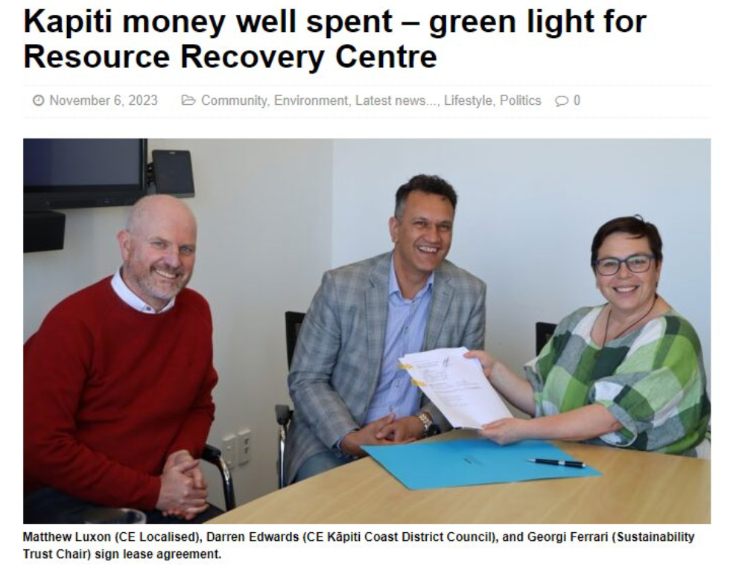
Seed funding and lease agreement

Slide 3
Phase 1: Complete
Physical works on site
Established legal entity
Formed team
Reusable building and construction materials
Selected recycling initiatives
Community compost corner
Various lease holders joined site

Slide 4
Achievements
Total Diverted: 95t total, including 57t timber
15 local and regional businesses engaging on commercial waste reduction.
Developing relationships with the 4 major waste companies in Kapiti.
Currently employing 3.2 FTE staff with planned increase.
One employee has been hired in conjunction with MSD Flexi-wage program.
Contributes to multiple objectives & targets in the WMMP (2023-2029).

Slide 5
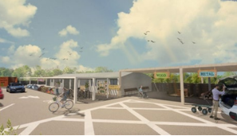
Phase 2: Tip Shop Reuse Shop
New building currently being constructed on the Zero Waste Hub Site
Operations of the current Tip Shop will cease from 30 June 2025
A new Reuse Shop will open at Otaihanga Zero Waste later this year

Slide 6
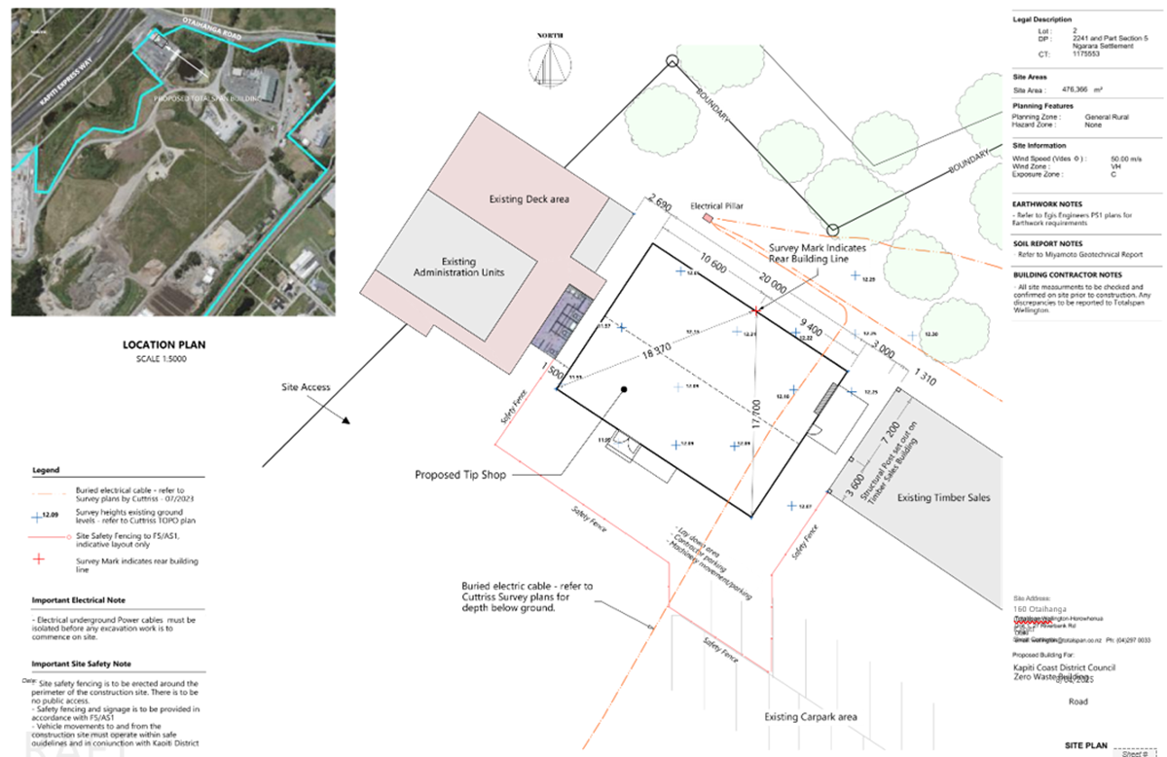
Reuse Shop
Total cost: $345,175
100% funded from waste levy
20mx15m = 300m2 of shop/work space
Estimated completion August 2025

Slide 7
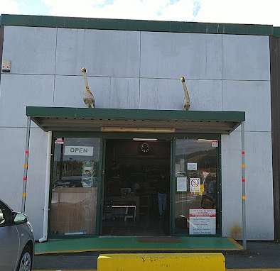
Current building
Difficult and expensive to relocate.
Congested traffic flows.
Returned to Council from Waste Management on 30 June.
Could be used for additional resource recovery operations, extra storage of bulk materials, or education.

Slide 8
Tip Shop closure
Estimated date: | Milestone:
16 April | Public comms start
18 May | Tip Shop goods acceptance stops
Late-June | Tip Shop Open days
30 June | Tip Shop closes
Late July | Construction of new shed complete
August | Reuse Shop opens

Slide 9
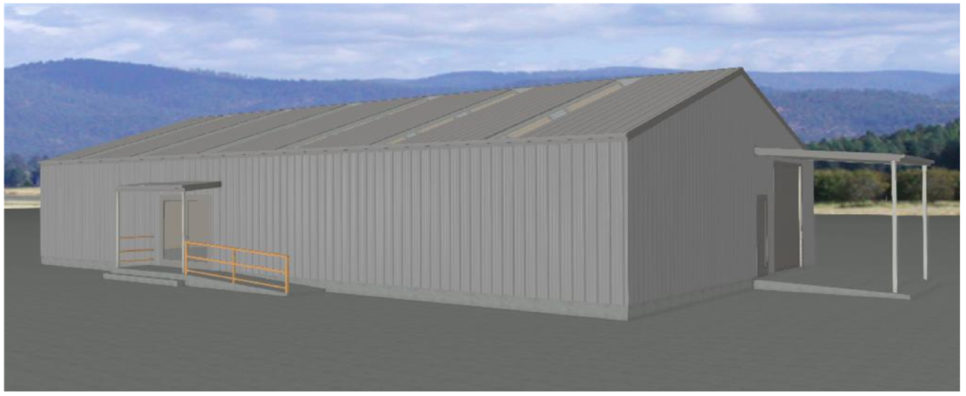
New Reuse Shop

Slide 10
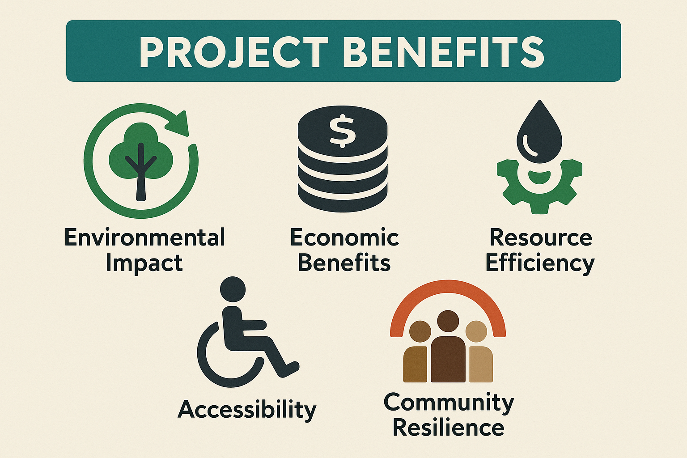
Key benefits

Slide 11
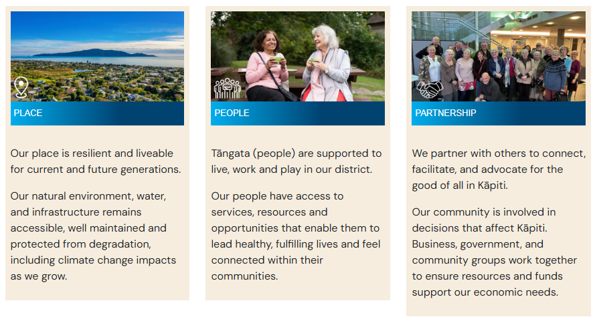
Key benefits

Slide 12

Partnership agreement
Sets out how Council and OZWH will work together and how they will support delivery of our WMMP (2023-2029) .
States OZWH goal to “provide best practice resource recovery services to the people of Kāpiti in alignment with the waste hierarchy and aim “to support other community initiatives.”

Slide 13
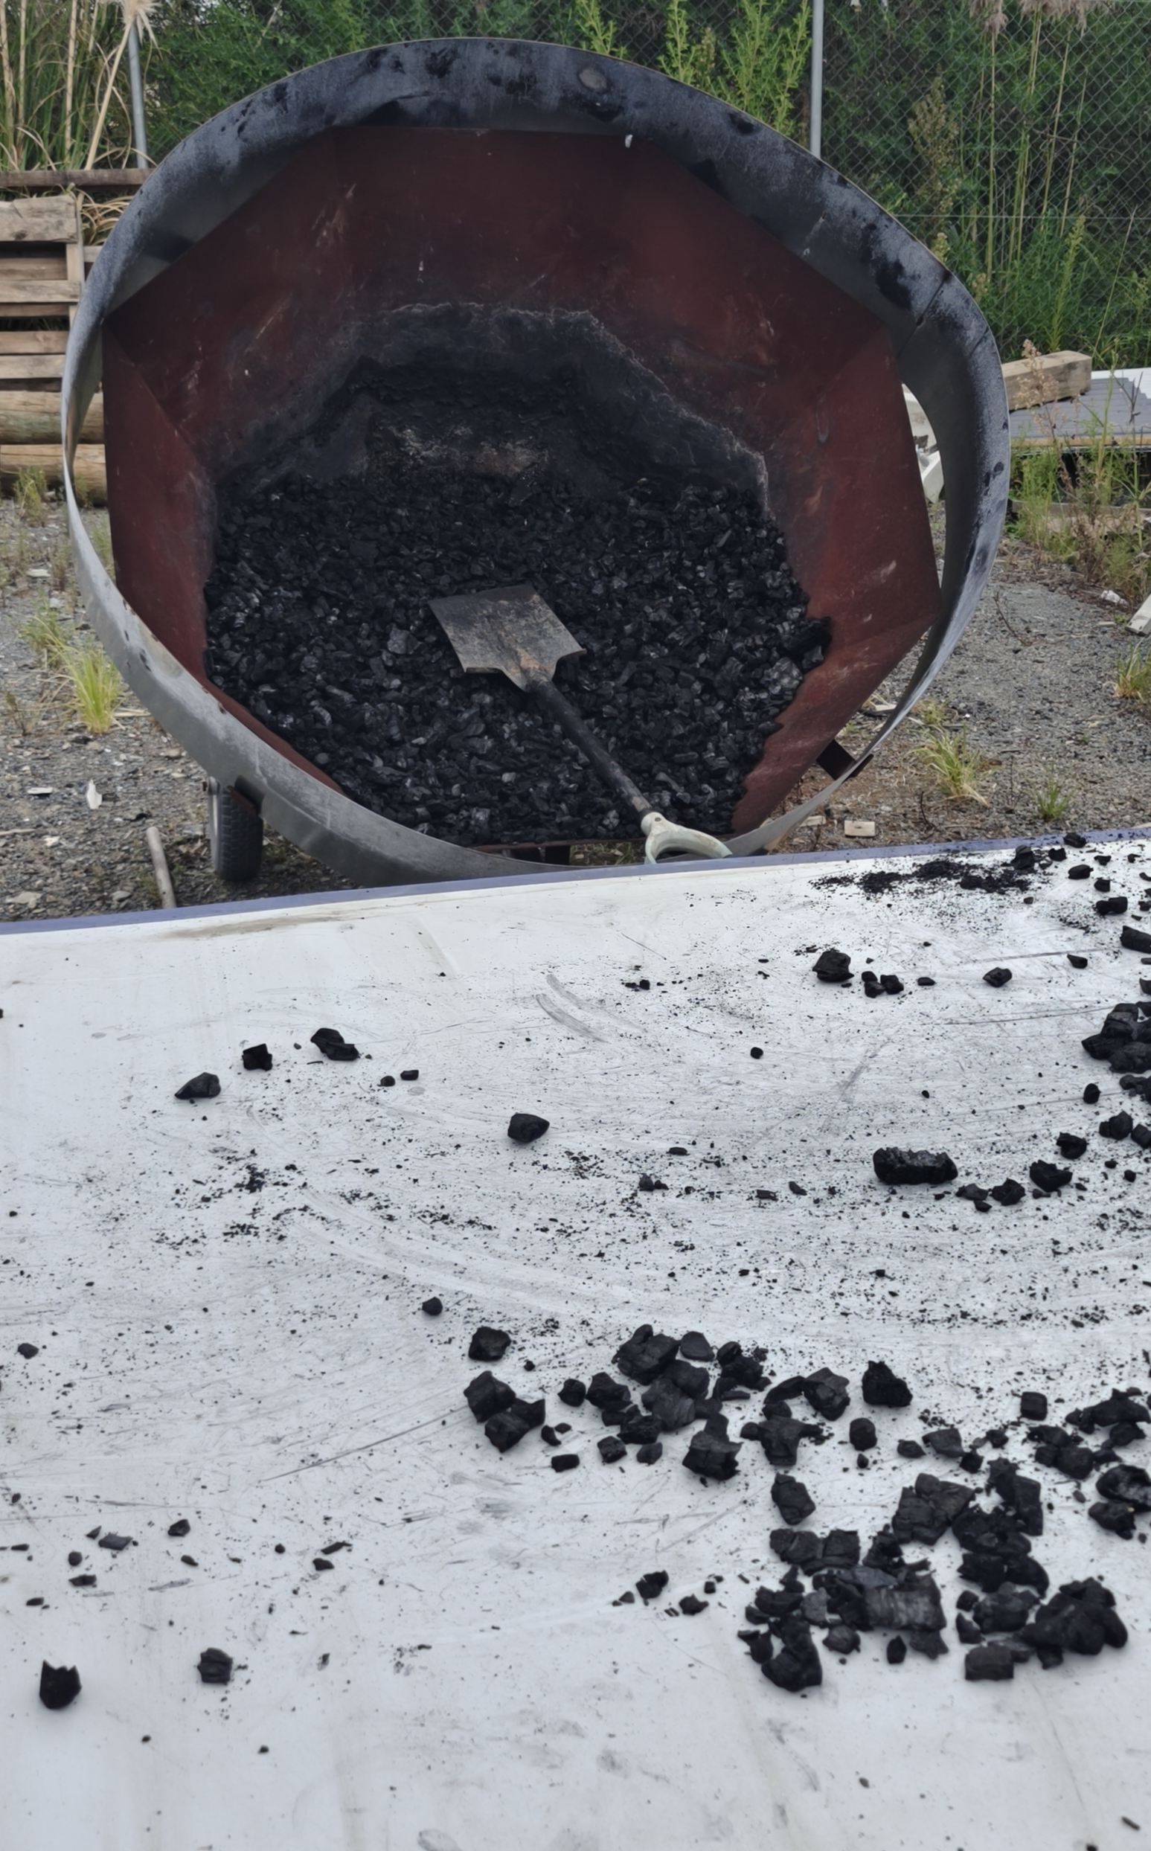
Opportunities: Biochar
  OZWH is looking to undertake proof of concept, consenting, and establishment of an operation to use H1.2 timber for biochar.
  Significant gap in timber diversion options in the lower North Island.
  Significant proportion of waste to landfill is timber.
  Potential for Kāpiti to show innovation and leadership in this space.

Slide 14
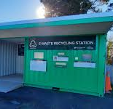
Opportunities: E Waste
  OZWH is currently developing a local e-waste solution with a focus on reuse.
  Currently working with other local groups to recycle electronic waste.
  Aim to expand and offer a Kāpiti-wide service for residents and businesses so that reuse and recycling of electronic items can be done locally.

Slide 15
Opportunities: Waste Min Plans
  OZWH could support processing waste minimisation plans for construction above a certain threshold, to progress implementation of the Solid Waste Bylaw.
  Threshold will be set this year, with implementation details tbd.
  OZWH could provide feedback on the plans as required by consent conditions, on site advice, and collection and processing/reuse of waste material from building sites.

Slide 16


