Slide 1
Te Ara Whetū Update
Council Briefing Tuesday 10 June 2025

Slide 2
PROJECT programme
1
2
3
4
5
Studio Pacific engaged
Design brief
Building investigation
Demolition & decontamination
Concept design
February 2024
February to April 2024
March to April 2024
April to June 2024
May to September 2024
9
8
7
6
Procurement of main contractor
Resource consent lodged
Preliminary design
Community engagement
Early 2025
March 2025
October to December 2024
September 2024
10
11
12
13
14
Developed design
Detailed design
Building consent
Construction
Opening
December 2024 to April 2025
April to August 2025
September 2025
July 2025 to late 2026
Late 2026
Notes:
Red Diamond = negotiate contract price with main contractor
We will be coming back to you once the Detailed Design is developed to a point where we can agree a price with the construction contractor.
We expect to seek this approval at the July or August Council Meeting.
Checked with Democracy Services and the contract can still go up to Council to approve during the pre-election period – we just need to make sure Sean and Darren are aware of this in advance…..

Slide 3
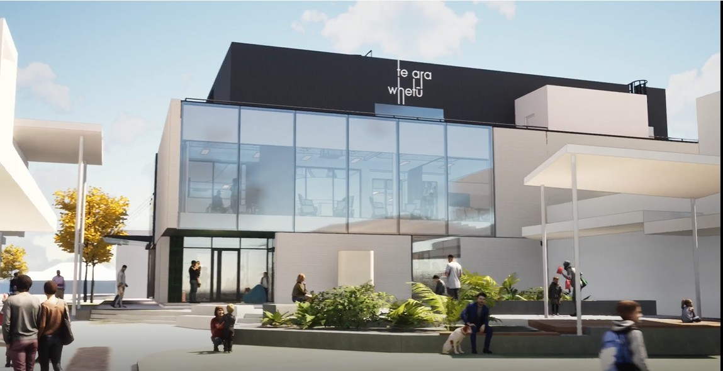
Developed Design fly-through
Notes:
The Developed Design phase:
Further progressed a structural restrengthening and refurbishment strategy
Refined the material palette for both the interior spaces and external envelope
Play flythrough off USB Stick

Slide 4
Design collaboration
Council staff and the design team have run workshops with Council teams, e.g. Libraries, Property, Customer and Community and IT to sense check the design
Barnes Beagley Doherr and Naylor Love are collaborating to help us understand costs and identify opportunities to ensure we stay within budget
Naylor Love have provided early input on key trades to ensure accuracy of the pricing estimates

Slide 5
Site compound and crane 3D Model Link
Notes:
Naylor Love proposes locating the site compound at the back of 15 Mahara Place as shown
This will require the use of 6-8 existing carparks for the duration of the project
We will minimise the impact trade vehicles on local businesses during the construction period by ensuring they are parked away from public car parks for the shops
This is our preferred approach because it will be the least impactful for construction. We will provide early notification and consistent messaging to local businesses and the public
Naylor Love are developing multiple crane plans to understand cost vs impact for heavy works
One option is to use a 90-tonne crane within the hoarded construction site at the east end of the site as shown in the image
This option would eliminate the risk of lifting over public, avoid disruption to the main carpark and the need to isolate public zones
Another option being developed is using a 30-tonne mobile crane at both ends of the site
This option may result in cost savings but would require a traffic management plan and isolating public areas to ensure the safety of the community. More disruption to the community and businesses
Early works
Split consent- allows structural shop drawings to progress early
Understanding critical trades to start procuring materials
Gives us the best opportunity to complete construction late 2026

Slide 6
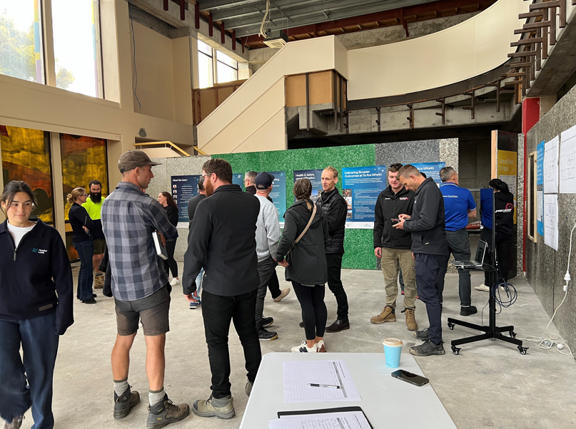
Communications and engagement
On 7 May we ran a session for local sub-contractors to meet the Naylor Love team and find out how they could be part of the project. Approx. 30 different groups attended.
On Wednesday 18 June we are hosting a pre-construction meeting for Mahara Place business operators to meet Naylor Love, find out more about the construction programme and ask questions.
Council staff and Naylor Love talked to neighbours who will be affected by the early works.
We are providing regular updates to local business operators and this will continue throughout construction.
We'll update the community via our normal channels after this briefing.

Slide 7
Next steps
End of June – asbestos investigations
July – Naylor Love site establishment and early works commence
Detailed Design 15 weeks – due mid-August
Naylor Love confirm contract price
September – Building Consent submitted
September to late 2026 – main construction
Late 2026 – Te Ara Whetū opens!

Slide 8
QUESTIONS

Slide 9
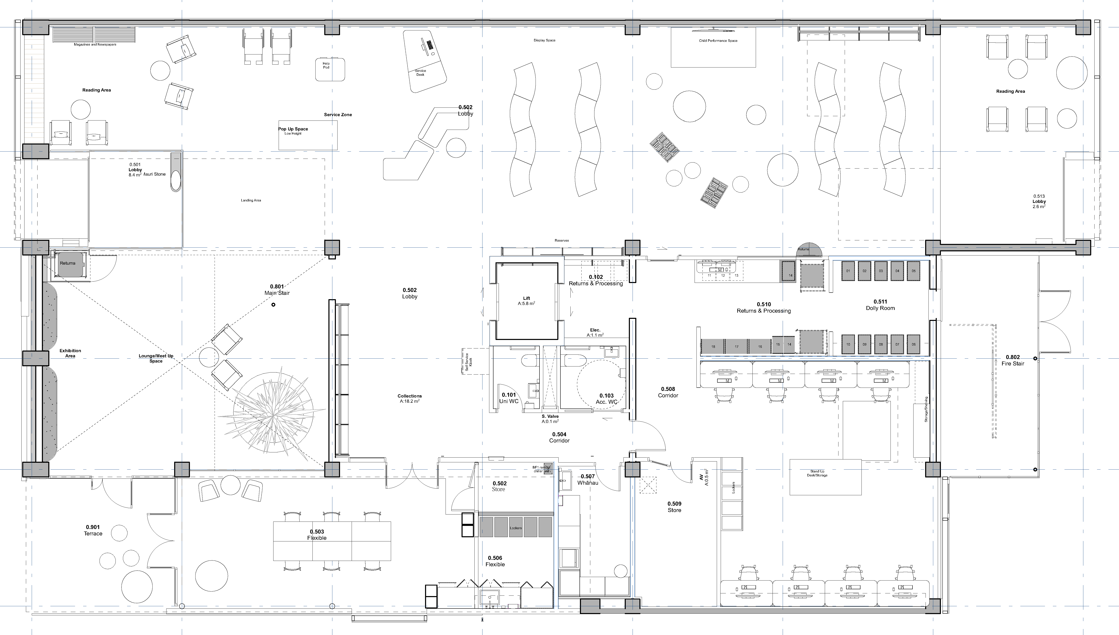
Ground Floor

Slide 10
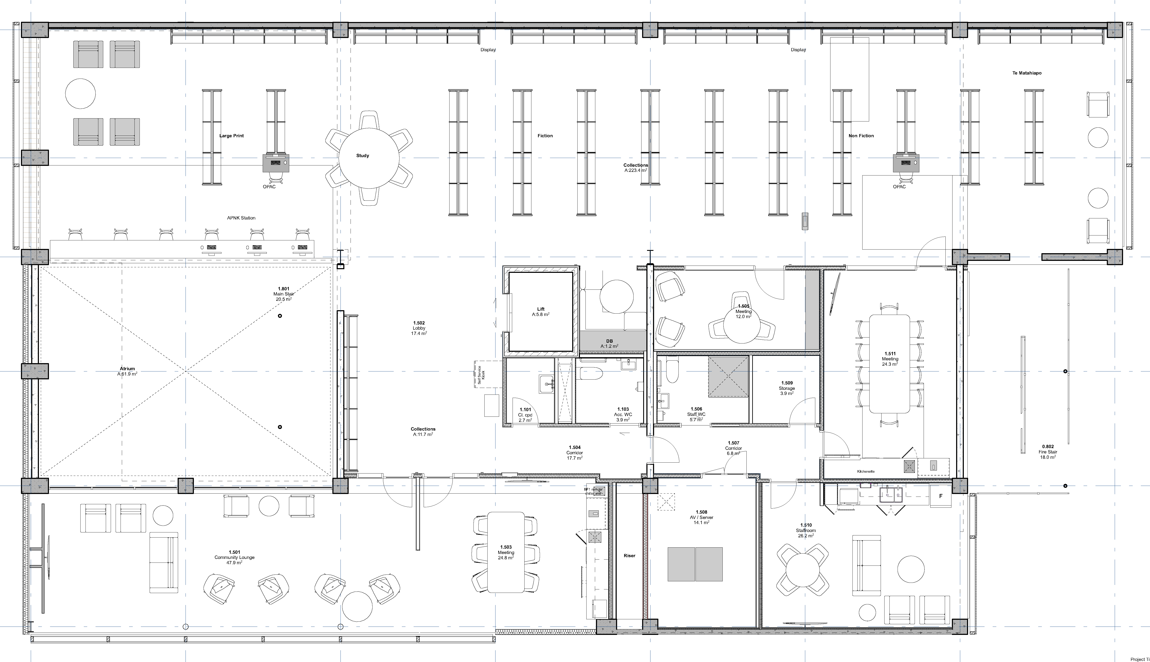
First Floor

Slide 11
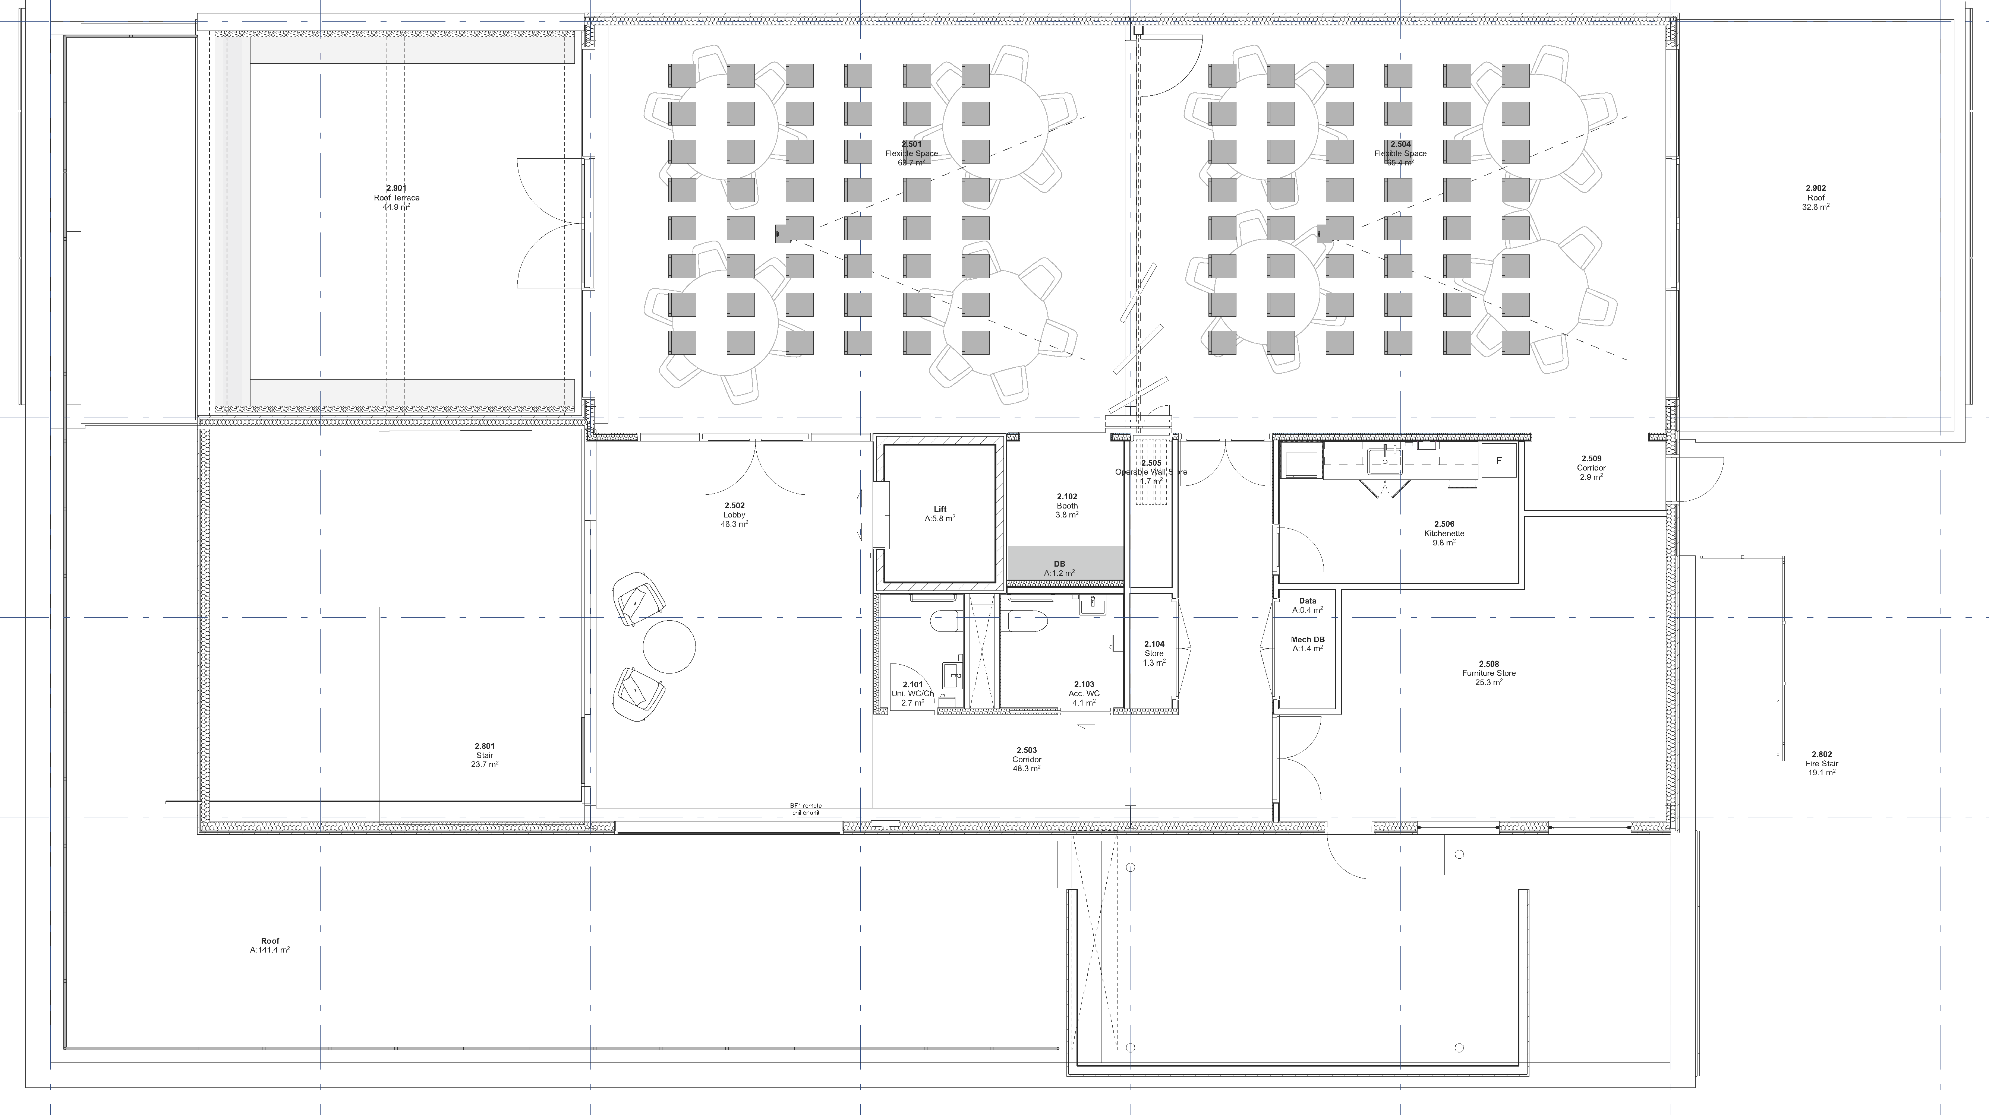
Second Floor

