Slide 1
Temporary Pop-Up
56-62 Main Road Waikanae

Slide 2
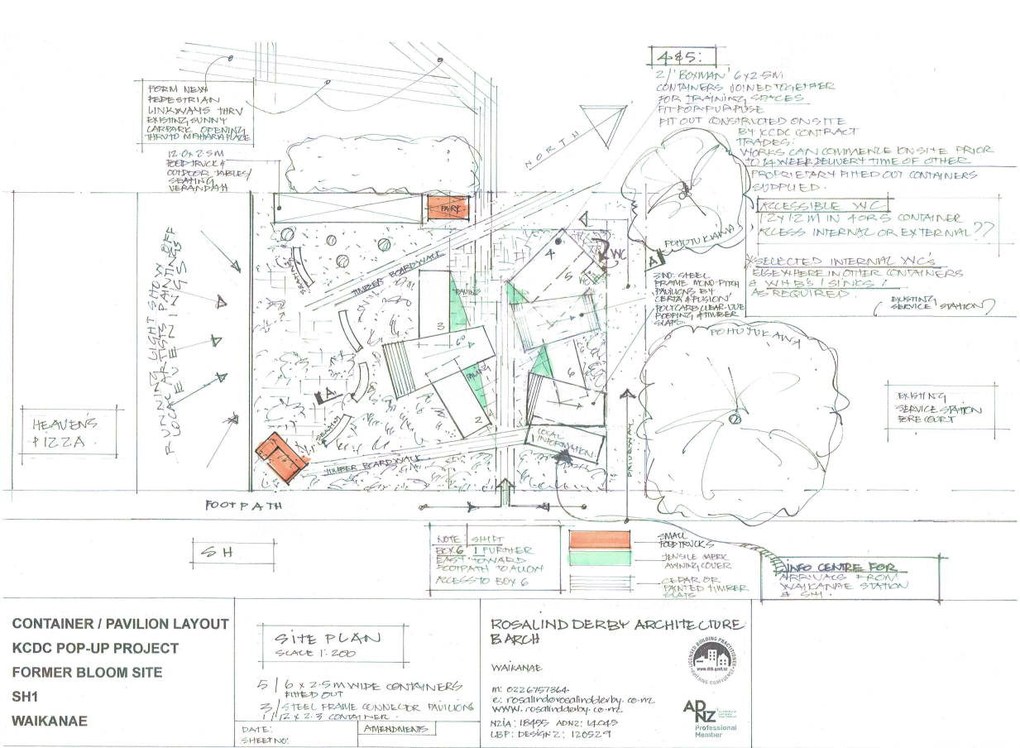
Background
In August 2024, we provided an update on the property at 56-62 Main Road Waikanae and the proposed pop-up development.
At this time we were working to finalise the design and potential uses on site.

Slide 3
Finalised Site Design
The basic layout of the site has now been confirmed and is in general accordance with concept layout. There has been some design changes to ensure the site layout works for accessibility purposes, that we remain within budget and that we are able to get the necessary consents.
Modified shipping containers were selected, because of flexibility and value for money provided. The can also be quickly relocated to other locations in the district in the event of civil emergencies or for similar pop-up activities.
Modifications to the containers are in the process of being completed prior to being relocated to the site.

Slide 4
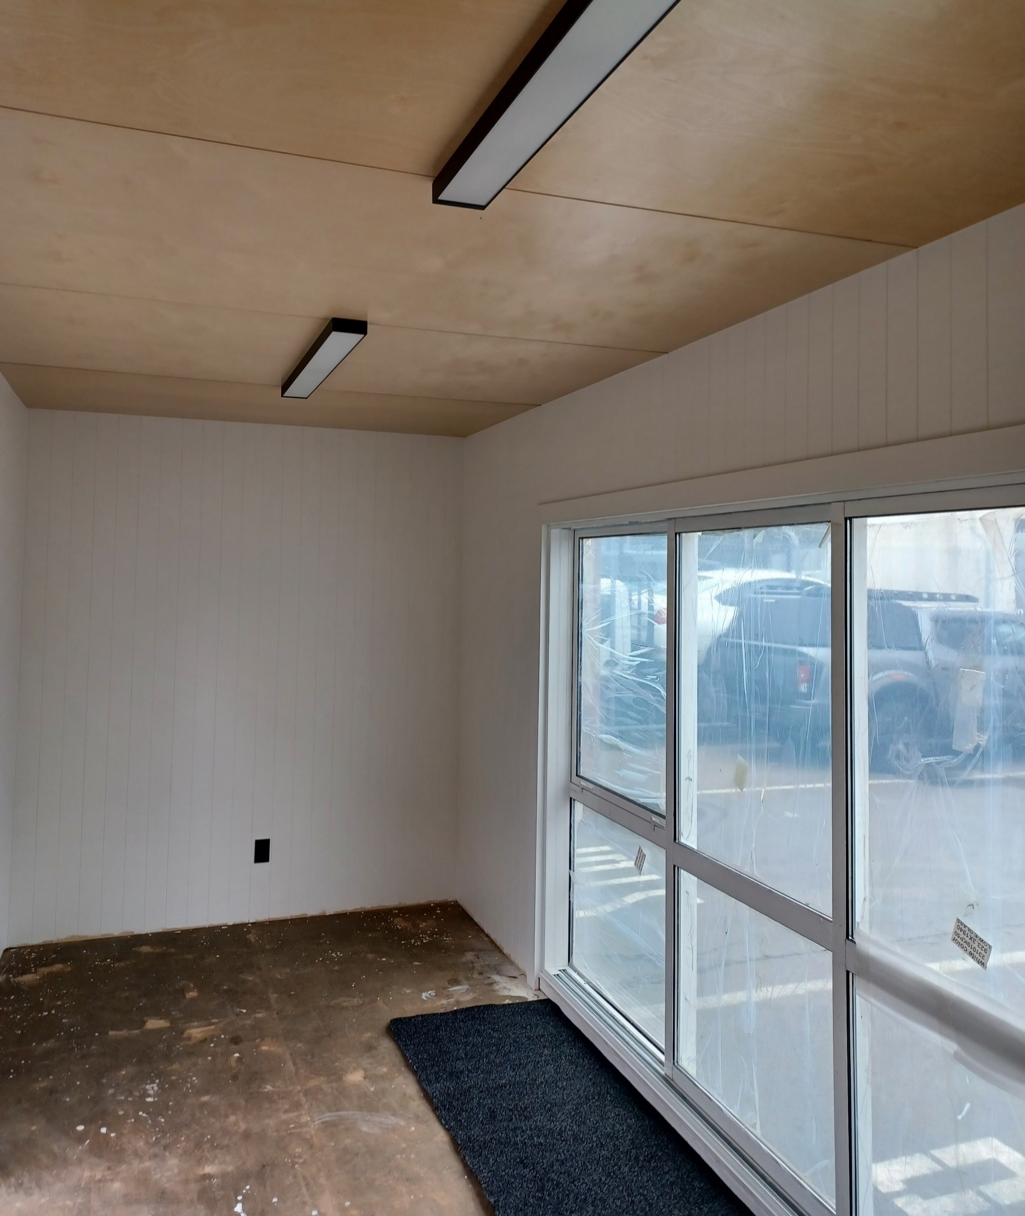
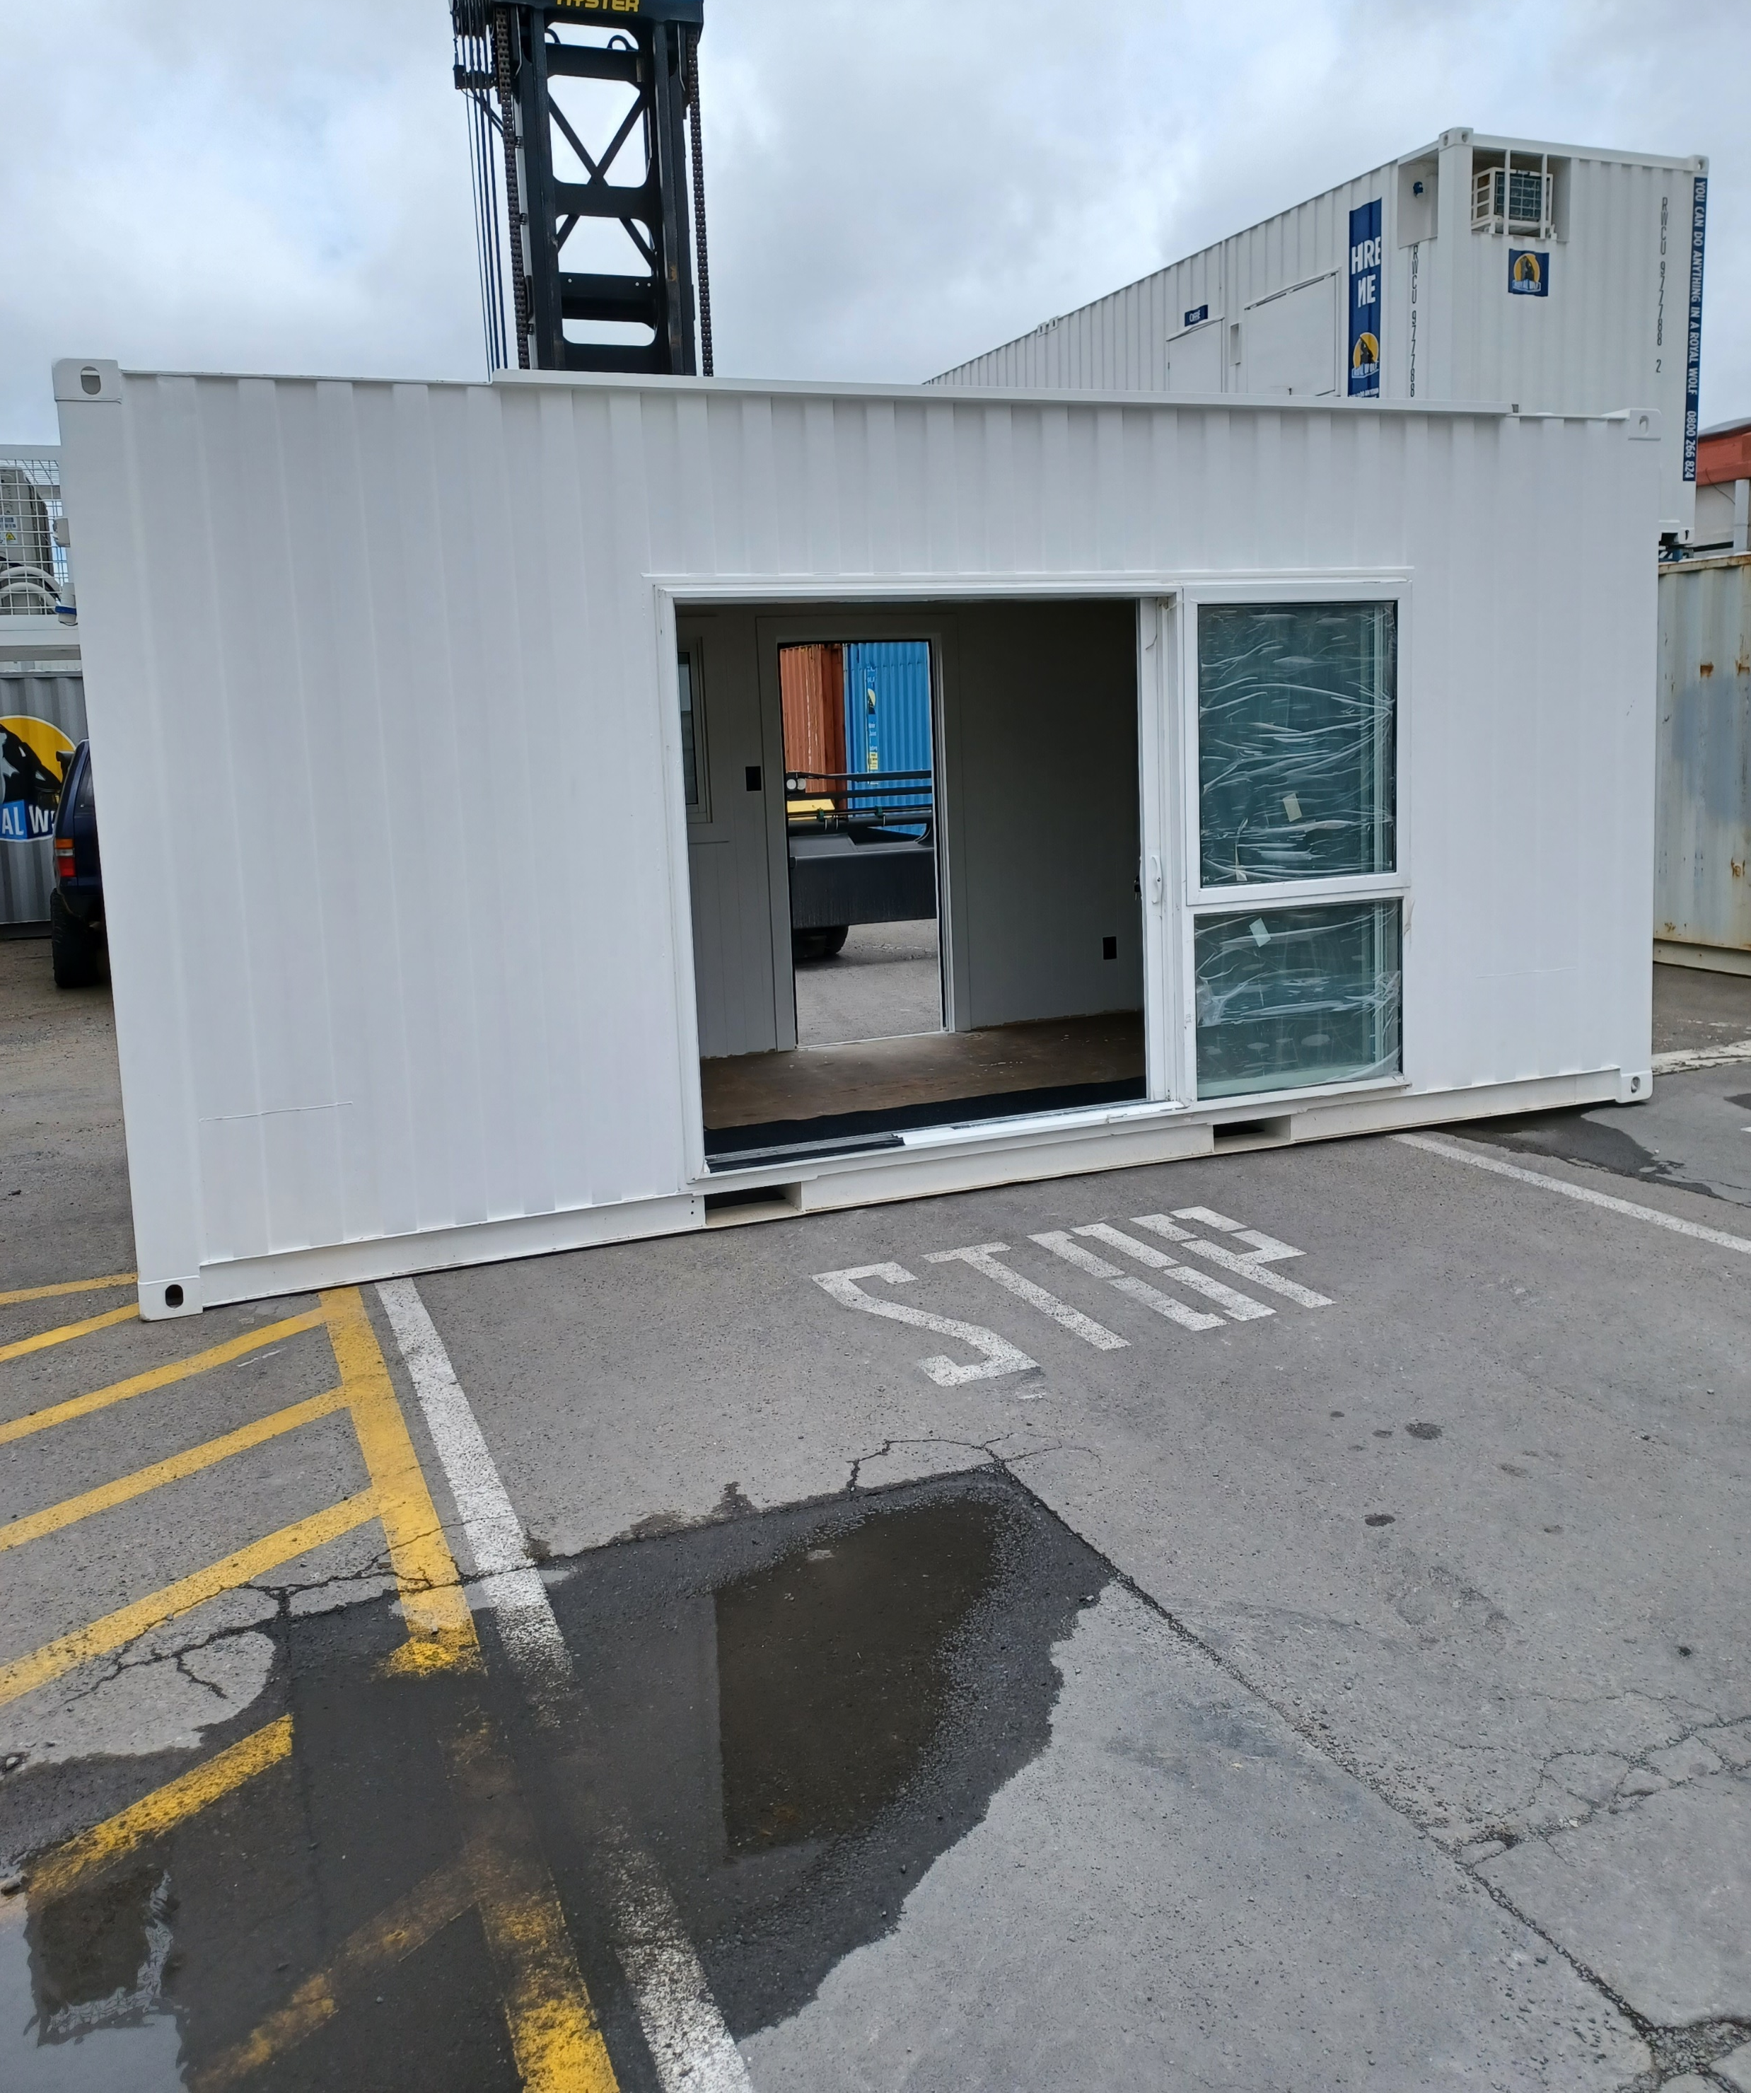
Modified Container Units

Slide 5
Current Situation
A Building Consent is required due to the public accessibility requirements and plumbing/drainage works.
The Building Consent has been lodged and is currently being processed by Councils Building Consent team.
Once the Building Consent has been approved, the site works will commence. This will include ground works for plumbing and drainage, footings for the containers and construction of pathways etc. The containers will then be delivered to site.
Council has been in discussion with the Kāpiti Public Art Panel regarding opportunities around the site, including the exterior of the units.
There is general support from the Art Panel for the activation of the site as public art project and discussions about what this looks like will be progressed.

Slide 6
Project Cost
The following is a high level breakdown of costs for the project:
  Contractors / Consultants $130k
  Modified Containers $100k
  Consents $ 5k
  $235k
The above and ongoing costs will be offset by charges for use of the containers – approx $250 per week per container. Charges will vary depending on length of time and proposed use / user.
We will be proactively working with the Waikanae Business Association on tenanting the containers and options for targeted events / activations.

Slide 7
Opening date
Unfortunately, the steps required to get to this stage have taken longer than expected.
As a result it is unlikely that we will be completed until late December this year. Because of the close proximity to the Christmas / New Year holidays, we are not proposing to open the site until the New Year.
This is to ensure that we are able to keep the site activated and that momentum on site is maintained.
Potential opening date options are being discussed with the Waikanae Business Association.

Slide 8
Next Steps
Following further engagement, the proposed next steps include:
Commence site works following receipt of building consent. Contractors have estimated approximately six weeks to complete this work.
Continue discussions with Iwi, the Kāpiti Public Art Panel, Waikanae Business Association, and other key partners/ stakeholders.
Release information about the options for businesses / organisation looking to occupy the containers.
Confirm opening date.

Slide 9
Questions?

