Slide 1
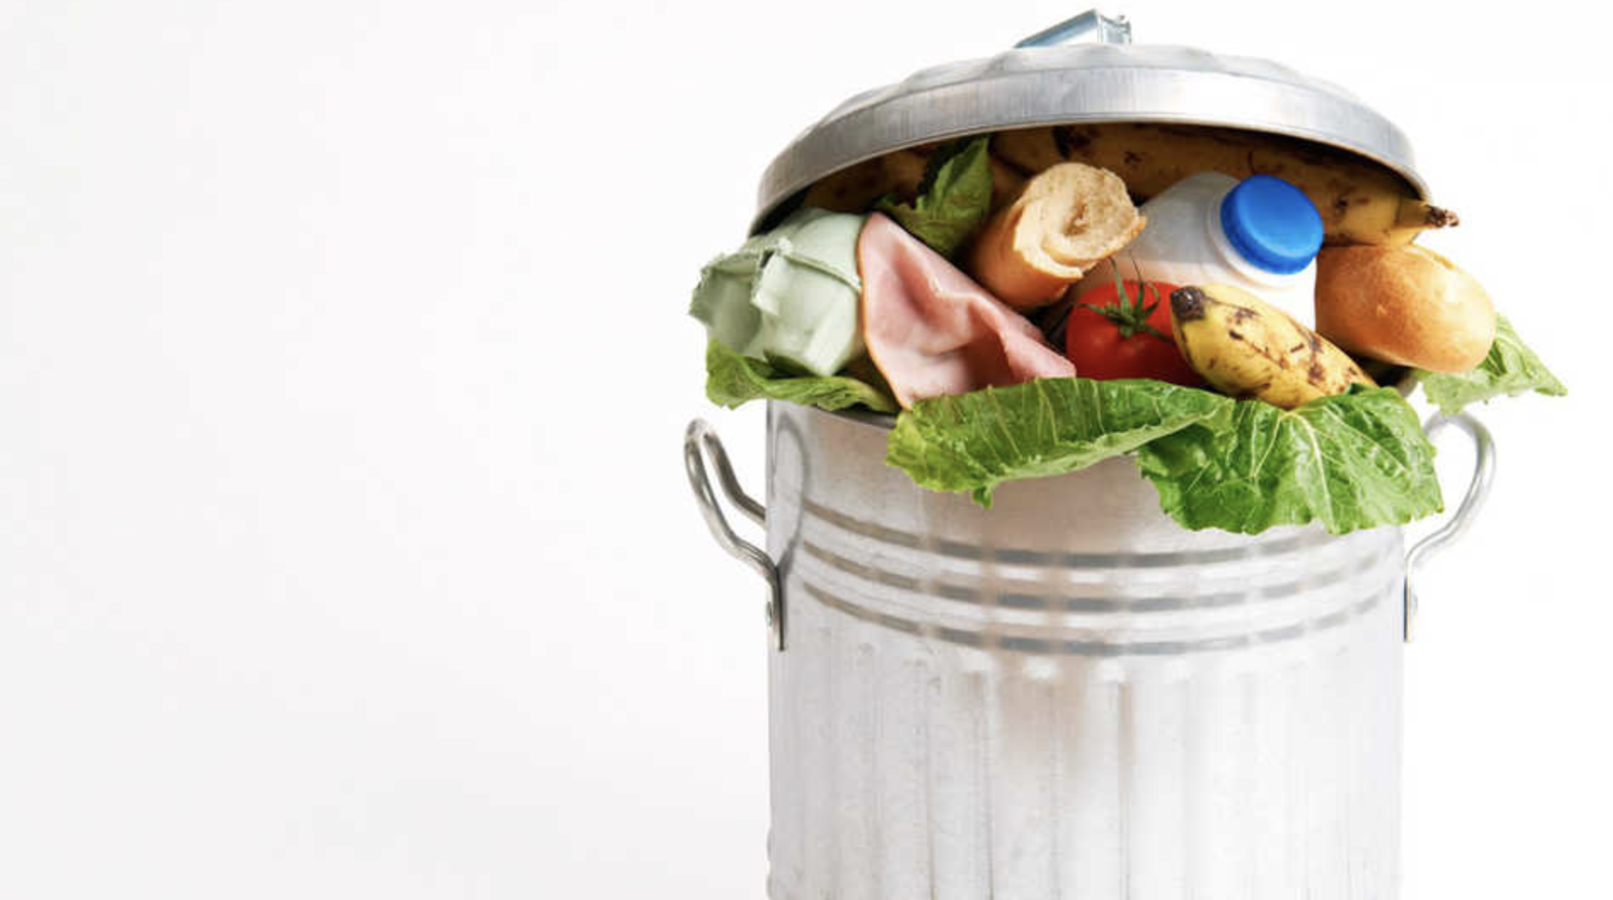
Waste Minimisation Task Force Update
8th Aug 2019

Slide 2
Runsheet of Presentation
Intro members
Task outline
Challenges to the Waste Minimisation Task Force (WMTF)
Local Waste Context
Progress on tasks
Youth perspective
Iwi perspective
Next steps
Summary / key points
Questions

Slide 3
Intro members
David Ledson
The WMTF has nine members - including:
one Youth representative
two community representatives
three iwi representatives, and
two elected Council members
Small membership
Mix of skill sets
No industry/commercial representation

Slide 4
Task outline
David Ledson
The WMTF’s task is set out in Council mandated Terms of Reference. Its purpose is to:
‘Review the actions listed in the 2017 Wellington Region Waste Management and Minimisation Plan(WMMP), and report back to Council on how these actions can be implemented to achieve the most cost effective reduction in the volume of waste materials in the District.’
Broad, comprehensive and extensive - but an opportunity to make a difference

Slide 5
Challenges to the WMTF
David Ledson
WMTF Meeting cycle
Available resources
Shortcomings in the WMPP - process and the plan
Getting out and about
There is a lot of noise in the waste space
BUT
Progress is being made

Slide 6
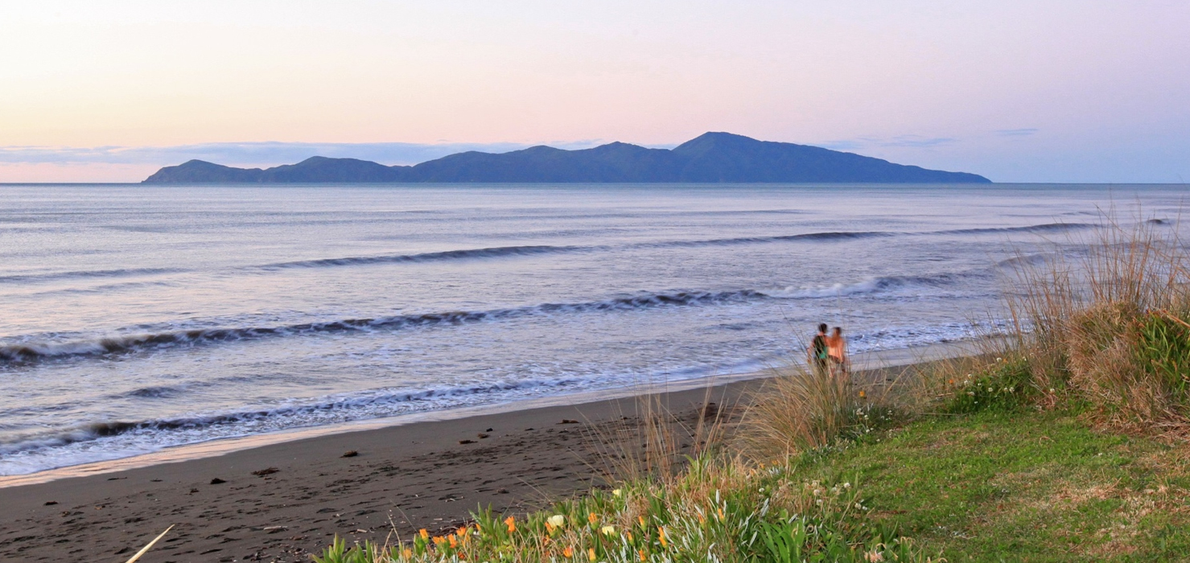
Local Waste Context
Bill Carter
Christchurch sets an example:
Concrete crushing for road fill
Composting of organic wastes
Recycling of wood and fittings
Less than half the Kapiti domestic per capita kerbside collection
Complex but the challenges and solutions not unique

Slide 7
Local Waste Context
The make up of Kāpiti kerbside collection is:
Half either food or green waste (in equal proportions)
One-third waste
The balance, about one-sixth, recyclable materials

Slide 8
Local Waste Context
Given community support, Kapiti could halve the present waste stream to landfill within five to 10 years.
First target is construction and demolition waste recovery.
Second target is demonstration of diversion of commercial food waste to hot rot composting.
Third target is the domestic kerbside disposal of food and green wastes.
Fourth target (and certainly the most difficult) is the waste stream of the several categories of sheet and formed plastics, and the potential for other disposals such as a proportion of hot asphalt roading mix, and the production of fence posts and palings.
An approach to making a difference

Slide 9
WMTF Work Programme
The WMTF first met on 16 May. It has identified five priority projects for the initial phase of its work programme:
Step Up - encouraging central, regional and local government leadership
Educate and Engage - targeted messaging at the right group with the right information delivered the right way
Food and Green waste - capture and process as much as possible before it goes to landfill
Construction, Demolition and Cleanfill - reduce the amount going to landfill
Transfer Station improvements - enable more effective resource recovery

Slide 10
Progress on Projects
Food waste (Project Kai Tiaki) - progressing a submission to the Provincial Growth Fund
Otaihanga Landfill - Identifying ways to responsibly exploit the potential of the site as an opportunity to manage significant waste and environmental challenges
Engagement and education - Education in schools - Kai tiaki, Website, Guidance videos and infographics, social media presence, Information on website, Waste minimization education, Lobbying central Government and involving the community in this, Repair Cafes.

Slide 11
Youth perspective
Sophie Handford
Are you concerned about the amount of waste we send to landfill?
Do you think minimising waste is important?
Do you feel educated about waste statistics in Kāpiti and ways you can reduce your household waste?

Slide 12
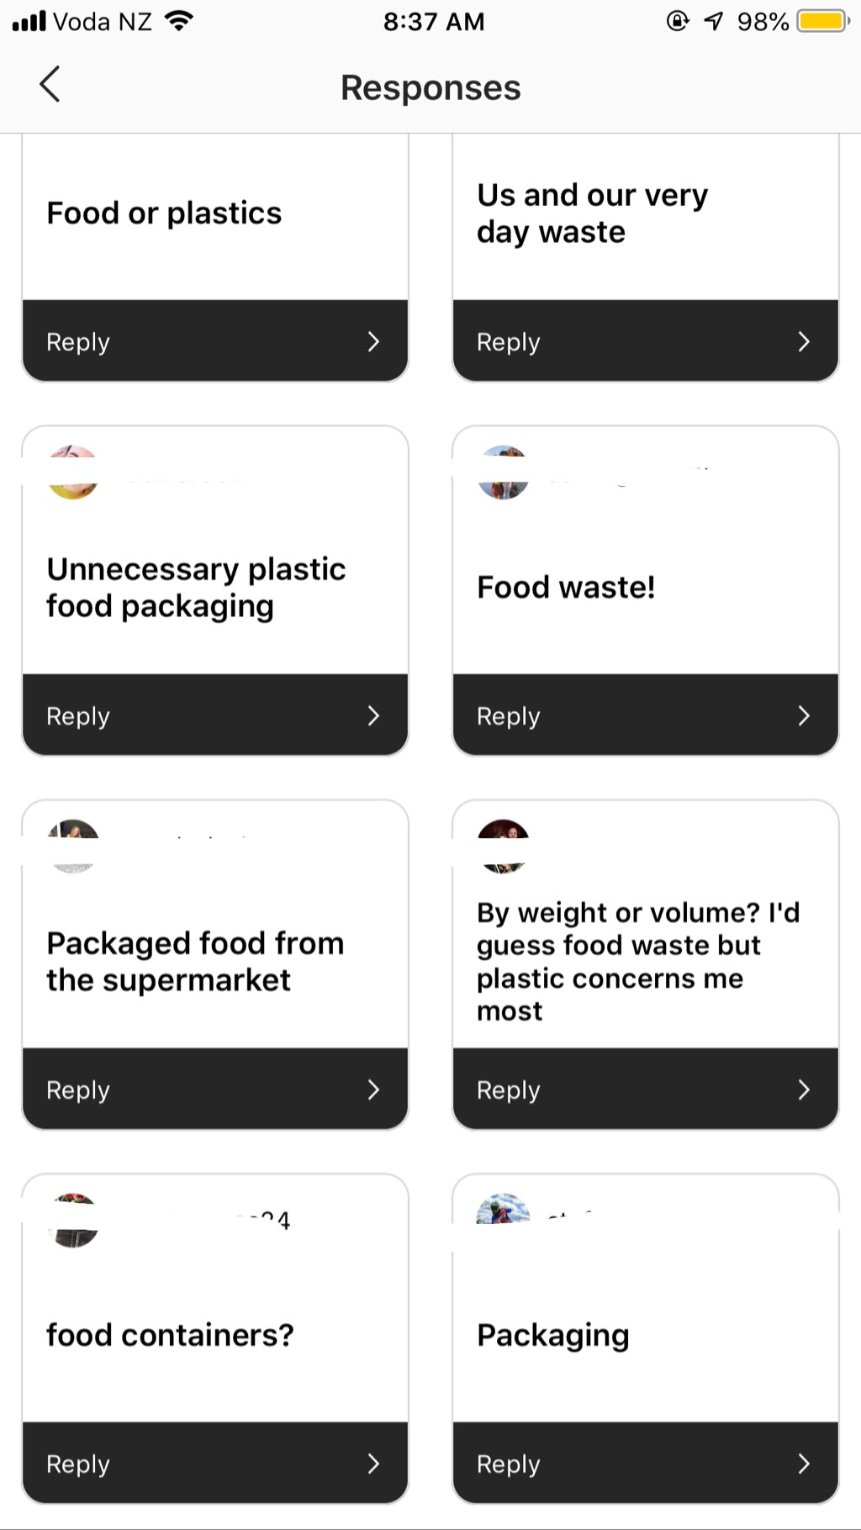
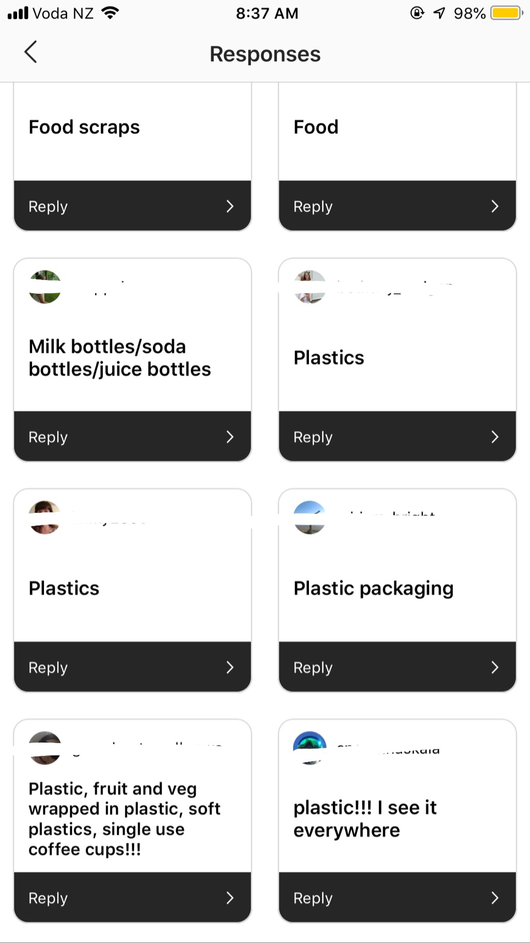
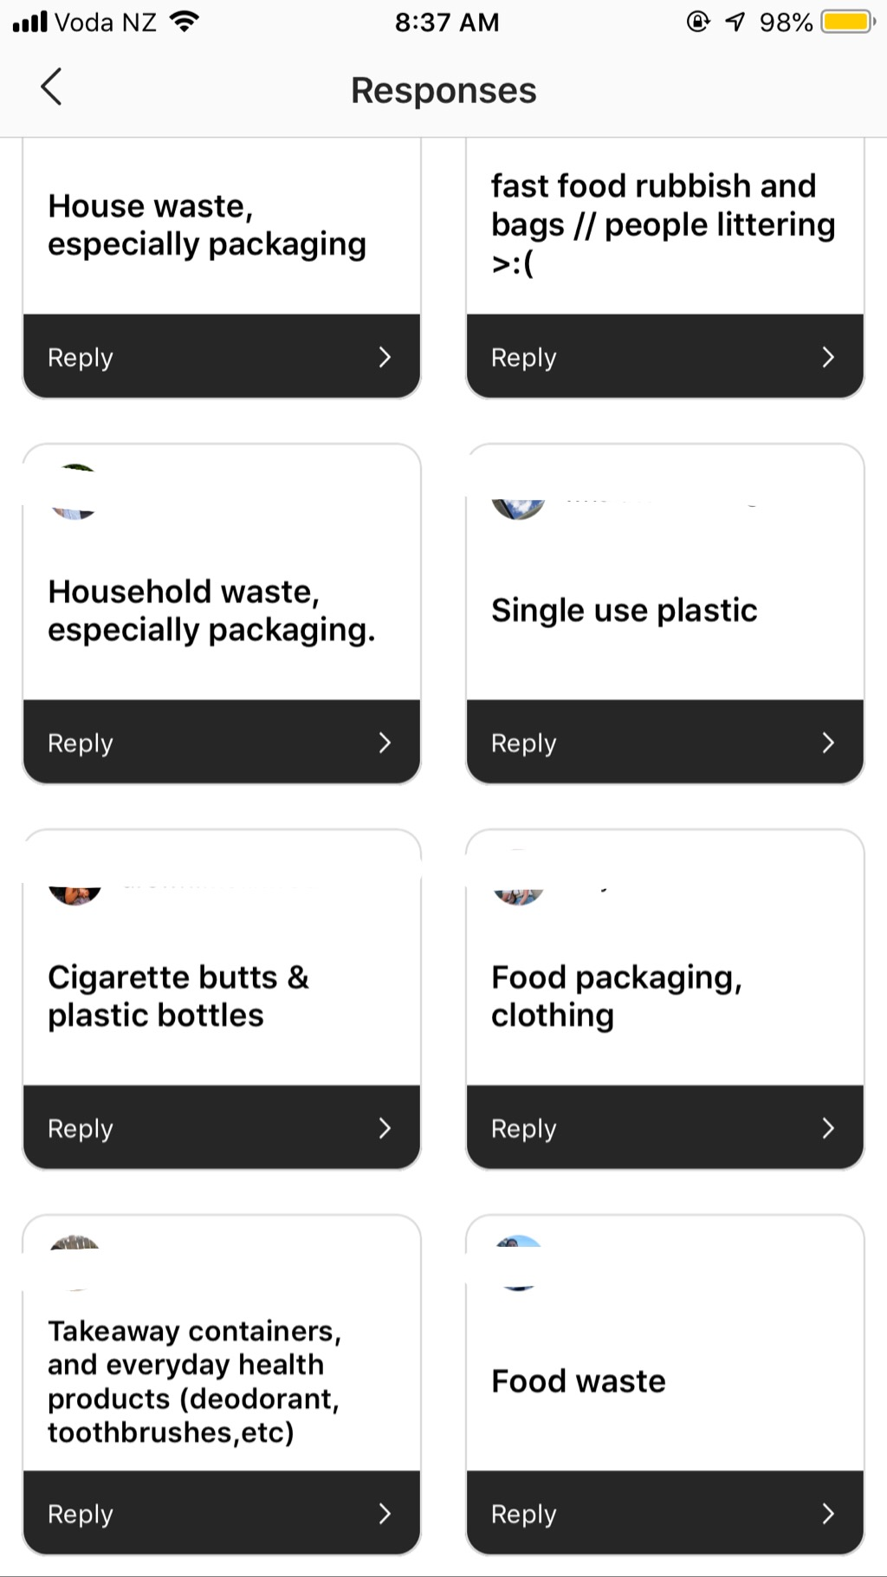
Youth perspective
What do you think makes up the biggest portion of Kāpiti’s waste?

Slide 13
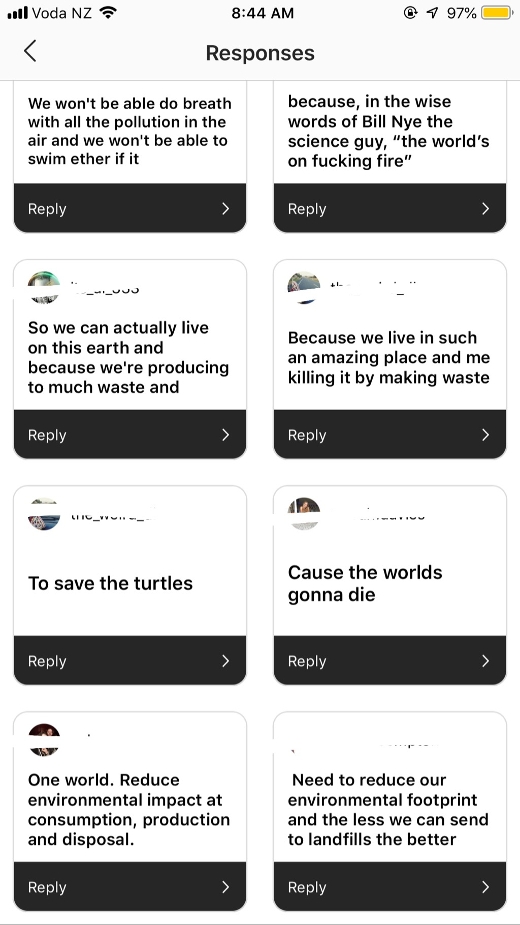
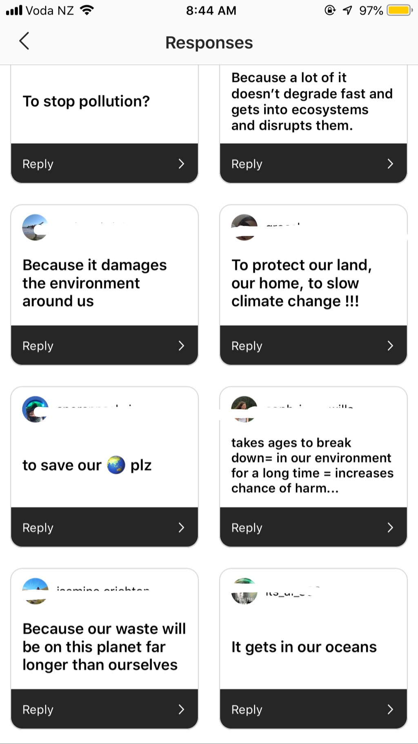
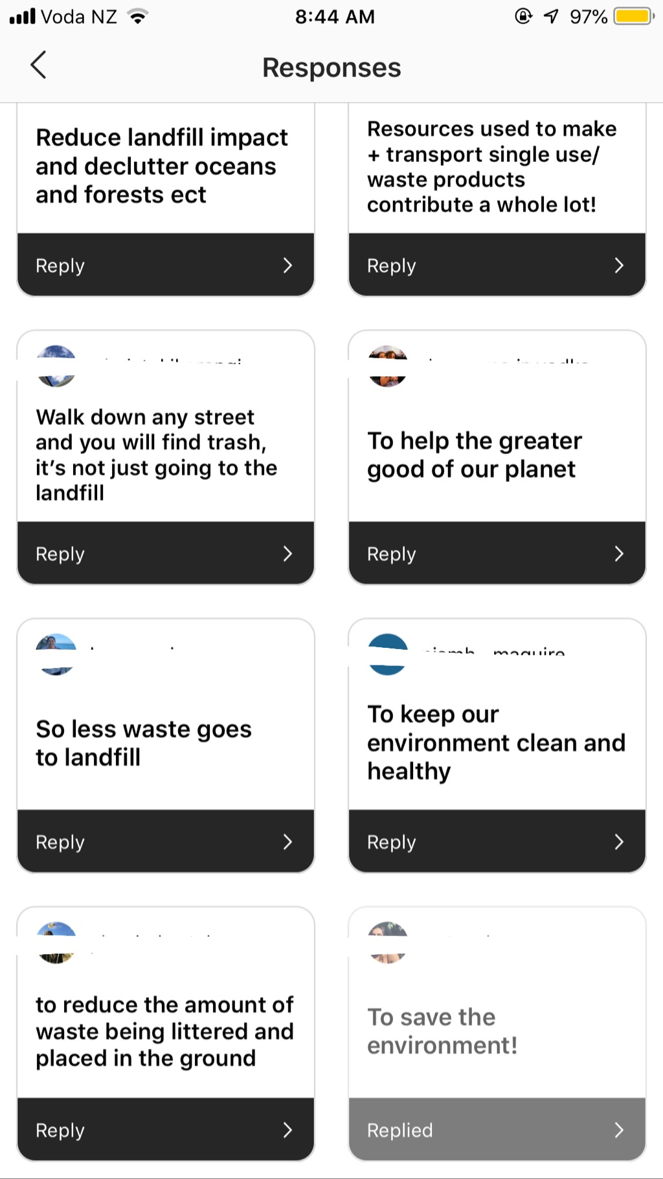
Youth perspective
Why do you think it’s important that we minimise our waste?

Slide 14
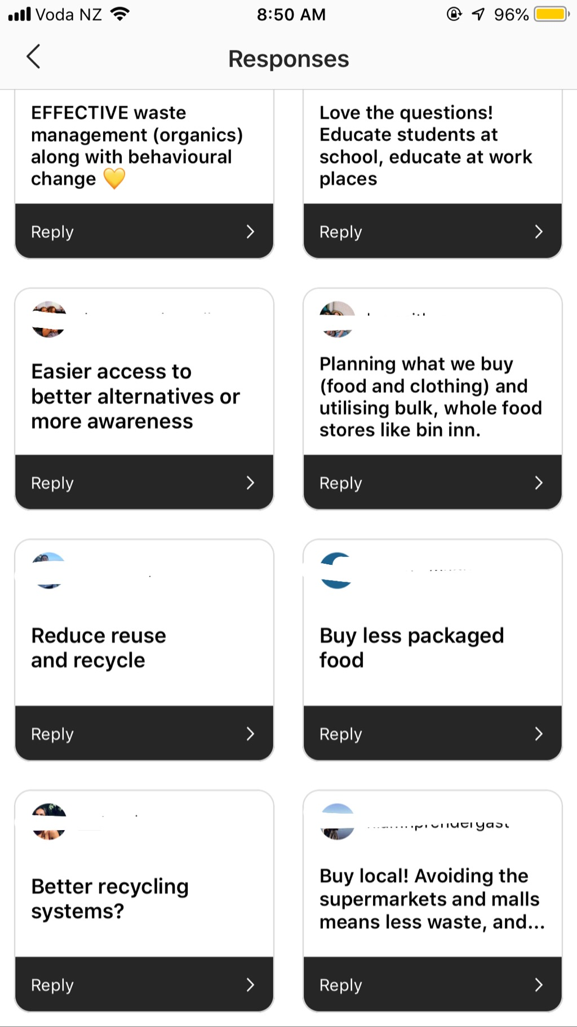
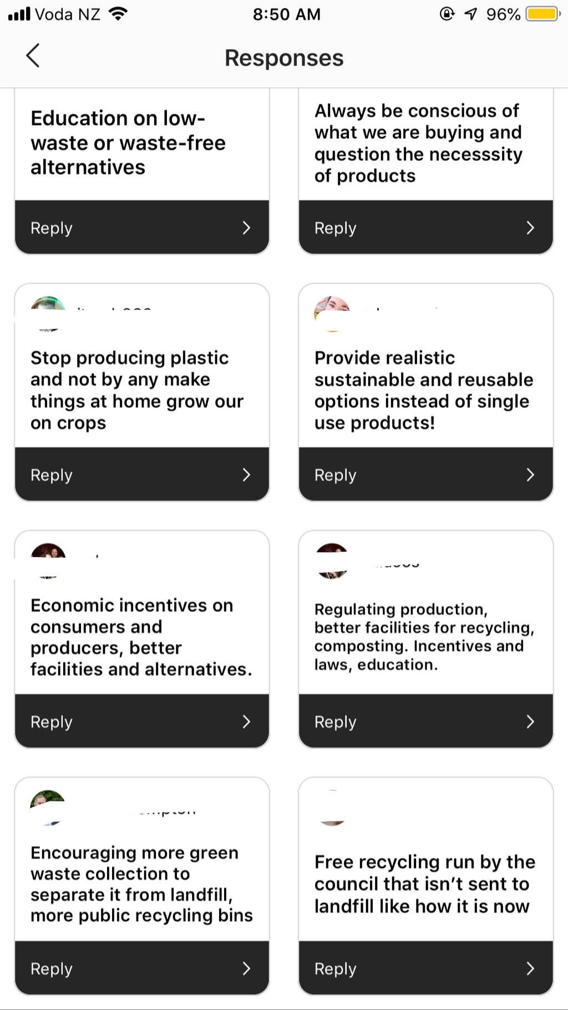
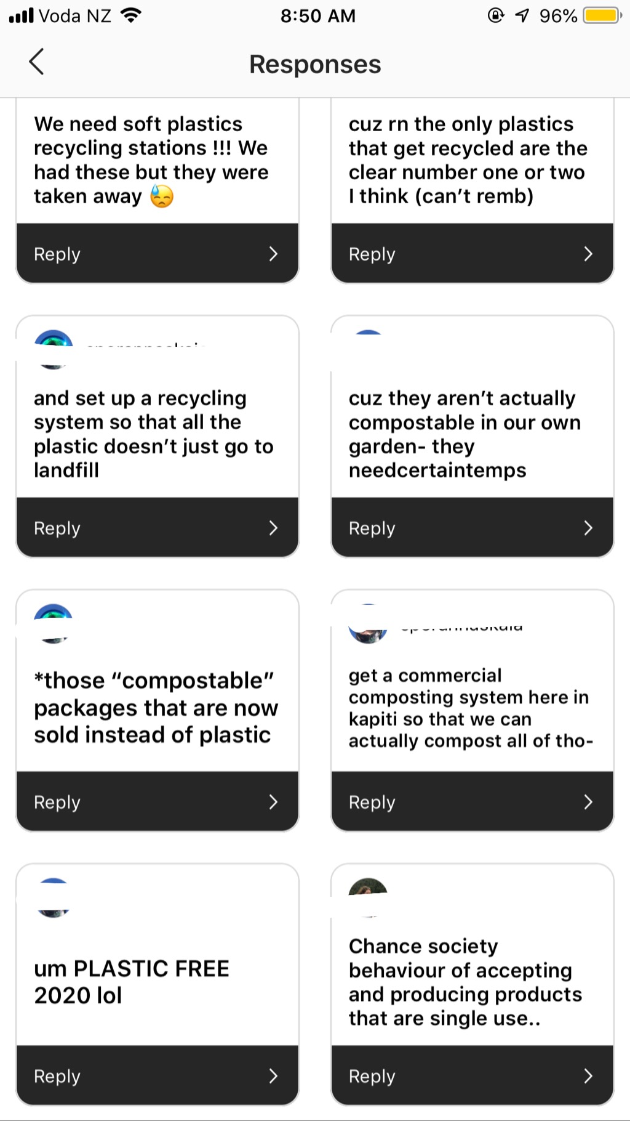
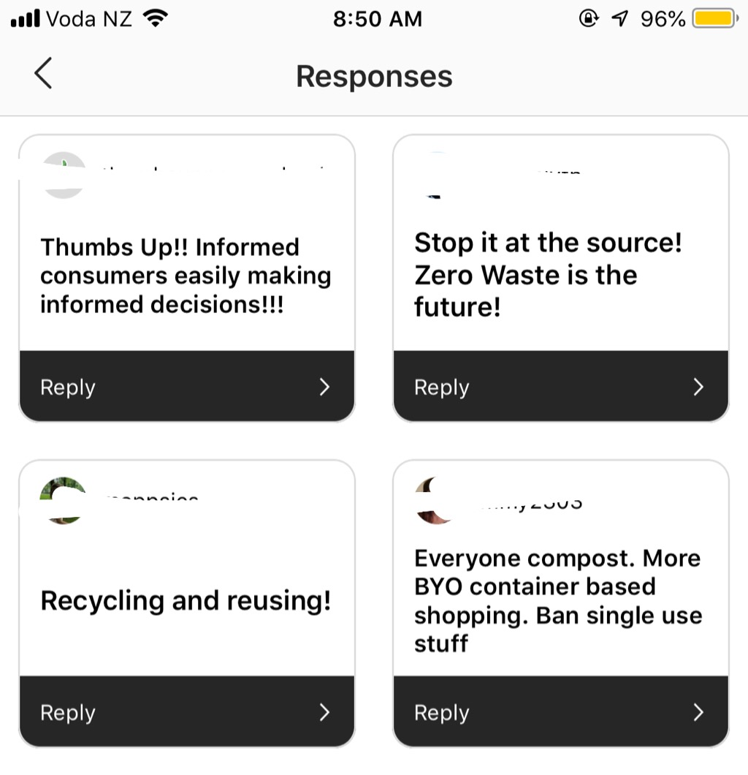
Youth perspective
How do you think we can reduce the amount of waste going to landfill?

Slide 15
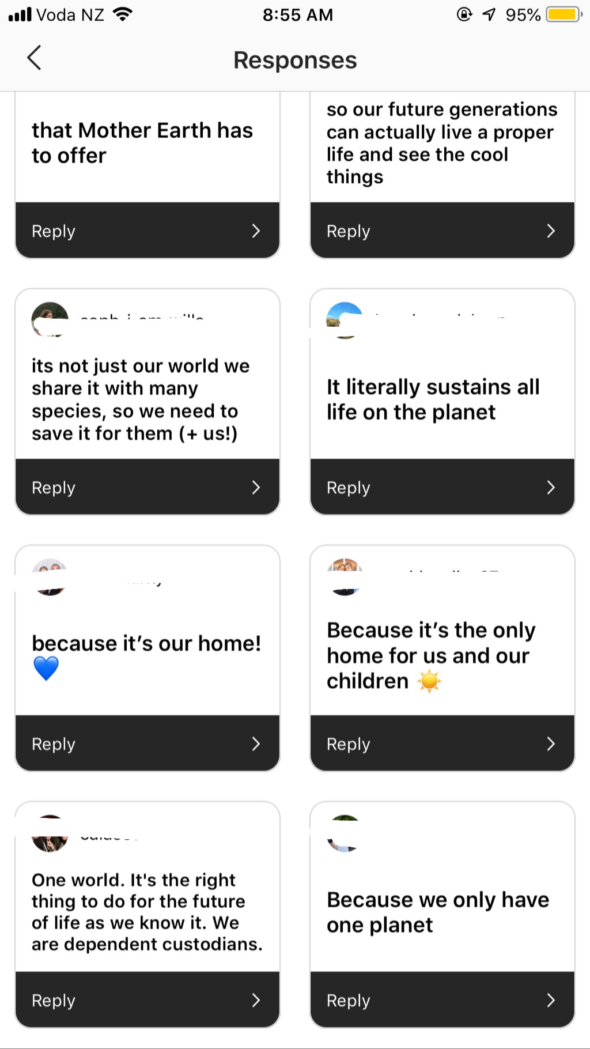
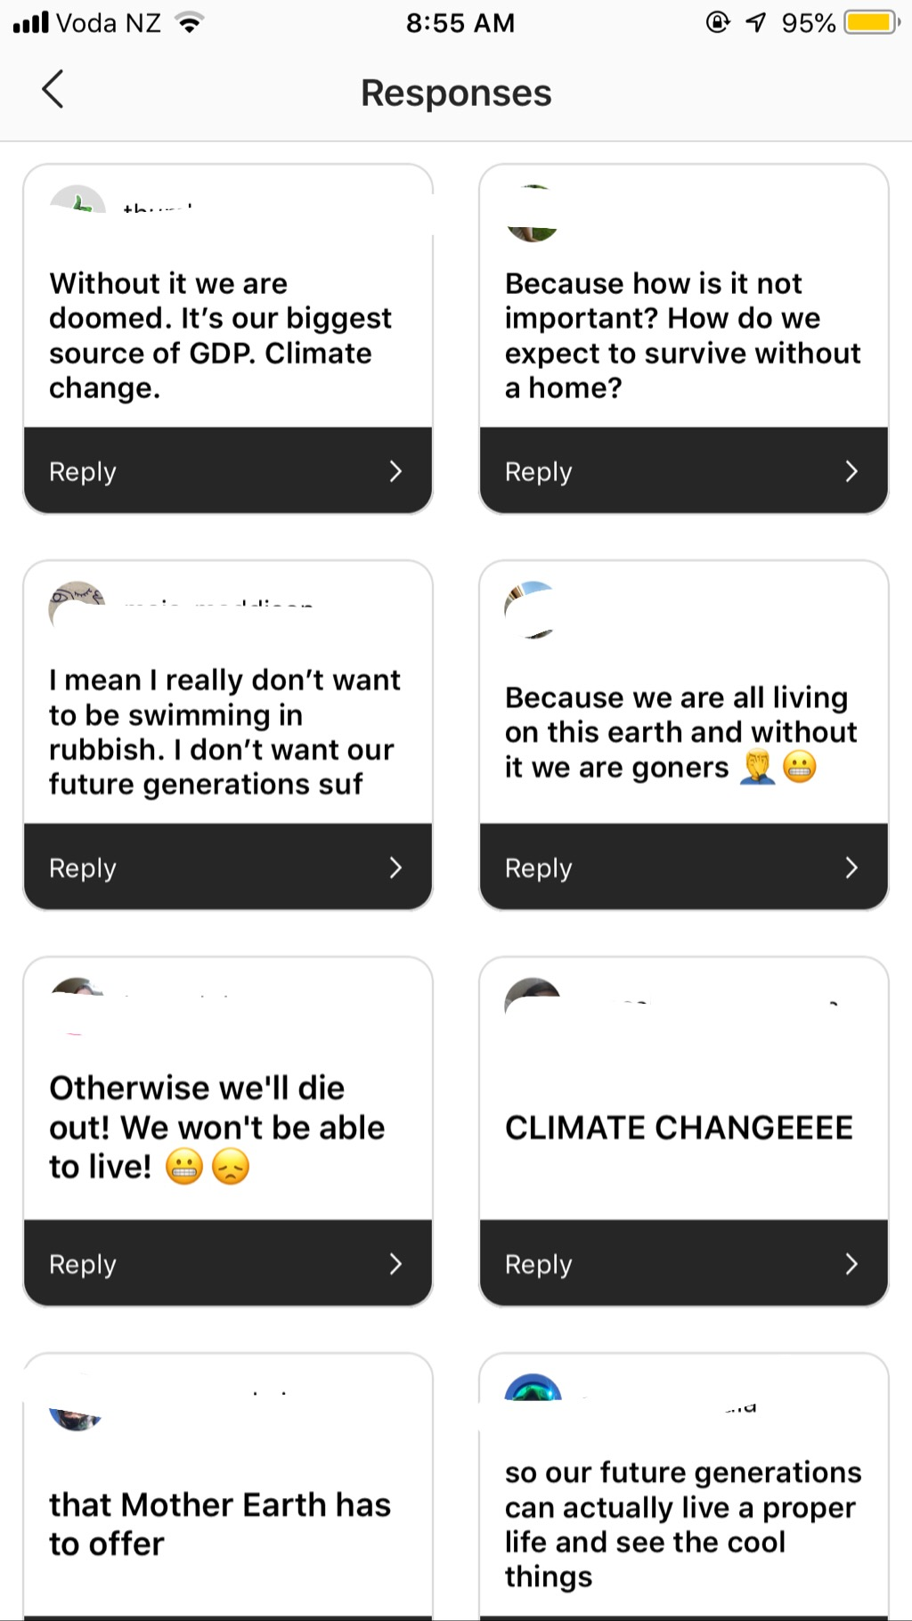
Youth perspective
Why do you think it’s important to look after the planet?

Slide 16
Iwi perspective
Bill Carter
Iwi perspective
General concern for the environment and impact on future generations
Cultural opposition to waste disposal in the rohe of other iwi
Cultural concern for the essential element of water and pollution of streams, beaches and all food gathering areas
Support for waste minimisation and resource recovery
Consistent with broader community interests

Slide 17
Summary
David Ledson
Some challenges but good progress is being made
Projects have been identified that will address key waste challenges facing the District
WMTF members are committed to the work they are engaged in
More good news than bad news

Slide 18
Next steps
David Ledson
Continue to work on the two projects largely under way
Generate momentum in the other three projects
Visit Christchurch to identify good practices that can inform the programme of work
Identify and scope a new project which will address the plastic challenges facing the District
Identify ways to engage outside the Council Building with other stakeholders
Work up a report back to Council by mid-November
Much remains to be done in a few months

Slide 19
Questions?

