Slide 1
Progressing an Environment Strategy
Climate and Environment Committee
22 May 2025

Slide 2
The agreed approach
Environment Strategy - Indicative development schedule
This is a top 10 priority for Council and there is a desire to make progress wherever possible.
Phasing and scoping options were discussed with you on 8 April.
The preferred approach was for an overarching strategy which:
Maps existing strategic direction to provide clarity and alignment.
Leverages what we already know about community aspirations.
Identifies gaps for future work.
Focuses on growing partnerships, expanding monitoring and understanding.
Develops an Action Plan separately (in 2026).
Your feedback was given to the Strategy, Operations and Finance Committee on 15 May who have endorsed a preferred development approach.
Date | Milestone
8 April | Climate and Environment Committee (CEC) provide direction on revised approach (scope and delivery options, see Appendix).
15 May | Strategy Operations & Finance Committee (SO&F) endorse revised approach.
May – July | Iwi partner and key stakeholder engagement.
22 May | CEC provide update and discuss initial direction.
10 June | Open Briefing – discuss draft strategy content.
17 June | Te Whakaminenga o Kāpiti - discuss draft strategy content.
26 June | Council – endorse draft strategy content and approve consultation.
July | Public consultation (dates TBC).
19 August | Open Briefing – discuss feedback and possible strategy revisions.
9 September | CEC – provide feedback on final draft.
18 September | Council – strategy completion.

Slide 3
Proposed structure
Illustrative strategic framework
Keep it simple – domains of focus.
Medium term horizon (3-5 years).
Principles based, not prescriptive.
Future focused.
Adaptive to change.
Alignment not unanimity.
Acknowledging our role but also the roles of others.
Framed by overarching purpose, principles, outcomes and partnerships/relationships.
Specific objectives, shifts and aspirations for each domain.
Next steps:
Discuss principles and values in June 2025
Vision Kapiti + Community Outcomes
Purpose statement
Current State
Where we are
now
Future state
Where we want to be
Principles
Air Quality
Air Quality
Biodiversity
High level transition pathways (aka Focus Areas, )
Biodiversity
Land use
Land use
Water / Ocean Health
Water / Ocean Health
Owners & Stakeholders

Slide 4
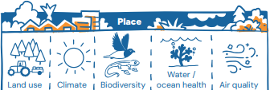
Introducing four domains for focus
The Environment Strategy will cover the ‘place’ elements of the Doughnut Model.
While climate is being addressed through other strategies, the linkages between climate and the environment will be acknowledged throughout.
1
2
3
4
Notes:
Council is one of several actors taking responsibility for the environment.
Government at all levels are involved as are iwi partners, business and our community.
This strategy will draw on local, regional and national direction.
Council does not have all the levers – we need to consider where we can influence and partner.
Notes:
Legislative definition from the RMA
Being defined for working purposes only

Slide 5
Today: areas of focus and feedback
Do the statements for each domain resonate? Any suggested changes (if so, why)?
What does “good” look like to you for the Environment, in terms of measurement/progress?
Are there any clear gaps we need to consider as we progress?

Slide 6
Getting into the ‘Substance’
This strategy is about mapping relevant existing direction
This will be framed under the insights from Vision Kāpiti Stage One
Note these are still draft and will be refined in due course
We will outline:
The challenges we are facing
The drivers/requirements affecting our current approach
The outcomes/aspirations we are working toward
Significant initiatives/actions already in place
Gaps/areas for future work

Slide 7
Leverage existing direction but create some clarity
National direction
Resource Management Act 1991 🔴🟢🔵🟤
Local Government Act 2002 🔴🟢🔵🟤
Reserves Act 1977 🟢🔵
Conservation Act 1987🔴🟢🔵
Biosecurity Act 1993 🔴
Wildlife Act 1953 🔴🟢
Wild Animal Control Act 1977🔴
Marine and Coastal Area (Takutai Moana) Act 2011 🔴🟢🔵
Civil Defence Emergency Management Act 2002 🟢🔵
National Policy Statements 🔴🟢🔵🟤
National Environmental Standards 🔴🟢🔵🟤
NZ Biodiversity Strategy 🔴🟢
NZ Coastal Policy Statement 🟢🔵
Waste and Resource Efficiency Strategy 🔴🟢🔵🟤
Wellington Conservation Management Strategy 🔴🟢🔵
Our actions are already guided by existing direction and requirements.
National and regional direction is shifting – especially through RMA changes and Kāpiti Whaitua
Council already has a lot in place across the four domains.
Some of this direction is dated and potentially misaligned with our current aspirations
The challenge becomes achieving clarity and strategic alignment.
Regional direction
Future Development Strategy 🔴🟢🔵🟤
Regional Policy Statement 🔴🟢🔵🟤
Natural Resources Plan 🔴🟢🔵🟤
Regional Pest Management Plan 🔴🟢
Waste Management and Minimisation Plan🟢🔵🟤
Wellington Regional Erosion Control Initiative (WRECI) 🟢🔵
Wellington Region Emergency Management Group Plan 🟢🔵
Floodplain Management Plans 🟢🔵
Regional Coastal Plan 🔴🟢🔵
Te Whaitua o Kāpiti 🔴🟢🔵
Local direction
Vision Kāpiti 🔴🟢🔵🟤
Long-term Plan 2024-34 🔴🟢🔵🟤
District Plan🔴🟢🔵🟤
Climate Emergency Action Framework 🟢🔵🟤
Coastal Strategy🟢🔵
Open Space Strategy🔴🟢🔵
Stormwater Management Strategy 🔴🟢🔵
Sustainable Water Management Strategy 🟢🔵
Infrastructure Strategy 🟢🔵
Te Tupu Pai – Growing well 🔴🟢🔵
Economic Development Strategy 🟢
Sustainable Transport Strategy 🟢🟤
Reserve Management Plans 🔴🟢🔵
Key:
🔴Biodiversity
🟢Land use
🔵Water
🟤Air quality

Slide 8
Vision Kāpiti – Our North Star … and voice of our community
Everything Council does should be contributing to Vision Kāpiti.
Through stage one, we heard a lot about community aspirations for the environment.
We’ve mapped the insights from these engagements to understand current state, aspirations and what’s needed to achieve them.
We propose using Vision Kāpiti to guide this strategy by:
Using the aspirations and shifts identified to frame the strategy.
Adding additional layers of detail by integrating this with existing strategic direction.
Mapping areas of work underway and identifying gaps for future work.
Identifying relevant measures to understand our current state and track progress toward our aspirations.
Domain | Current state | Aspiration for 2060+ | Required shifts
Biodiversity | We place high value on our natural environment, and show strong support for local conservation initiatives. | Our community would like to see enhanced natural spaces with diverse ecosystems and protected habitats. | Increasing native planting, strengthening pest control programs, reduce damaging environmental practices.
Land use | We are concerned about balancing development with need for housing growth in a way that limits environmental impacts. | Community feedback expresses a desire for sustainable land use that accommodates growth whilst preserving productivity and natural character. | Implementing strategic growth plans, enhancing green spaces, protecting agricultural and conservation land.
Water /Ocean Health | We have a strong appreciation for our proximity to water bodies, as well as some concerns about erosion and water quality. | Community feedback expresses desire for clean, healthy waters with effective management of water use, erosion and flooding. | Improving stormwater management, supporting coastal defences, enhancing water quality.
Air quality | We generally are satisfied with local air quality, though we have some concerns about environmental impact of development. | Community feedback demonstrates a desire for pristine air quality with minimal pollution and ensuring sustainable development practices that will support this. | Continuing practices that support and protect good air quality. Expanding green spaces.
Notes:
Legislative definition from the RMA
Being defined for working purposes only

Slide 9
Biodiversity
Current state
Shifts we need to make
Desired future state
We place high value on our natural environment and show strong support for local conservation initiatives.
Increasing native planting
Strengthen pest control programs
Reduce damaging environmental practices.
We want enhanced natural spaces with diverse ecosystems and protected habitats.
Challenges
Current regulatory requirements
Current initiatives
Gaps/areas for future work
Outcomes & Objectives
Measures

Slide 10
Air quality
Current state
Shifts we need to make
Desired future state
We are satisfied with local air quality, though we have some concerns about the impacts of development.
Continuing practices that support and protect good air quality.
Expanding green spaces.
We want pristine air quality with minimal pollution. We want sustainable development practices that support this.
Challenges
Current regulatory requirements
Current initiatives
Gaps/areas for future work
Outcomes & Objectives
Measures

Slide 11
Land use
Current state
Shifts we need to make
Desired future state
We are concerned about balancing development with the need for housing growth in a way that limits environmental impacts.
Implementing strategic growth plans
Enhancing green spaces
Protecting agricultural and conservation land.
We want sustainable land use that accommodates growth whilst preserving productivity and natural character.
Challenges
Current regulatory requirements
Current initiatives
Gaps/areas for future work
Outcomes & Objectives
Measures

Slide 12
Water/Ocean health
Current state
Shifts we need to make
Desired future state
We have a strong appreciation for our proximity to water bodies, as well as some concerns about erosion and water quality.
Improving stormwater management
Supporting coastal defences
Enhancing water quality.
We want clean, healthy waters with effective management of water use, erosion and flooding.
Challenges
Current regulatory requirements
Current initiatives
Gaps/areas for future work
Outcomes & Objectives
Measures

Slide 13
Circling back: areas of focus and feedback
Do the statements for each domain resonate? Any suggested changes (if so, why)?
What does “good” look like to you for the Environment, in terms of measurement/progress?
Are there any clear gaps we need to consider as we progress?

Slide 14
Appendix 1: background material

Slide 15
A reminder - Scope and delivery options
 | Option 1 – Environment Framework (Meta-Strategy) | Option 2 – Full Environment Strategy | Option 3 – Full Environment Strategy (Phased) | Option 4 – Reduced scope Environment Strategy | Option 5 – No Strategy
Description | Describes the environment as we understand it and council’s roles and responsibilities toward it. | Comprehensive strategy that reflects community and iwi aspirations for the environment. | Phased development of a comprehensive strategy that reflects community and iwi aspirations for the environment. | Develops a strategy to improve biodiversity and/or air quality. | Seeks endorsement of an approach to monitoring and partnership development. No strategy document as an output.
Scope | Comprehensive – Land, Air, Water, Biodiversity. Consolidates existing strategic direction (as opposed to developing new direction). Outlines the roles and responsibilities of Council and other actors. Identifies gaps and opportunities. Improves monitoring and collaboration. | Comprehensive – Land, Air, Water, Biodiversity. Creates new strategic direction (noting what we already know through VK). Identifies desired future state and changes required to get there. Supported by comprehensive action plan. | As for option 2 but delivery phased as follows: Phase 1 – Biodiversity & Air Quality. Phase 2 – Land use. Phase 3 – Freshwater management. | As for Option 2 but scope limited to only focus on air and biodiversity. | Improved monitoring and environmental intelligence (State of the Environment report/dashboard). Deeper collaboration through improved relationships with GWRC, iwi etc. Prioritising a response to Whaitua and preparing for upcoming reforms.
Advantages | Allows a strategy to be completed prior to the election. Recognises the significant amount of existing strategic direction. Emphasis on growing partnership, monitoring and understanding. Allows for work to continue on response to Whaitua and RMA reform. | Likely to provide most comprehensive direction and actions. Potentially creates a more enduring framework. Positions council proactively to respond to upcoming reforms. | Provides a manageable approach to delivering elements of the strategy. Allows progress to be made while RMA reform and Whaitua are worked through. | Allows progress to be made while RMA reform and Whaitua are worked through. | Recognises the substantial amount of existing strategic direction on environmental issues. Allows Whaitua recommendations to continue being worked on. Recognises the continuing uncertainty posed by RMA reform. Least time and resource intensive to deliver.
Disadvantages | May not meet community expectations. Places strong reliance on other actors and work already underway. | Not achievable before the election. Potentially duplicates existing strategic direction. Minimal opportunities for new council investment given current financial strategy. Significant engagement required. Reforms may require change in direction. | Crosses the election period. Air quality already a focus of the Climate Mitigation Strategy. Biodiversity affected by upcoming RMA changes. Minimal opportunities for new council investment given current financial strategy. | Limited scope for further Council action in this area – very reliant on central and regional govt. Potentially creates a strategy with an incomplete view of the environment. May not produce added value beyond current approaches. | Does not give effect to the Top 10 priority. May not meet community expectations.
Indicative timeframe | 4-5 months Complete - Aug-Sep 2025 | 12-15 months Complete – Apr-Jun 2026 | Phase 1 – Aug-Sep 2025 Phase 2 – Mar-Apr 2026 Phase 3 – Jul-Aug 2026 | 4-5 months Complete - Aug-Sep 2025 | 1 month Report back to CEC May 2025
Other considerations | Engagement with iwi still required and may be difficult to achieve in timeframe. | The election period creates a longer timeframe as does a higher engagement requirement. | Delivering a full strategy on biodiversity and/or air quality would be challenging given the need to develop direction with iwi and community. | Significant existing direction on biodiversity in the Open Spaces Strategy and air quality in the upcoming Emission Reduction Strategy.
Notes:
Options 3 and 4 – The phasing and scope inclusions are just ideas based on what we think would make the most sense

Slide 16
Principles
Example: Draft Emissions Reduction Strategy principles
Principles | Because...
Be fiscally responsible | ...the community expects the Council to use funding for climate action wisely, in ways that maintain or improve service delivery and help cut operating and debt servicing costs.
Focus on greatest gross emissions reduction opportunities | …this has more co-benefits, including economic innovation, transformation and more sustainable growth, maximises the impact of limited Council resources (time, people, funding), and because relying on emissions offsetting is not a long-term solution for achieving net zero.
Be ambitious and ‘SMART’ when setting objectives | ...the urgency of climate change demands we move quickly, with purpose and aligned with the latest science, so objectives must be specific, measurable, achievable, relevant, and timebound (‘SMART’).
Apply a just transition lens to all our actions | ...to be sustainable, change must be fair for current and future generations and help address, not embed, existing inequalities.
Incorporate mātauranga wherever possible | ...the knowledge of mana whenua brings a unique and holistic approach to climate action
Take a ‘systems’ approach | ...climate change is complex, interconnected and dynamic. Actions must be well designed to deliver integrated, adaptive solutions that capture multiple benefits and avoid unintended consequences.
Lead where the Council can | ...we must ‘walk the talk’ and because Council’s leadership, directly and indirectly, unlocks climate action by others.
Advocate where needed | ...there is much that depends on the actions of others, especially by national and regional government decision makers.
Engage, consult, & enable partners | ...to succeed, the Council must work with, learn from and enable our iwi partners and community stakeholders, including our most vulnerable, helping leverage greater change through education and grant funding initiatives.
Amplify not replicate the work of others | ...the Council can’t and doesn’t need to do everything, but it can champion and promote the good work of others to accelerate positive change.
Principles sit at the heart of good strategy, providing flexibility to enable effective delivery
They provide ‘guardrails’ for action and act as the criteria against which all action plan activities can be assessed, filtered, and prioritised.
In the environment context, principles are most likely to be informed by values.
We will discuss draft principles with elected members in June.

Slide 17
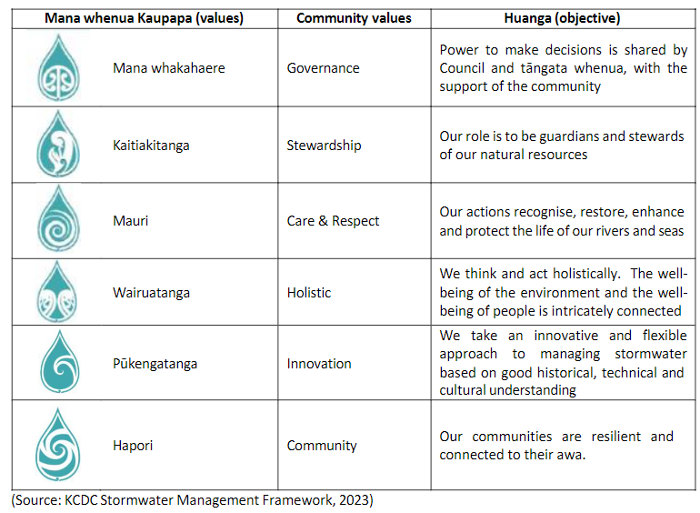
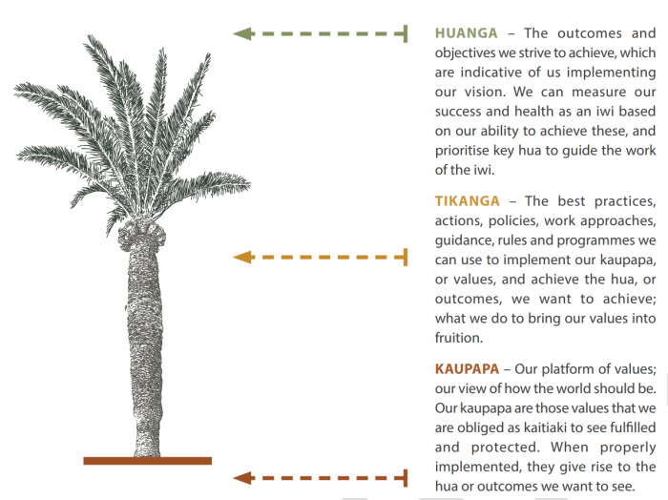
Values are particularly important in this context
KCDC Open Space Strategy 2022
KCDC Stormwater framework 2023
Te Ātiawa climate values statement 2023
Kaupapa framework
Whakapapa | our genealogy and connection to each other, past generations, future generations, and the environment
Wairua | the aspect of wellbeing that reflects the connection between the mental, emotional, psychological and spiritual human conditions and the physical and non-physical aspects of the environment
Mana | the security and authority held by whānau, hapū and iwi because of their status as mana whenua and their Te Tiriti o Waitangi right to tino rangatiratanga of taonga. The Treaty granted local government kāwanatanga, and local government and iwi work together to achieve Treaty partnership .
Māramatanga | the knowledge created over generations of observation and interaction with the environment . This knowledge guides decision-making
Te Ao Tūroa | the world of natural order, balance and pattern that connects the elements of the environment, and the understanding that environmental components cannot be viewed in isolation
Mauri | the essential energy required for all life . It is a systemic quality that speaks to the quality of processes and systems as opposed to individuals .
We want to look across existing values frameworks, group common values and test this with iwi partners.

